Slide 1
Digital Cookie
Family Training

Slide 2
What is Digital Cookie and Who Uses it?
Getting Started
Digital Cookie Pages
Mobile App
Customer Experience
Digital Cookie Help
Notes:
Note to council: you may want to update the agenda to the specific topics you will cover. You may choose not to cover all the topics in this presentation. Slides that have new pieces for the 2027 season have a NEW burst added to them.
Script:
The Digital Cookie Family Training will cover the following agenda items, :: List Items on Slide::. All images shown reflect how the site appears when accessed via a mobile device.

Slide 3

Digital Cookie® is a powerful online selling platform that expands opportunities for Girl Scouts to participate, connect with customers, and build valuable skills. With user-friendly tools and flexible selling options, Digital Cookie helps girls maximize their cookie sales. Research shows that combining Digital Cookie with traditional sales methods can lead to increased sales and faster goal achievement.
Notes:
Script:
Digital Cookie® is an online selling platform that provides Girl Scouts with easy-to-use tools and multiple opportunities to develop entrepreneurial skills. As eCommerce continues to grow, Digital Cookie helps Girl Scouts expand their reach, connect with more customers, and maximize their cookie business. Now that we've explored what Digital Cookie is, let's take a look at the different user roles and who can use the platform.

Slide 4
Girl Scouts use Digital Cookie to supercharge their cookie business!
Girl Scouts create their own sites and share their link with customers through email, text, or social media.
Troop Cookie Managers use it to set up and manage sales for their troop's online sales site, including taking payments at a cookie booth through the mobile app.
Girl Scouts take orders and track purchases (Customers purchase cookies).
Troop Cookie Managers support Girl Scouts and families with visibility to their online progress.
Girl Scouts and caregivers can manage their online sales, inventory, and financials using Digital Cookie.
Notes:
Script:
• Digital Cookie is primarily used by Girl Scouts and their caregivers. Girl Scouts can create and personalize their online storefront, send marketing emails to customers, and manage their online sales. Together, Girl Scouts and caregivers can track orders, monitor inventory, review financial information, and follow customer purchases.
• Troop Cookie Managers use Digital Cookie to support Girl Scouts and families throughout the cookie program. They have visibility into troop and individual online sales activities and use the platform to set up and manage the troop's online sales site, track performance, and support online selling efforts.

Slide 5

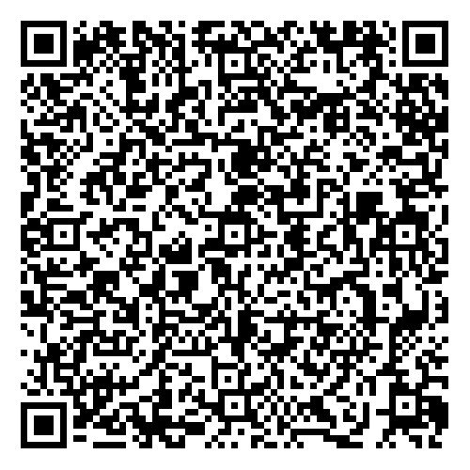
Registering for Digital Cookie
1
January 5 (12am CST)
2
3
Receive Email
Click “Register Now”
Create password & Login
Sender: “Girl Scout Cookies” email@email.girlscouts.org
Subject: It’s time for your Girl Scout to register for Digital Cookie!
All users must register through their Digital Cookie registration email every year.
Can’t Find Registration Email?
If you do not receive the email, check your Promotions, Junk, and Spam folders, confirm that the email address in your myGS account is correct, and add the sender's email address to your contacts or safe senders list.
Notes:
Note to councils: Customize the date for when registration emails are sent.
Script:
Watch for your registration email from Girl Scout Cookies (email@email.girlscouts.org) with the subject line, "It's Time to Register Your Girl Scout for Digital Cookie!" on ::ENTER COUNCIL DATE::. If you do not see the email, check your Promotions, Clutter, Junk, or Spam folders.
The registration email will be sent to the primary email address associated with your myGS account, so be sure that information is up to date before your access date. If you do not receive the email, refer to the available tip sheets for instructions on how to resend the registration email or verify the email address on file for your Girl Scout.
Once you locate the email, open it and select Register Now. You will be directed to Digital Cookie® to create your password for the current season. After setting your password, use your email address and newly created password to log in to Digital Cookie.
Note to councils: password requirements if questioned.
Your password must include:
At least 8 characters
1 uppercase letter (A-Z)
1 lowercase letter (a-z)
1 number (0-9)
No previously used password
Optional: you can also include ! # $ for extra security.

Slide 6
Registering for
Digital Cookie
Watch Video
Read T&Cs
Review pledge with your Girl Scout
Check boxes
Click Continue
Notes:
Note to councils: If caregivers are both volunteer AND parent, they will only walk through this process once. If parent access is after volunteer access, they will not see the parent Terms and Conditions the parent role until parent access date starts.
This slide has animation.
Script:
When you first log in, you will need to complete the following steps:
Watch the safety video. Be sure your Girl Scout is available to watch it with you.
Read the Terms and Conditions agreement.
Read the Girl Scouts Digital Cookie Pledge with your Girl Scout.
::ADVANCE SLIDE::
Check the boxes to acknowledge and agree to both the Terms and Conditions and the Digital Cookie Pledge.
Once all steps are completed, the Continue button will turn green. Click Continue to proceed with the registration process.

Slide 7
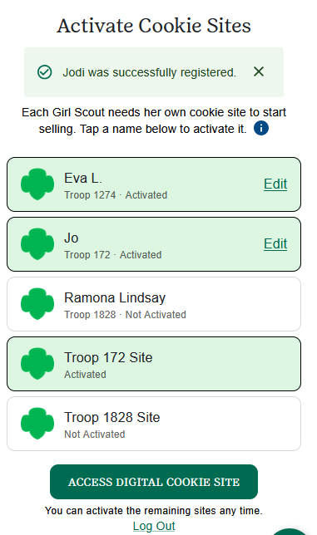
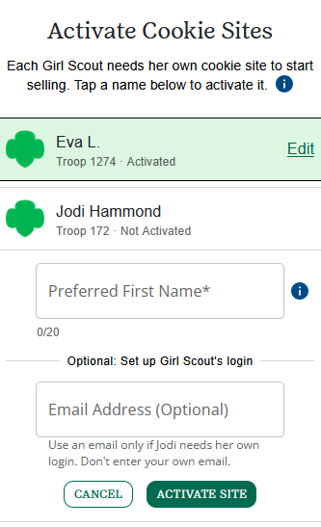
Activating Girl Scout’s Account
Select the Girl Scout
you want to activate.
Add a preferred name
and email if GS is 13+
Name will appear on the storefront and customer’s emails.
Email is optional, do not enter your email address.
Tap Activate Site
Tap Access Digital Cookie Site once you have activated your participating Girl Scout(s).
Notes:
Note to councils: If caregivers are both volunteer AND parent and access dates have begun for both roles they will see their troop and Girl Scouts in the Activate Cookie Sites list.
This slide has animation.
Now it's time to activate your Girl Scout(s) for the Digital Cookie program.
If you have more than one participating Girl Scout, first select the Girl Scout whose account you would like to activate.
::ADVANCE SLIDE::
Add the Girl Scout’s Preferred First Name.
If the Girl Scout is age 13 or older, you may enter a unique email address. This allows the Girl Scout to help set up the site and monitor Digital Cookie activity. Please note that this email address must be different from the email address you use to log in to Digital Cookie.
::ADVANCE SLIDE::
After reviewing and updating the information, click Activate Site. You will be returned to the list of Girl Scouts who still need to be activated.
Repeat this process for each participating Girl Scout.
Once all participating Girl Scout accounts have been activated, click Access Digital Cookie Site to open the first Girl Scout's Dashboard.
After completing registration, watch for a registration confirmation email and save it in an easy-to-find location for reference throughout the cookie season.

Slide 8
Digital Cookie Dashboard
Notes:
Script:
Once you log in to Digital Cookie, you will arrive on your Dashboard. The Dashboard includes seven sections designed to help you support your Girl Scout's Digital Cookie program.

Slide 9
Digital Cookie Dashboard
Before Site is Set Up
After Site is Set Up
My Sales Goal
Digital sales progress bar and number of packages credited by troop volunteer.
Message from Council
Note of encouragement from your council.
Girl Scout’s Cookie Site
Set up cookie site and then share the cookie site link or print the QR Code.
Notes:
Note to Councils: This slide has animation
Script:
Message from Council
This section contains important updates and messages from your council to help guide and support you throughout the cookie season. You can hide the message after reviewing it. If the message is updated, it will automatically reappear on your Dashboard.
::ADVANCE SLIDE::
2. My Sales Goal
This section shows your Girl Scout’s progress toward their sales goal and the number of packages assigned by the troop cookie volunteer.
Donated and In-Hand orders are reflected in the progress tracker immediately.
Shipped orders are added to the graph once the order has shipped. Please note that orders do not ship on weekends or holidays, so updates may take a few days.
Girl Delivery orders appear after the order has been approved.
::ADVANCE SLIDE::
3. My Cookie Site
This section provides everything you need to set up and share your Girl Scout's cookie site. Before setup, you will see a button to create the site. Once the site is approved and published, you can:
Copy and share the site link with customers. Use the Share button to quickly post the site using your preferred social media, email, or text messaging apps.
Screenshot or Print the site's QR code for easy sharing.

Slide 10
Digital Cookie Dashboard
Pending Orders
At a glance, see if their Girl Scout has any orders that need to be approved or marked as delivered.
Cheers
Quick access button to “Send a Cheer” to a Girl Scout in their troop.
Pins & Badges
Track the progress toward completing the Cookie Business Badges and Cookie Entrepreneur Family Pins.
Notes:
Note to Councils: This slide has animation
Script:
4. Pending Orders
This section alerts you to any orders that require action. You will be notified when there are orders that need approval and reminded when delivered orders still need to be marked as delivered.
::ADVANCE SLIDE::
5. Cheers
This section provides snapshot of recent cheers your Girl Scout has received and quick access to the Cheers page, where your Girl Scout can send encouraging messages to other Girl Scouts in the troop and view cheers received from fellow Girl Scouts, volunteers, and customers.
::ADVANCE SLIDE::
6. Pins & Badges
This section tracks your Girl Scout’s cookie program achievements. When a cookie pin or badge has been completed, it will be displayed here.
Visit the Badges page by clicking UPDATE to view the required steps and activities.
Completed pins and badges will appear in full color, making it easy to track progress and celebrate accomplishments.

Slide 11
Online Sales and Marketing
Notes:
Script:
7. Online Sales and Marketing
The seventh section, located at the bottom of the Dashboard page, is the Online Sales and Marketing section. This area helps you monitor your Girl Scout’s cookie business by providing an overview of online sales activity.
Here, you can:
View total sales and track progress throughout the cookie season.
See a breakdown of sales by cookie variety and delivery method.
Monitor the number of marketing emails sent to customers.
This information makes it easy to track performance and measure the impact of your Girl Scout’s online marketing efforts.

Slide 12
Setting up the Girl Scout cookie site.
Menu
Notes:
Script:
To set up your Girl Scout’s cookie site, select Site Setup from the navigation menu, or click Get Started in the Girl Scout Cookie Site section of the Dashboard.
Both options will take you to the Site Setup process, where you can customize and prepare the site for customers to place orders.

Slide 13
Site Setup
Add a photo
Write your story
Notes:
Note to Councils: This slide has animation
Script:
On the Site Setup page, you can begin by adding a photo to personalize your Girl Scout’s cookie site.
Click the camera icon to add a photo.
You can upload a photo from your device, take a new picture, or choose an image from the available gallery options.
::ADVANCE SLIDE::
Next, add a personal message by creating your story.
Click the pencil icon to open the story editor.
Write a brief message explaining why your Girl Scout is participating in the cookie program and why customers should support their goals.
Adding a photo and personal story helps create a more engaging site and allows customers to connect with your Girl Scout’s cookie business.

Slide 14
Site Setup
Set goal
Add video
Notes:
Note to Councils: This slide has animation
Script:
Next, set your Girl Scout’s sales goal.
Click the pencil icon to open the goal editor.
Enter the number of cookie packages your Girl Scout plans to sell during the season.
::ADVANCE SLIDE::
Next, add a video to personalize the cookie site.
Click the camera icon to manage the video.
You can upload a video from your device, select the default Girl Scout video, or remove the video if you do not wish to include one.
New this year: Your Girl Scout’s cookie site can feature both a photo and a video, making it even easier to create a personalized experience for customers.

Slide 15
Site Setup
Click PUBLISH
When site is ready.
Notes:
Note to Councils: This slide has animation
Script:
Once your Girl Scout has finalized her site. Click the Publish button.
::ADVANCE SLIDE::
You will receive a pop up that will
Girl Scout’s 13+ will have a button that says, “see your site and submit for approval”. They can see the preview and edit. Parent is sent an email to approve the site.

Slide 16
Digital Cookie Pages
Menu
Switch Roles
Notes:
Script:
Now, let’s take a look at the individual pages in Digital Cookie that are available from the navigation menu. If you have multiple roles, you can switch between profiles by clicking the arrow next to your profile image and selecting the role you’d like to access. From this menu, you can also update your password through the My Account page and sign out of Digital Cookie.

Slide 17
Site Setup
Notes:
Script:
Once your site is published, you can return to the Site Setup page at anytime to edit the site.
Here you can click EDIT SITE and use the edit icons to make changes then click PUBLISH when done.
You can also close the cookie site if you are done taking orders for the season.

Slide 18
Orders
Notes:
Script:
On the Orders page, you can view all orders that have been placed through your Girl Scout’s cookie site.

Slide 19
Viewing Orders
Hide/Show Columns
Horizonal View
Notes:
Note to Councils: This slide has animation
Script:
There are several options available to personalize this page, helping you navigate and manage your information more efficiently.
To view more columns on your mobile device, you can tap the HIDE/SHOW COLUMNS button and select which columns you want to view.
::ADVANCE SLIDE::
Then you can flip your phone horizontally and will be able to see the additional columns.

Slide 20
Viewing Orders
Export List
Filter
Notes:
Note to Councils: This slide has animation
Script:
New this year, you can use the Filter feature to tailor your view and easily locate specific orders. Filters are available for order type, order status, payment method, and date, making it easier to find exactly what you're looking for.
::Advance Slide::
Digital Cookie also allows you to export your order data. You can export either all orders or only the orders shown in your filtered view, making it easy to download exactly the information you need.
To view an order's full details, simply click the order number. This will open the order record and display all associated information.

Slide 21
Order Details: Shipped Order
Delivery Info
Order Info
Payments & Billing
Notes:
Script:
The Order Details screen is organized into three tabs: Delivery Info, Order Info, and Payments & Billing. No matter which tab you're viewing, you'll always see an order summary.
The Delivery Info tab displays customer and delivery details. For shipped orders, you'll also find the shipping address, ship date, and tracking information. The Order Info tab contains key order details such as the order status, date, and type.
The Payments & Billing tab shows where the order was placed, how the customer paid, and the customer's email address.

Slide 22
Order Details: In-Person Delivery (only available in select communities)
Delivery Info
Order Info
Payments & Billing
Notes:
Script:
For in-person delivery orders, the Delivery Info tab displays the customer’s secondary delivery preference.
The Order Info tab shows the order status and the date the order was approved or declined.

Slide 23
In-Person Delivery
(only available in select communities)
NEW
Notes:
Script:
New this year, the In-Person Delivery page provides a centralized location for managing in-person delivery orders. From this page, you can easily identify orders that need approval or delivery confirmation and complete the necessary actions. The In-Person Delivery Settings, formerly found on the My Cookies page, have also been moved here for easier access.

Slide 24
Approving/Declining Orders
Approving from order details page.
Approving from main page.
Notes:
Note to Councils: This slide has animation
Script:
There are two ways to approve or decline an order from the In-Person Delivery page.
::ADVANCE SLIDE::
The first option is to select the checkbox next to the customer’s name and then click the Approve or Decline button.
The second option is to click the customer’s name to open the Order Details page.
::ADVANCE SLIDE::
From the Order Details page, you can review the order information and determine whether you're able to fulfill the delivery. Once you've completed your review, click the Approve or Decline button at the top of the page to take action.

Slide 25
Marking Orders as Delivered
Mark As Delivered from order details page.
Mark As Delivered from main page.
Notes:
Note to Councils: This slide has animation
Script:
Alternative (more conversational):
The process for marking an order as delivered is similar to approving an order.
::ADVANCE SLIDE::
You can mark an order as delivered directly from the In-Person Delivery page by selecting the checkbox next to the customer's name and clicking Mark as Delivered.
::ADVANCE SLIDE::
You can also open the order by clicking the customer’s name. On the Order Details page, simply click Mark as Delivered at the top of the screen.

Slide 26
In-Person Delivery Settings
Don’t want to deliver cookies in person?
Turn off Girl Scout delivery on your troop site.
Run out of a cookie variety?
Turn it off for Girl Scout delivery on your troop site.
Notes:
Script:
At the bottom of the In-Person Delivery page, you'll find the Delivery Settings section.
Delivery Settings allow you to:
Turn Girl Scout Delivery on or off.
Enable or disable specific cookie varieties.
These settings can be helpful if you've run out of a particular cookie variety and can't fulfill additional orders, or if you're temporarily unable to deliver cookies to customers.
When a cookie variety or Girl Scout Delivery is turned off, customers will no longer see that option when placing an order. This helps prevent orders that you may be unable to fulfill and reduces the need to decline customer orders later.
To disable a cookie variety or turn off Girl Scout Delivery entirely, simply toggle the switch next to the item you want to disable. You can turn it back on at any time by toggling the switch again.

Slide 27
Inventory & Financials
NEW
Name
Notes:
Script:
The Inventory & Financials page (formerly called My Cookies page) allows you to track inventory for each cookie variety and receive alerts when additional inventory may be needed. You can also monitor funds collected, review outstanding balances, and determine whether money needs to be turned in to your Troop Cookie Manager. If applicable, this page is also where you can place your Initial Order.

Slide 28
Initial Order
Notes:
Note to councils: Remove this slide if you are not offering this feature or if you are a Direct Sale council.
Script:
During the Initial Order period, you can enter the cookies your Girl Scout needs to fulfill orders collected on paper order cards, along with any additional inventory you would like to have on hand. Do not include any online In-Person Delivery orders received before the Initial Order deadline, as those cookies have already been included in your order.
When you first access this page, you will see a message containing important instructions, reminders, and details to help you complete your Initial Order accurately.

Slide 29
Entering Your Order
Notes:
Note to councils: Remove this slide if you are not offering this feature or if you are a Direct Sale council.
Script:
As you enter the initial order quantities for each cookie variety, the total number of packages updates automatically at the top of the page. You can also view the total number of packages already sold online for in-person delivery, which is displayed at the top of the screen for easy reference.
The form automatically saves each time you make a change, so you can leave the page and return later to continue entering your initial order. Once you have entered and reviewed all quantities, click Submit to finalize your order.

Slide 30
Submitting Your Order
Notes:
Note to councils: Remove this slide if you are not offering this feature or if you are a Direct Sale council.
Script:
After you click Submit, the system will ask you to confirm that you are ready to send your initial order to your cookie volunteer. Be sure to review your order carefully, as you will not be able to make any changes after it has been submitted. Once your order is submitted, you can return to the page at any time to view your initial order details.

Slide 31
Inventory
Notes:
Note to councils: if your council used the initial order submission. This screen will appear for families once the initial order period has completed.
This slide has animation
Script:
At the top of the Inventory & Financials page, you can view your Girl Scout’s goal progress, along with the total number of packages assigned to her by the troop cookie volunteer. Below that is an inventory summary that shows how many packages are currently available, how many packages are pending, and how many packages are needed to fulfill outstanding orders. Pending packages represent orders that have not yet been approved or delivered.
::ADVANCE SLIDE::
When you select a specific cookie variety, you can view additional details for that variety. This includes the number of packages from the initial order, any additional inventory assigned by the troop cookie volunteer, packages sold through the Digital Cookie Mobile App using cash or mobile payments, and packages that have been delivered.
In the Pending section, you can see a breakdown of packages tied to unapproved orders versus undelivered orders.
The page also shows how many additional packages you need to request from your troop cookie volunteer to ensure all orders for that variety can be fulfilled.

Slide 32
Financials
Notes:
Note to councils: This slide has animation
Script:
The Financials section is a valuable tool to help you understand the amount due for the cookie sale and how the troop is calculating the amount.

Slide 33
Financials
Notes:
Script:
There are four sections within Financials that you can expand to view additional details:
Initial Cookies (Order Card)
This section shows the number of packages included in your initial order.
Cookie Packages and Specialty Packages may both appear if your council sells cookies at different price points.
If you have questions about cookie pricing in your area, contact your troop cookie volunteer for more information.
Payments
This section provides a summary of payments that have been recorded on your account.
Online Paid reflects online payments received through Digital Cookie for In-Person Delivery and Cookies in Hand orders.
Offline Paid reflects payments, typically cash or check, that you have given to your troop cookie volunteer and that have been entered into the system. This amount does not include cash sales you entered through the Digital Cookie Mobile App.
Additional Cookies Received
This section shows any additional cookie packages that have been assigned to you by your troop during the season.
Total Balance Due
This section summarizes the amount owed and the payments received.
Total Money Owed is the amount owed for both your initial cookie pickup and any additional cookies received. If your council sells cookies at different price points, those pricing differences are already reflected in this total.
Total Money Paid is the combined amount recorded in the Payments section.
Total Balance Due is the difference between the amount owed and the amount paid.
If you believe any of the information in the Financials section is incorrect, contact your troop cookie volunteer to review and compare the records on file with your own records.

Slide 34
Customers
Notes:
Script:
The Customers page allows Girl Scouts to add customer contacts, send email communications, and monitor the status and history of each customer’s orders.

Slide 35
Do not Add Customers
DO NOT ADD CUSTOMERS
Due to international privacy laws, customer data should not be uploaded into Digital Cookie by girls and families.
Share your link with family and friends so they can place orders. Customers enter their own information on the order form. Only after a customer has done this may you send emails to that person.
Notes:
Script:
To add a customer, select Add, enter the customer's information, and then select Add Customer to save the contact.

Slide 36
Send Email
Notes:
Note to council: This slide has animation
Script:
To send an email, check the box next to the customer’s name, or select Select All to choose every customer on your list. Click Send Email, select the email message you would like to send, and then click Send.
::ADVANCE SLIDE::
A confirmation pop-up will appear once the email has been successfully sent.

Slide 37
Viewing Customer Details
Notes:
Script:
When you click on a customer’s name, you can view and update their contact information, as well as review a list of all orders they have placed during the current season. Clicking on an individual order displays a summary of the order details.

Slide 38
Rewards
Notes:
Note to councils: Remove if you are not offering this feature.
Script:
The Rewards page allows Girl Scouts to explore the rewards available throughout the Cookie Program, view details about each reward, track their progress toward their cookie goal, and select reward choices as they unlock new achievement levels.

Slide 39
See what rewards you’ve earned!
Notes:
Note to councils: Remove if you are not offering this feature.
Script:
Tap or click a reward level to view the rewards available at that milestone. Then, tap or click an individual reward to see additional details. Some rewards require action, such as selecting a T-shirt size or choosing a reward option. When multiple rewards are available, Girl Scouts can review the details of each option and select the reward they prefer. If they change their mind, they can return to the Rewards page and update their selection at any time before the selection deadline.

Slide 40
Cheers
Notes:
Script:
Girl Scouts can be even more excited about their Digital Cookie experience when they give a Cheer to another Girl Scout in their troop or receive one from a troop member, troop volunteer, or even a customer.
In the Cheers module, Girl Scouts can see the other members of their troop and the percentage of sales towards them reaching their goal.

Slide 41
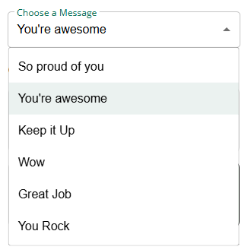
Sending a Cheer
NEW Cheers
Notes:
Script:
To send a Cheer, tap or click on the Girl Scout you would like to encourage.
Next, select a message and choose a GIF to accompany the cheer. Once the selections are made, you can preview the cheer to see exactly how it will appear. If everything looks good, click Send.
When a Girl Scout receives cheers, the number of unviewed cheers will be displayed on the Dashboard along with the GIF. From there, the Girl Scout can open and view all of the cheers that have been sent.
The available cheer GIFs are refreshed each year to align with the current cookie season, including updates that feature the new mascot and other popular GIF selections.

Slide 42
Badges
Notes:
Script
The Badges page displays the Cookie Entrepreneur Family Pins and the Cookie Business Badges that are appropriate for your Girl Scout’s grade level.
For the Cookie Business Badges, Girl Scouts can view an overview of the badge steps. For complete badge requirements, check with your troop volunteer or purchase the official badge requirements through the shop link or your local council store.
For the Cookie Entrepreneur Family Pins, Girl Scouts can click on each step to view detailed instructions. A pop-up window will provide information about the activity, and some steps may include links to activities that can be completed directly within Digital Cookie.
As each step is completed, the Girl Scout can check the box next to that step to track progress. If the final step for a pin is checked, a confirmation message will appear asking the Girl Scout to verify that the last step has been completed.
Girl Scouts can mark steps as completed even if they finished the activity before using Digital Cookie. They can also revisit and complete the activities again at any time, as these activities are valuable tools that support their cookie business.
When all steps for a pin are completed, a star will appear at the end of the progress bar, and the Girl Scout will receive a congratulatory message recognizing the achievement.
Once a badge or pin has been completed, it will appear in full color on the Dashboard page, making it easy to track accomplishments throughout the cookie season.

Slide 43
Digital Cookie
Mobile App

Slide 44
Digital Cookie Mobile App
IOS App Store
Google Play Store
Download a new version of the mobile app each year.
Mobile app found in App Store or Google Play store.
Notes:
Script
Girl Scouts can use the Digital Cookie Mobile App to process and review orders placed through the Girl Scout’s individual site. Make sure to download a new version of the mobile app each year.

Slide 45
Logging In
Use the same email and password use for Digital Cookie
Girl Scout Cookie site must be published
Notes:
Note to council: You might want to add council mobile app access dates if they do not align to the Digital Cookie access dates.
Script
To log into mobile app, you will use the same email and password used to log into the Digital Cookie browser site. The Girl Scout Cookie site must be published prior to accessing the mobile app.

Slide 46
Digital Cookie Home Screen
Select Girl Scout’s Name
Visit My Site
Email My Site
Customers can scan the QR code to visit the Troop’s Cookie Site.
Girl Scout’s can send a marketing email to a customer.
Notes:
Note to council: This slide has animation
Script
When you first log in to the Digital Cookie App, you may see multiple roles associated with your account. In this section, we’ll focus on the Girl Scout role. Select your Girl Scout’s name to access the home screen.
::ADVANCE SLIDE::
From the home screen, Girl Scouts can:
Place a new cookie order
Share their cookie site with customers
View and manage orders
::ADVANCE SLIDE::
The Visit My Site button displays a QR code that customers can scan to visit the Girl Scout’s cookie site and place an order.
The Email My Site button allows Girl Scouts to send a marketing email to customers, giving them the opportunity to purchase from the Girl Scout’s cookie site later.

Slide 47
New Cookie Order
Update Delivery Type
Select Cookie Quantity
Click CHECKOUT button
Notes:
Note to council: This slide has animation
Script:
To place a cookie order using the mobile app, the Girl Scout will tap New Cookie Order, then enter the cookie varieties the customer would like to purchase using the plus (+) and minus (-) buttons next to each variety. Once the order is complete, tap Checkout.
::ADVANCCE SLIDE::
The dark blue bar at the top of the screen indicates the order type being placed. Most transactions will be Give Now, which is used when the customer receives their cookies immediately. If you need to change the order type to Girl Delivered or Shipped, tap Update and select the appropriate option.
Keep in mind that the app remembers the last delivery type selected and will continue using that option for future orders until it is changed again. This is especially important when switching between different types of customer orders.

Slide 48
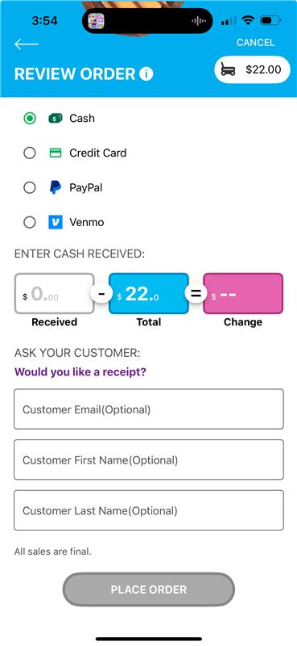
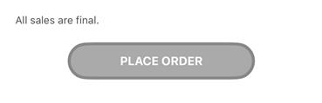
Customer Pays with Cash
Cash payment type is only available for “Give cookies to customer now” orders
Notes:
Note to council: there is animation on this slide.
Script:
Next, the Girl Scout will select how the customer would like to pay for their cookies.
::ADVANCE SLIDE::
When Cash is selected, a calculator will appear showing the amount the customer owes. Before the order can be completed, the Girl Scout must enter the amount of cash received from the customer. While the customer’s name and email address are optional, collecting this information is a great way to build a customer list for future cookie sales.
The Cash payment option is only available for Give Cookies to Customer Now orders.

Slide 49
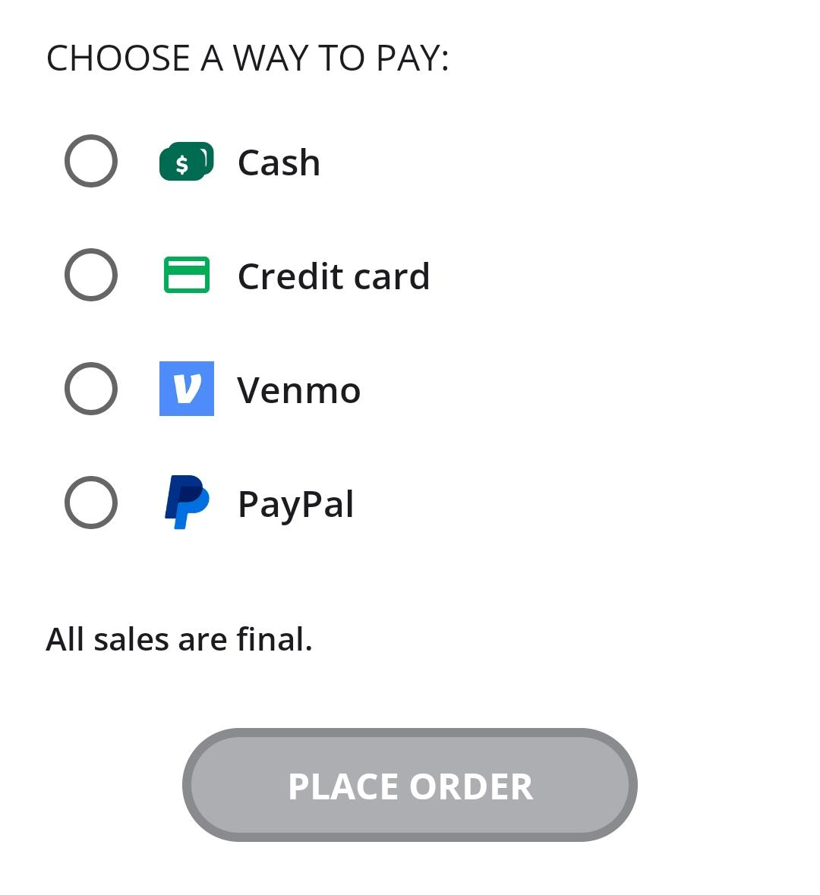
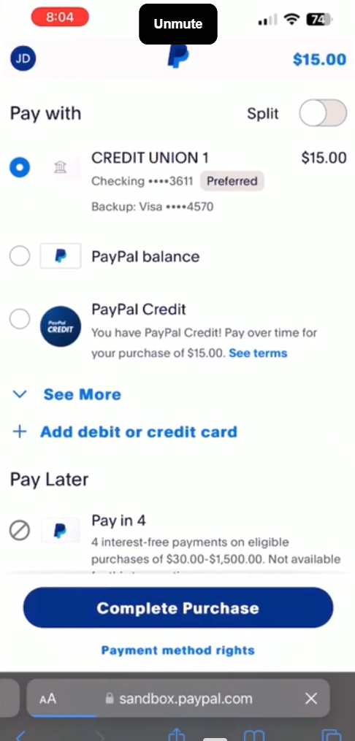
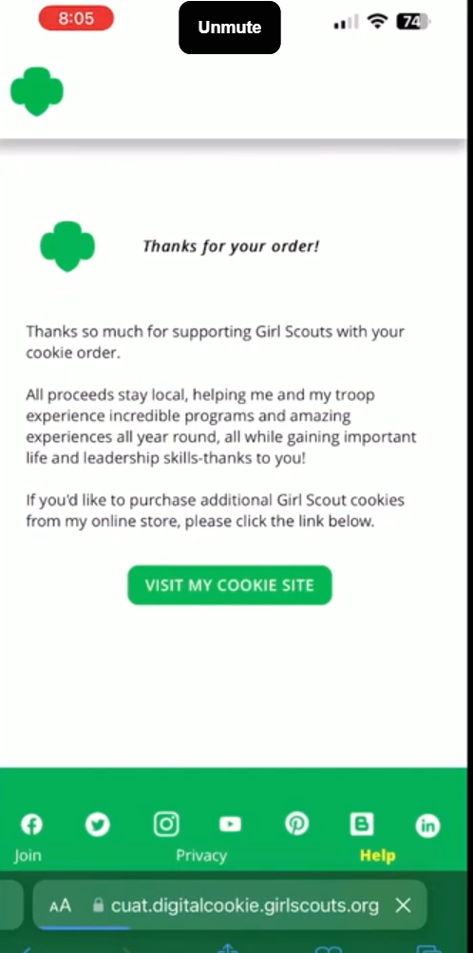
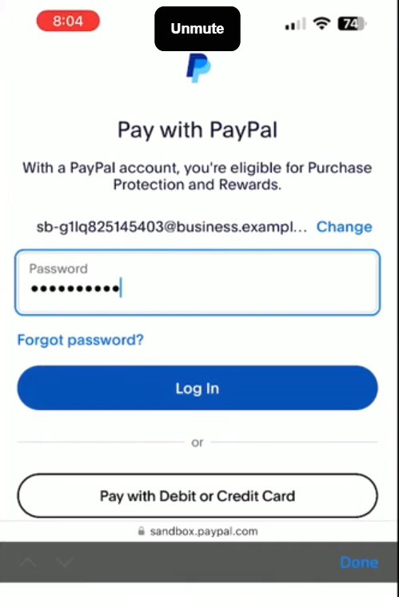
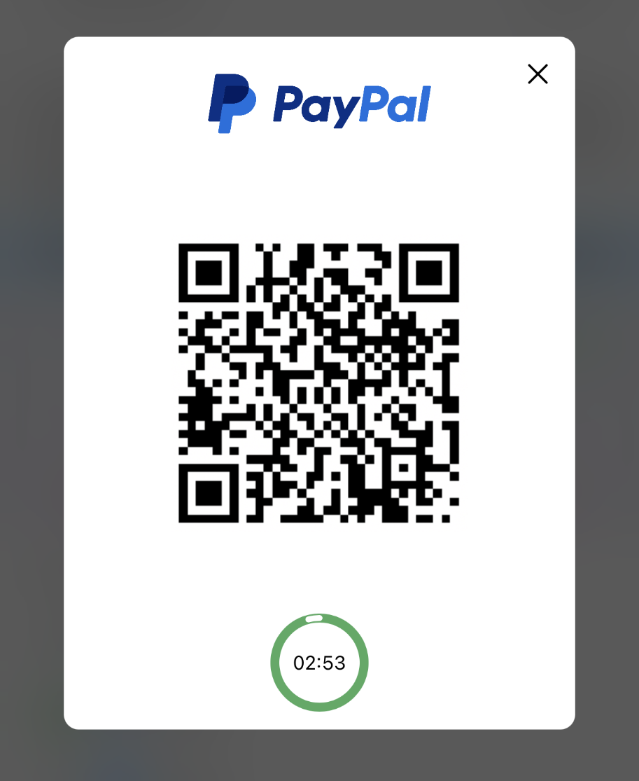
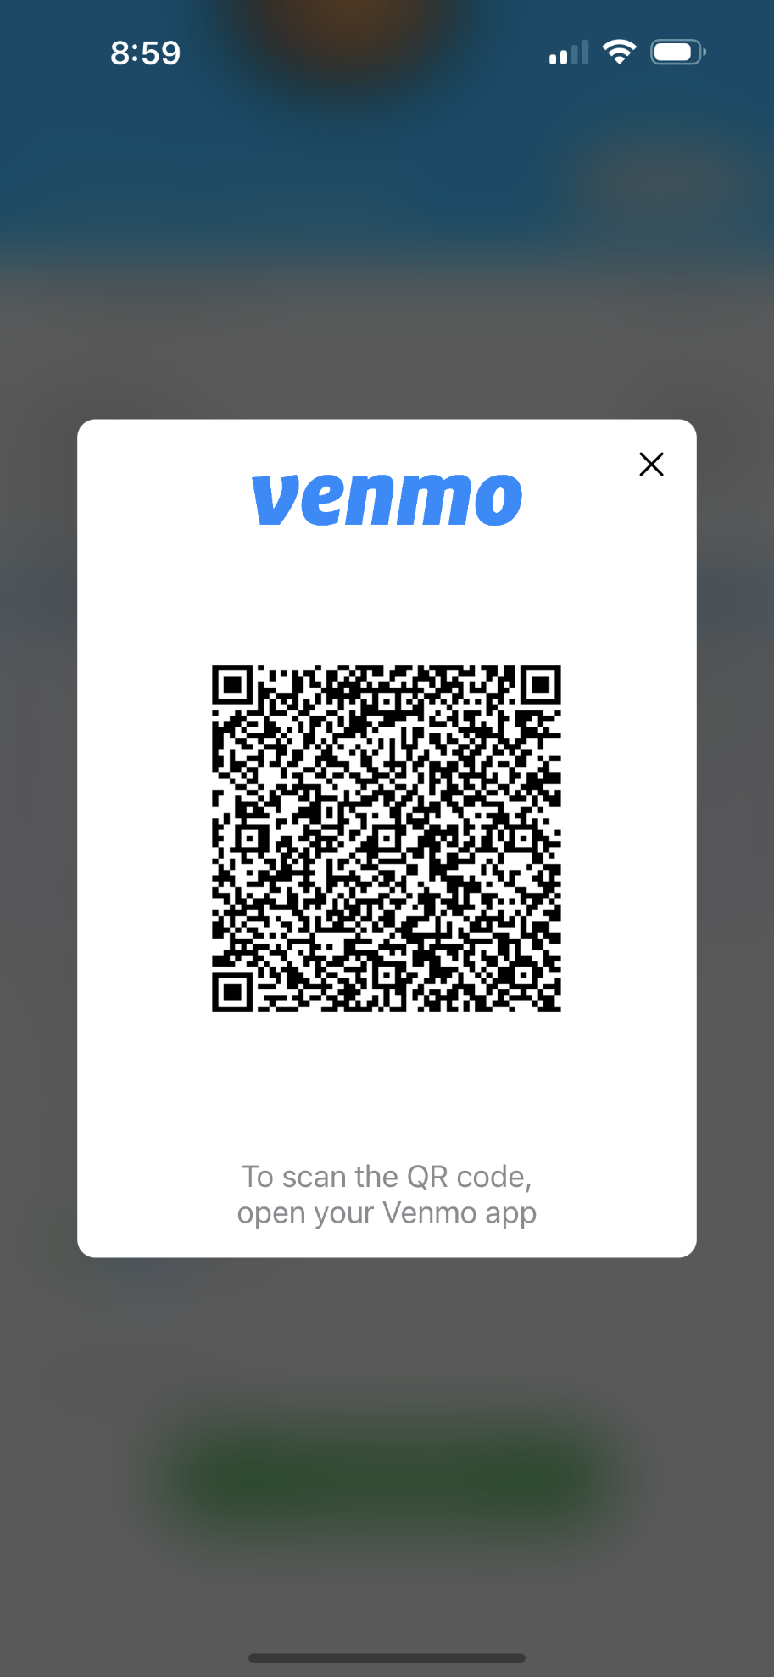
Payment Type: PayPal or Venmo
Demo
Demo
Notes:
Note to council: there is animation on this slide.
Script:
If the customer chooses PayPal or Venmo as their payment method, the Girl Scout will select that option and tap Place Order.
::ADVANCE SLIDE::
A QR code will appear on the screen. The Girl Scout can turn the phone toward the customer, who can then scan the QR code with their mobile device to complete their payment through PayPal or Venmo.
::ADVANCE SLIDE::
The next few screens show the payment process from the customer’s perspective using PayPal. After scanning the QR code, the customer is directed to the PayPal or Venmo sign-in page. Once logged in, they can select their preferred payment method, review the transaction details, and complete the purchase.
::ADVANCE SLIDE::
After the payment is successfully processed, the customer will see a confirmation screen indicating that the order has been completed. The Girl Scout should wait for this confirmation before considering the transaction finalized.

Slide 50
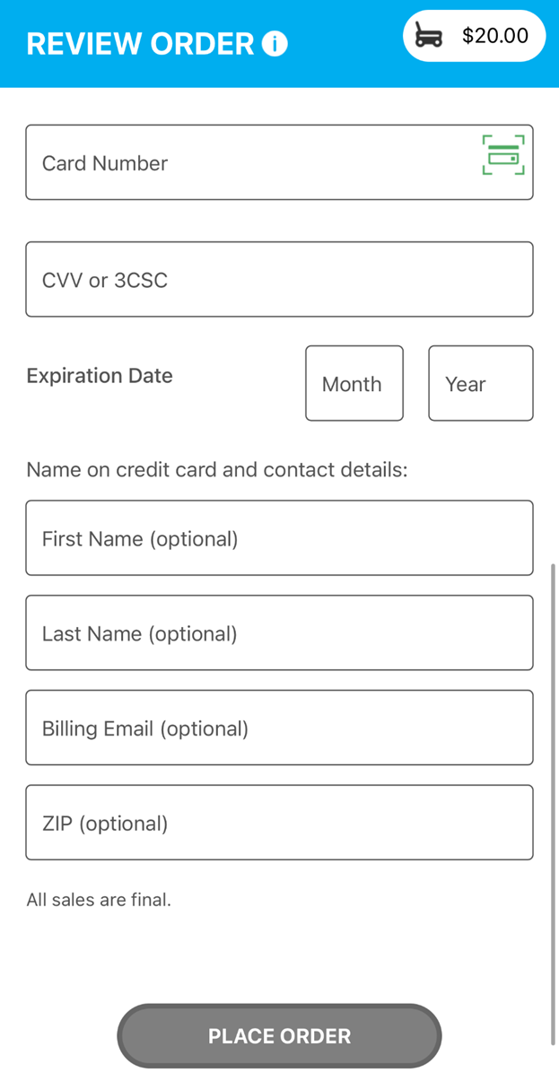
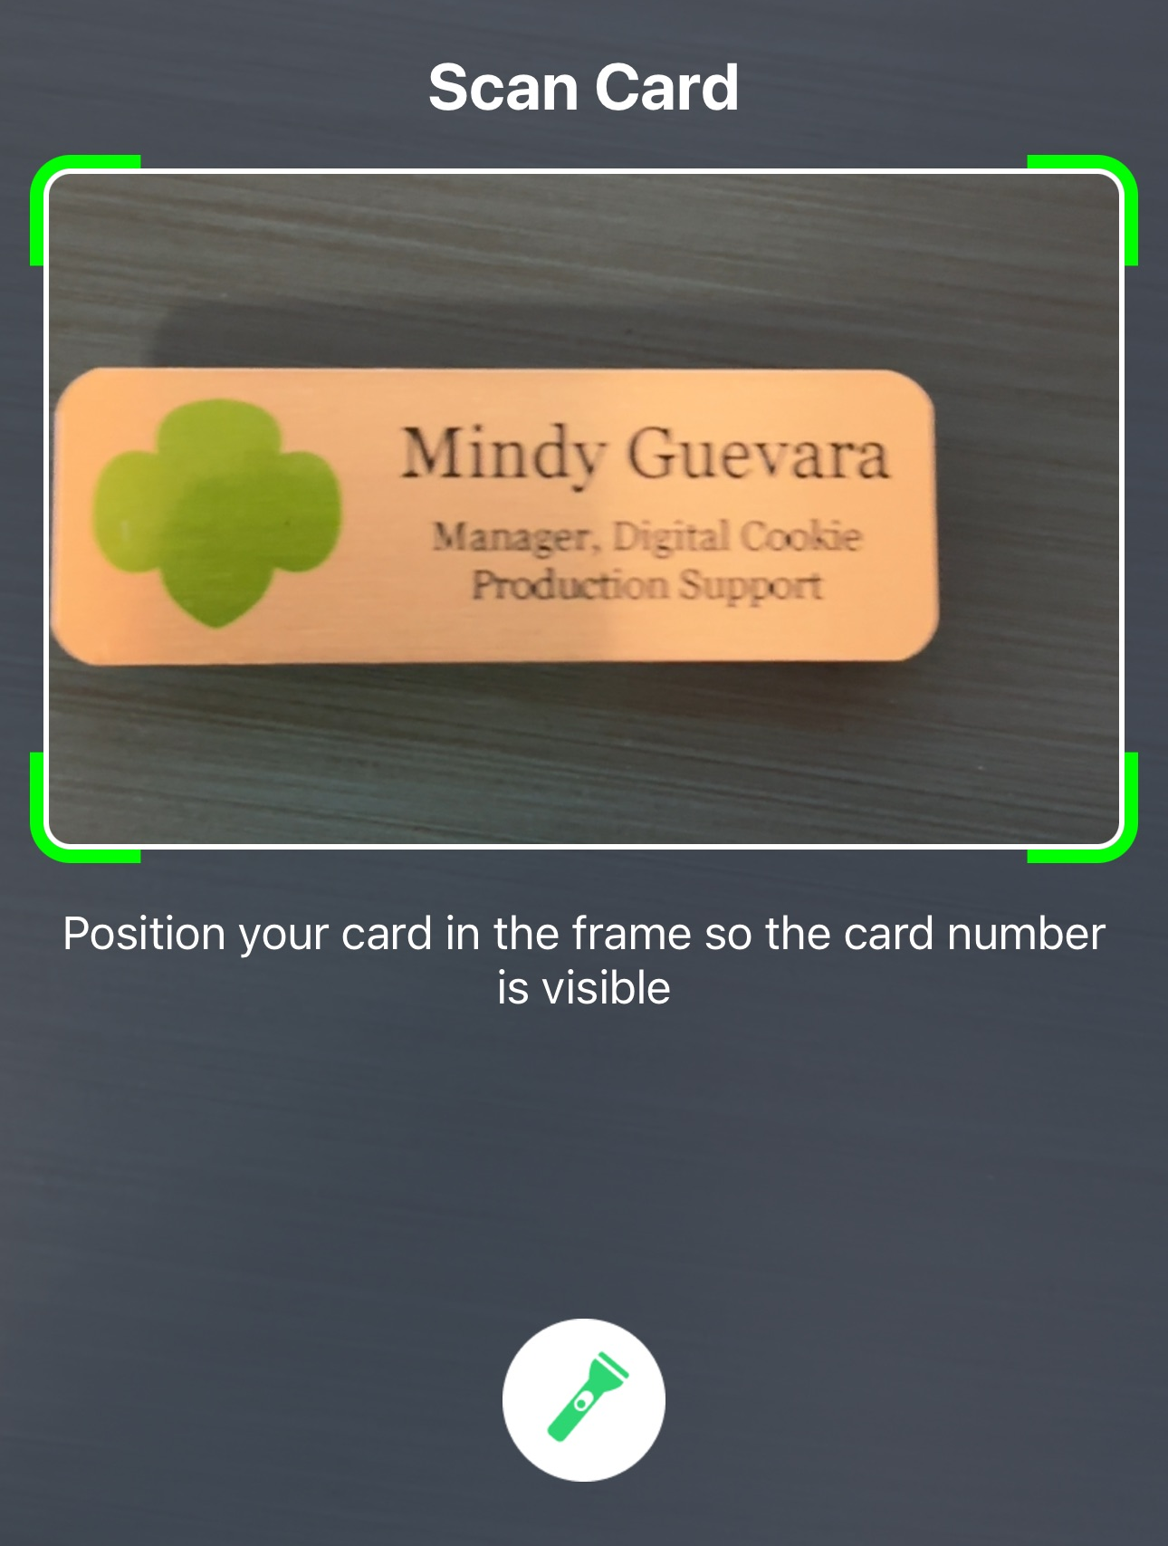
Payment Type: Credit Card
Contact details are optional. Girl Scouts should still ask if the customer would like an email confirmation.
Use the Scan Card feature instead of typing all the numbers.
Tip: Have good lighting and double-check the numbers before placing the order.
Notes:
Note to council: there is animation on this slide.
Script:
If the customer chose to pay by Credit Card.
::ADVANCE SLIDE::
The Girl Scout will scroll down on the phone to enter the payment details.
::ADVANCE SLIDE::
Use the Scan Card feature instead of typing all the numbers. Make sure to have good lighting when using this feature.
::ADVANCE SLIDE::
One the payment details have been entered; the Girl Scout can ask the customer if they would like to receive an email confirmation. While the customer details are optional now it is always good to ask and handy to have in case of any issues with the order.

Slide 51
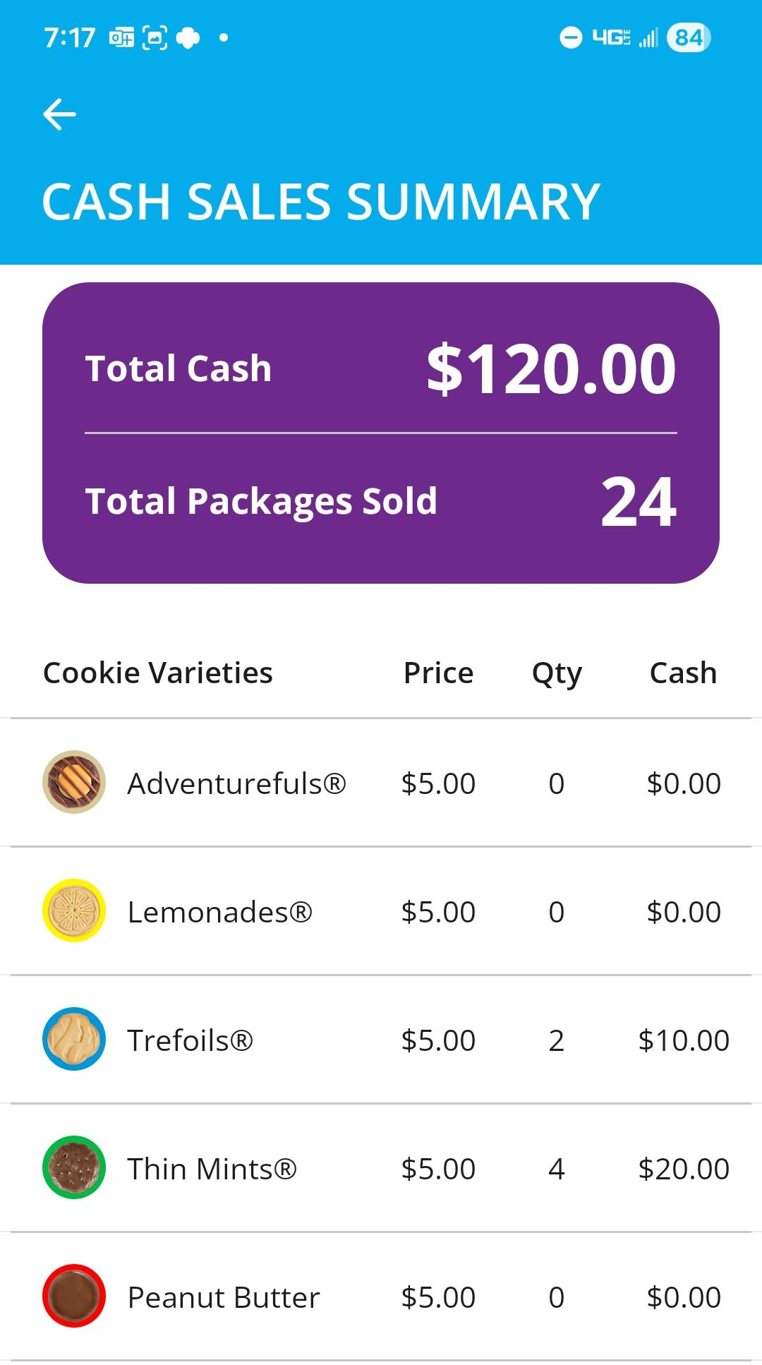
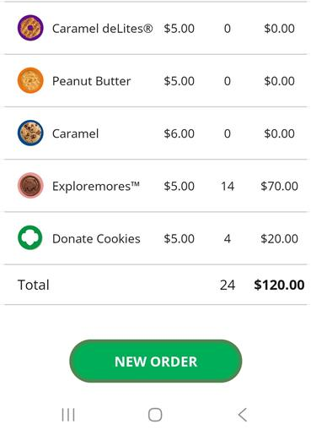
Cash Sales Summary
View a snapshot of the amount of cash that has been collected.
Notes:
Script:
From the main page of the mobile app, you'll find a View Cash Sales Summary button. Girl Scouts and their families can tap this button to quickly view a summary of their cash sales for the current cookie program.
The Cash Sales Summary displays both the total amount of cash collected and the number of packages sold through cash transactions. This provides an easy way to track cash sales and monitor progress throughout the season.

Slide 52
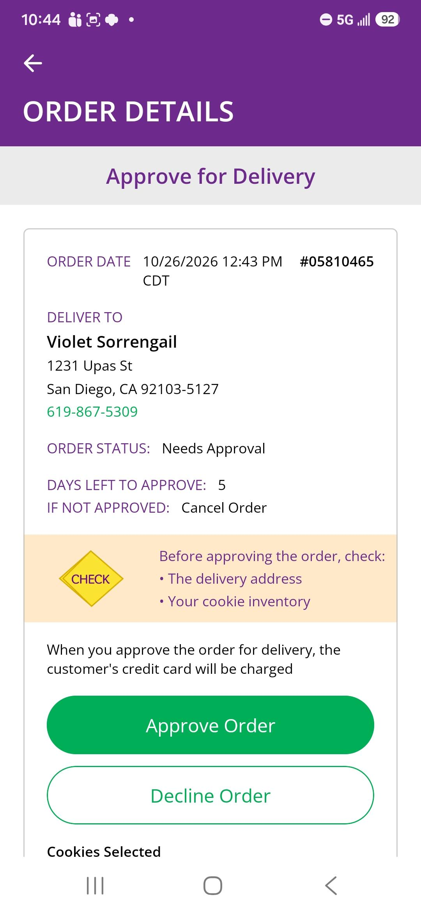
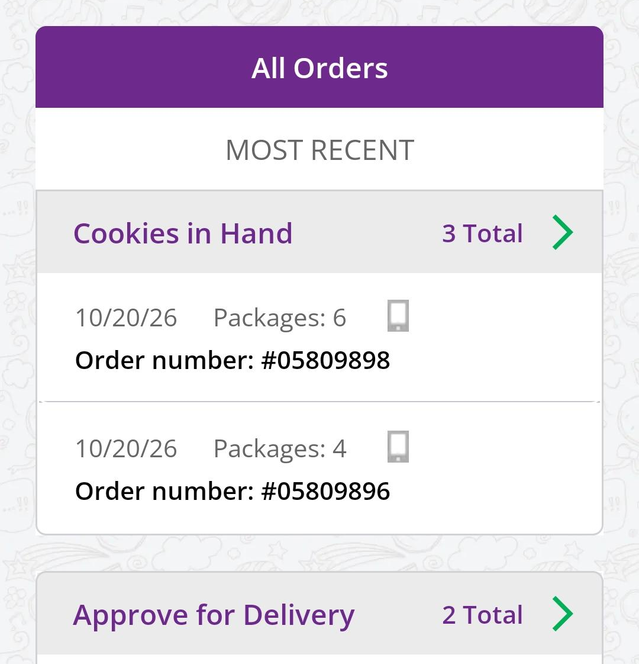
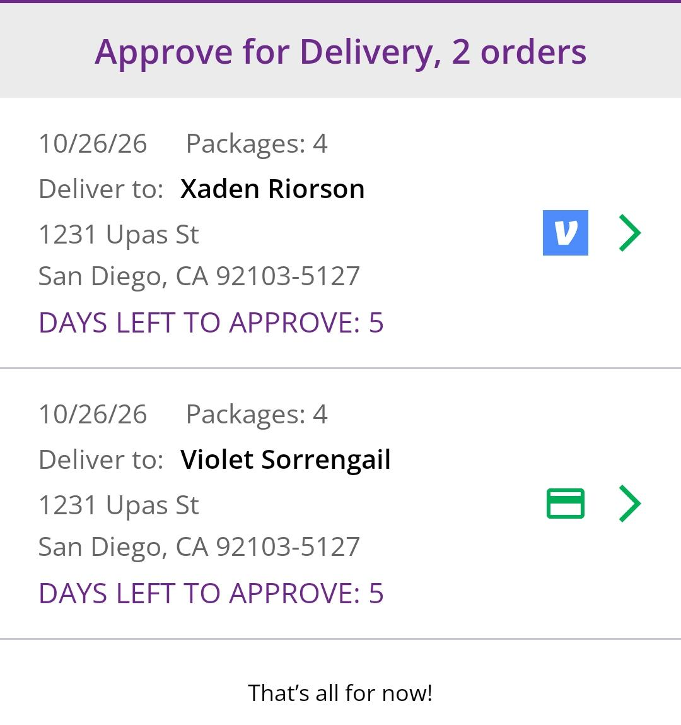
All orders for in-person delivery must be approved, even if placed through the mobile app
View All Orders
Notes:
Note to council: there is animation on this slide.
Script:
Once an order has been placed, the Girl Scout can view all orders (placed through the app and the Digital Cookie site) under the All Orders section from the home screen.
::ADVANCE SLIDE::
To view the orders in a specific category, click on the green arrow to the right to bring up all the orders.
::ADVANCE SLIDE::
Then click on the order you want to view.
::ADVANCE SLIDE::
If the order is an in-person delivery order, users can approve or decline the order from the app. If the order type is Delivery Later, the family will still need to approve or decline the order.

Slide 53
Using the Mobile App at a Cookie Booth

Slide 54
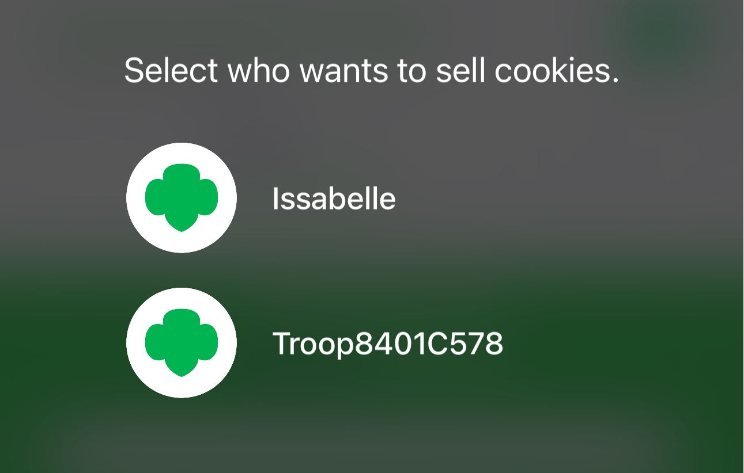
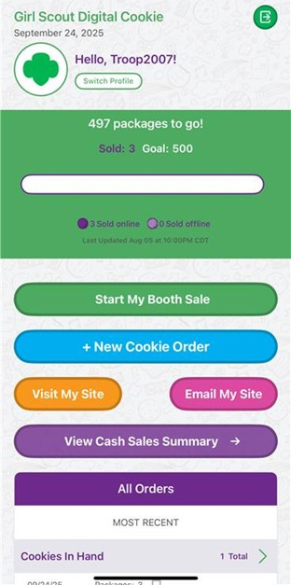
Starting Your Booth Sales
Select the troop role
Switch Profile
Click Start My Booth Sale
Notes:
Script
When using the Digital Cookie Mobile App at a cookie booth, make sure you're signed in using the Troop role. You can choose this role when you log in, or, if you're already signed in under a Girl Scout account, simply select Switch Profile and choose the troop profile.
Before taking your first order, tap Start My Booth Sale. This activates booth sales in the app and prepares you to begin accepting customer orders.

Slide 55
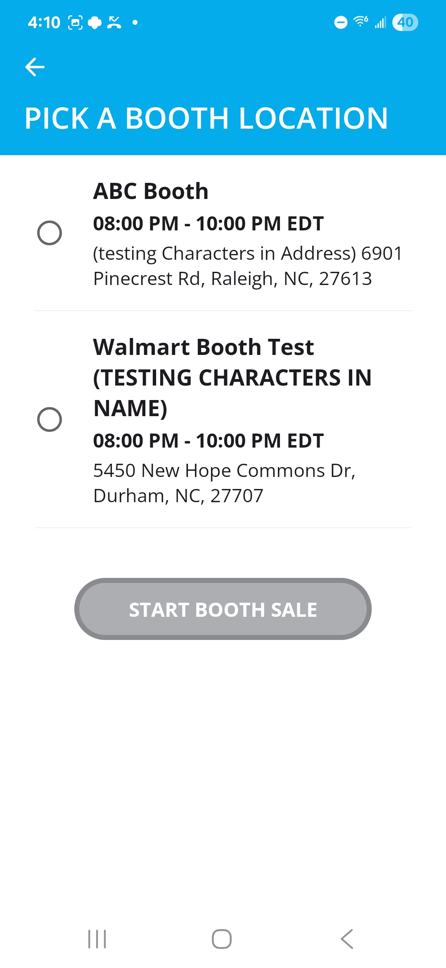
Starting Your Booth Sales
Select a booth
Click START BOOTH SALE
Booth sales remain available in the app all day, allowing you to start or end a booth sale whenever necessary. This flexibility makes it easy to manage sales and track orders throughout the duration of your booth event.
Notes:
Script
Next, choose the booth location you're currently working at. If you're holding a troop sale at a different location or don't see your booth listed, simply select New Cookie Order from the main screen. You can then process customer orders without selecting a booth.

Slide 56
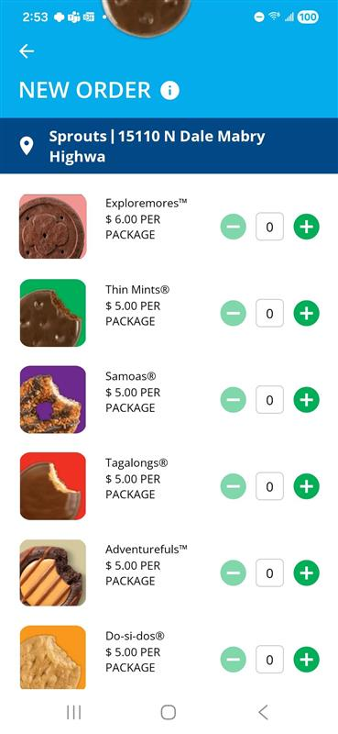
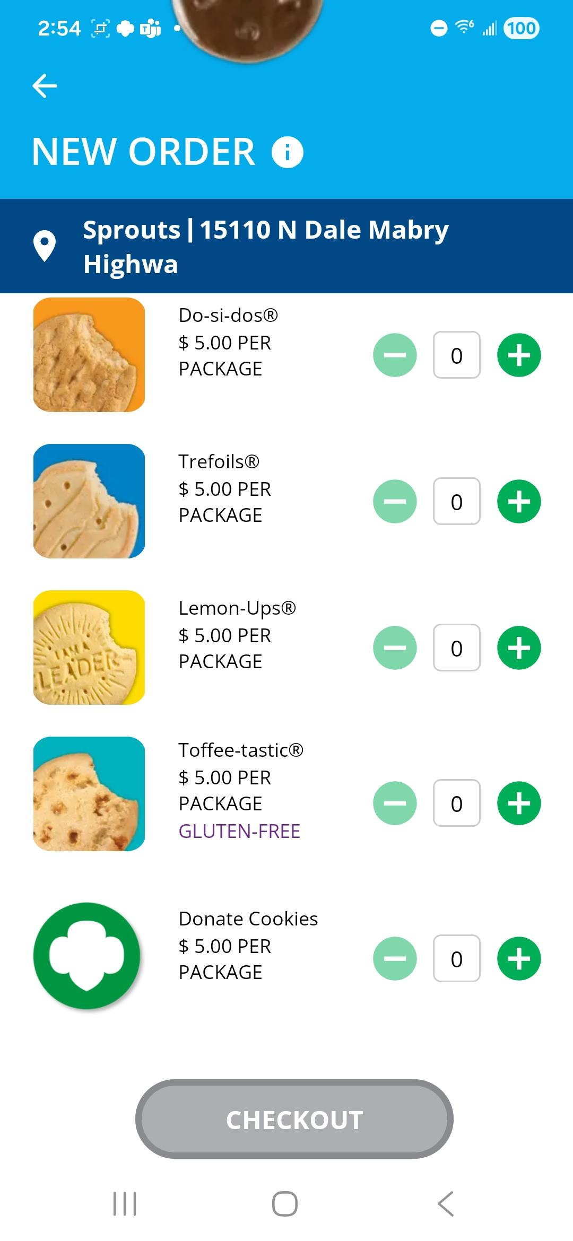
New Booth Order
Select Cookie Varieties
Cookie Booth Name
Select Cookie Quantity
Click CHECKOUT button
Notes:
Script:
You're now ready to enter the customer's order. Simply use the plus and minus buttons next to each cookie variety to add or remove packages based on the customer's selections.
The top of the screen displays the booth location you're logged into, so you can easily verify you're processing sales for the correct booth.

Slide 57
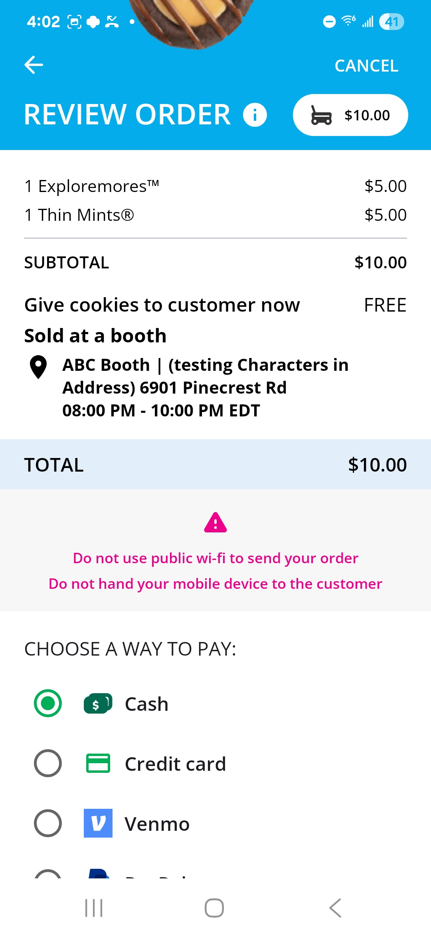
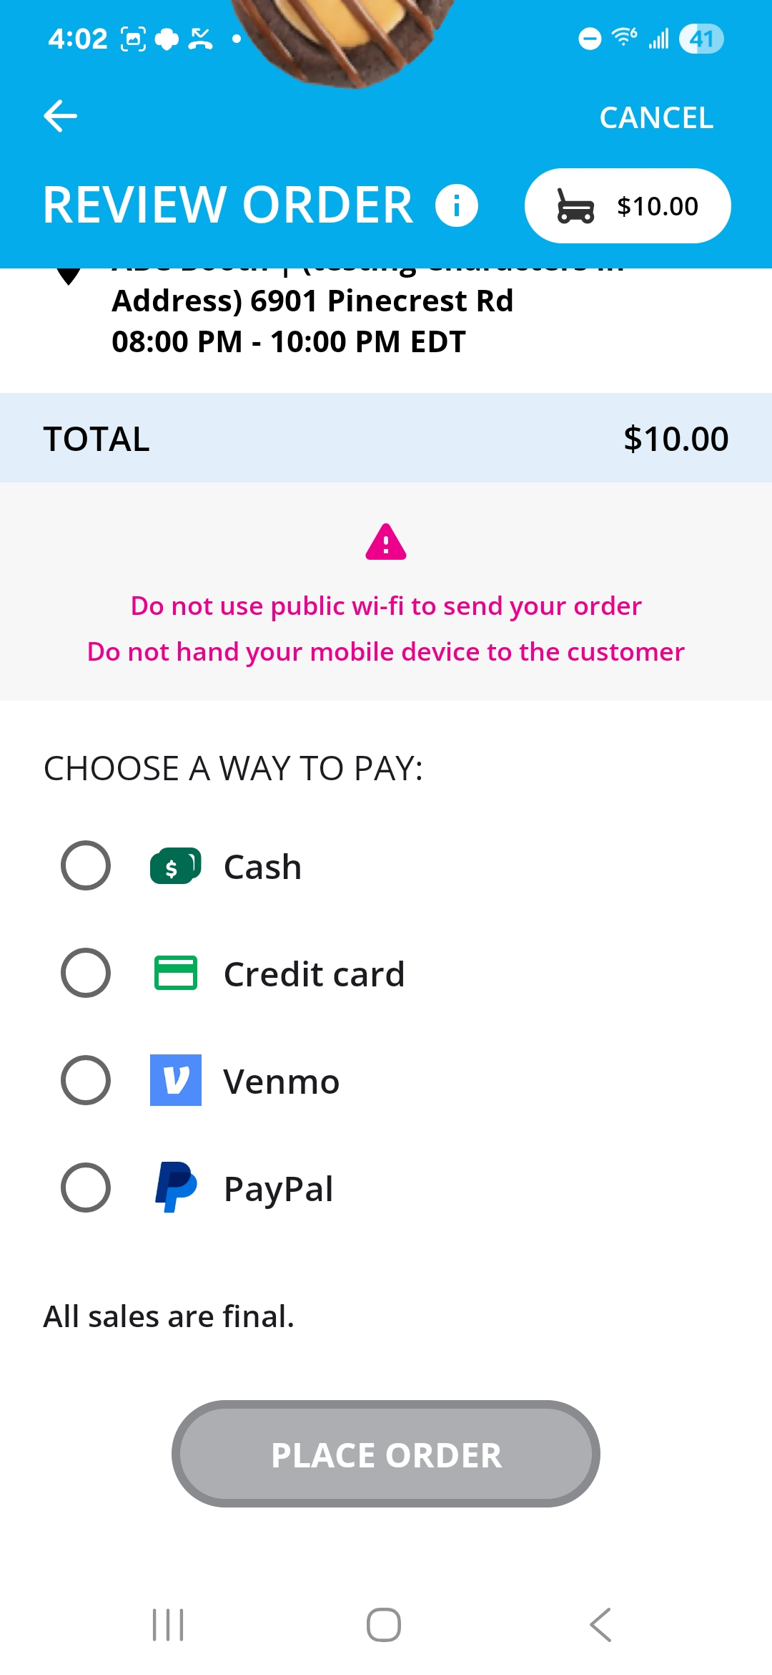
Review order and select how the customer would like to pay.
Booth location
Select payment type
Notes:
Script:
Next, you can review the order details and verify the booth location shown on the screen. Then select how the customer would like to pay.

Slide 58
Payment Type: Cash
Order Amount
Enter the amount of cash the customer gave
Customer’s change if applicable
Notes:
Note to council: Slide has animation
Script:
If the customer is paying with cash, a calculator will appear showing the total amount due.
::ADVANCE SLIDE::
Simply enter the amount of cash received.
::ADVANCE SLIDE::
The app will calculate any change that needs to be given back. You can also offer the customer a receipt by entering the customer's name and email address. Providing this information is optional.
When everything is complete, click Place Order to finalize the sale.

Slide 59
Contact details are optional. Girl Scouts should still ask if the customer would like an email confirmation.
Payment Type: Credit Card
Use the Scan Card feature instead of typing all the numbers.
Tip: Have good lighting and double-check the numbers before placing the order.
Notes:
Note to council: there is animation on this slide.
Script:
If the customer chooses to pay by credit card you will need to enter the payment information. ::ADVANCE SLIDE:: To make checkout faster and reduce data entry errors, use the Scan Card feature instead of manually entering the card number. For best results, make sure the card is in a well-lit area when using this feature.
::ADVANCE SLIDE:: Once the payment information has been entered, ask the customer if they would like to receive an email confirmation of their purchase. While entering the customer's name and email address is optional, it is recommended whenever possible, as this information can be helpful if there are any questions or issues with the order.
After all information has been entered and reviewed, click Place Order to complete the sale.

Slide 60
Payment Type: PayPal or Venmo
Demo
Demo
Notes:
Note to council: there is animation on this slide.
Script:
If the customer chooses to pay with PayPal or Venmo, select the appropriate payment option and click Place Order. A QR code will then appear on the screen. Turn the device toward the customer, who can scan the QR code with their phone to complete the payment using their PayPal or Venmo account.
::ADVANCE SLIDE
The next few screens demonstrate the payment process from the customer's perspective using PayPal. After scanning the QR code, the customer is directed to the PayPal or Venmo sign-in page. Once signed in, the customer selects their preferred payment method, reviews the transaction details, and completes the purchase. A confirmation screen is then displayed, indicating that the order has been successfully submitted.
::ADVANCE SLIDE::
After the payment is completed, the order is automatically recorded in Digital Cookie and is ready for fulfillment.

Slide 61
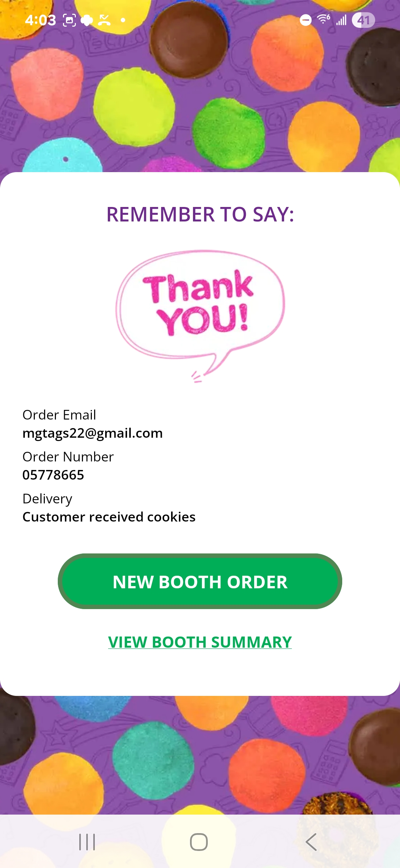
Booth Summary
Select View Booth Summary to review the sales processed at the current booth and see a summary of booth activity.
Click New Booth Order to begin processing another customer order at the current booth.
Notes:
Script:
No matter how the customer chooses to pay, a confirmation screen will appear when the order is complete. Always wait for this screen before giving the cookies to the customer so you know the order has been processed successfully.
When you're ready for the next customer, select New Booth Order. If you'd like to review your booth sales, select View Booth Summary.

Slide 62
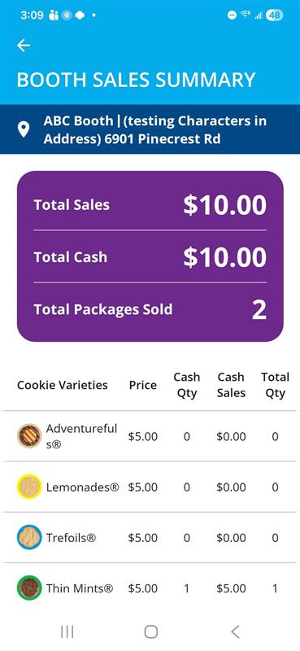
Booth Summary
If booth is over, click End Booth Sale
Notes:
Note to council: there is animation on this slide.
Script:
The Booth Summary, shows how many packages have been sold at the booth and how much money has been collected. If the booth is over, you can End the Booth Sale or start a new order.

Slide 63
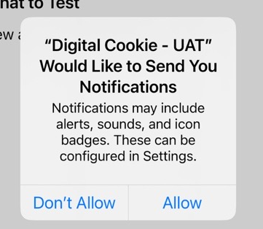
Make sure to enable notifications
Notes:
Script:
When notifications are enabled, you'll receive alerts to help you stay on top of your orders. You'll be notified when a new order is placed, receive daily reminders for any orders that still need approval, and get a final reminder when an order is scheduled to expire the next day. This helps ensure no orders are missed and allows you to take action before an order expires.

Slide 64
Customer Experience
Notes:
Script:
When a customer arrives at the Girl Scout’s cookie site, they can learn about the Girl Scout through its story, track progress toward the goal, and watch a video to learn more about the Girl Scout’s cookie program activities, if available.
When the customer is ready to purchase cookies, they simply select Start an Order to begin building and submitting their order.

Slide 65
Select Delivery Option
Notes:
Script:
Next, the customer selects their preferred delivery method. Once customers select their delivery type and click Choose My Cookies.

Slide 66
Choose Cookies
Click update to change delivery type.
Notes:
Script:
They'll be shown the cookie varieties available for that option. Any unavailable varieties will be listed at the bottom of the page.
If a customer doesn't see the variety they're looking for, they can go back and select a different delivery method to check whether that variety is available through another ordering option.
Once the customer has selected their cookies, they will tap Checkout.

Slide 67
Delivery Details
Notes:
Script:
Next, customers will arrive at the Delivery Details page, where they can review their order, provide delivery information, and enter their contact details.
After completing this information, customers can choose to connect with Girl Scouts or simply click Continue to Payment to proceed to the payment screen and complete their order.

Slide 68
Payment Details
Notes:
Script:
On the payment screen, customers can enter their payment information and take one last look at their order details. They can also update the billing address if it differs from the delivery address.
When everything looks correct, the customer selects Review & Place Order to continue to the final step of the checkout process.

Slide 69
Review Order
Notes:
Script:
The final review screen allows customers to verify all order details before completing their purchase. If the order is for In-Person Delivery, customers can update their backup delivery option if the order isn't approved within five business days.
When everything looks correct, the customer simply clicks Place Order to submit the order.

Slide 70
Order Confirmation
Notes:
Script:
After the order is submitted, the customer is taken to the Order Confirmation page. This page provides a summary of the order along with any applicable delivery details.
Customers can also choose to Send a Cheer, Download a Digital Cookie Patch, or start a new order if they'd like to purchase additional cookies.

Slide 71
Need Help?
Look for the green question mark bubble when logged into Digital Cookie for support on using the site.

