Slide 2
Digital Cookie Caregiver Training

Slide 3
Digital Cookie Caregiver Training
Training Agenda
1
Brief Digital Cookie Overview
2
Four Steps to Getting Started
3
Using Digital Cookie
4
Customer Experience
5
Digital Cookie Help Center
Notes:
Script:
The Digital Cookie Troop Cookie Volunteer Training will cover the following agenda items, :: List Items on Slide::.

Slide 4
What is Digital Cookie?
Notes:
Script:
What is Digital Cookie?

Slide 5
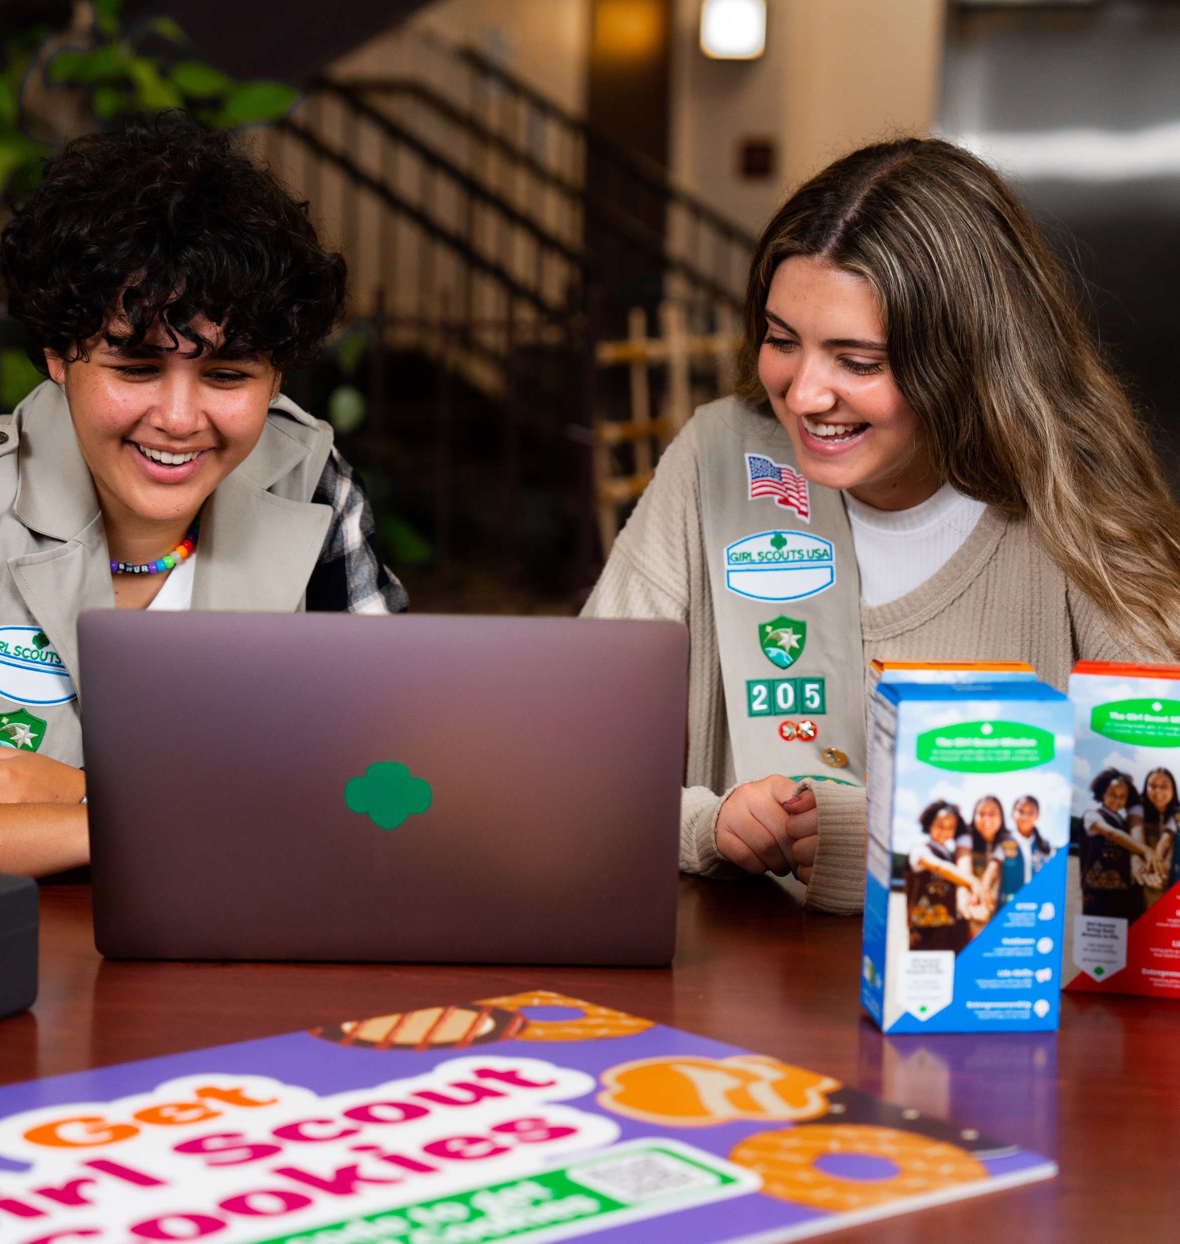
What is Digital Cookie?
Digital Cookie
Online Selling Platform
Packed with fun, easy-to-use tools, Digital Cookie® delivers more ways to participate, more ways to sell, more ways to buy, and more ways to learn! And in addition, studies show Girl Scouts who use Digital Cookie® in combination with traditional sales often sell more cookies and reach their goals faster.
Notes:
Script:
In general, Digital Cookie is a unified online selling platform. It has easy-to-use tools and provides multiple ways for Girl Scouts to enhance their entrepreneurial skills. eCommerce has grown over the years and the platform gives Girl Scouts the opportunity to supercharge their cookie business. Now we know what Digital Cookie is lets see who all can use Digital Cookie.

Slide 6
Who Uses Digital Cookie?
Notes:
Script:
Who Uses Digital Cookie

Slide 7
Who Uses Digital Cookie?
Girl Scouts create their own sites and send marketing emails to customers.
Girl Scouts use Digital Cookie to supercharge their cookie business!
Girl Scouts take orders and track purchases (Customers purchase cookies).
Girl Scouts and caregivers can manage their online sales, inventory, and financials using Digital Cookie.
Troop Cookie Managers use it to set up and manage sales for their troop's online sales site.
Troop Cookie Managers support Girl Scouts and families with visibility to their online progress.
Notes:
Note to councils: This slide has animation, click through each persona listing out how they use the system.
Script:
Digital Cookie is primarily used by Girl Scouts and Caregivers. Girl Scouts create their site and send marketing emails to customers. They can manage their online sales, inventory, and finances with their Caregiver. Girl Scouts can take orders and track the purchases from Customers.
Troop Cookie managers use Digital Cookie to support the Girl Scouts and families with visibility into their online activities. They also use it to set up and manage the troop site and online sales.

Slide 8
Girl Scout and Caregiver Experience
Notes:
Script:
The following slides will walk-thru the Girl Scout and Caregiver Experience

Slide 9
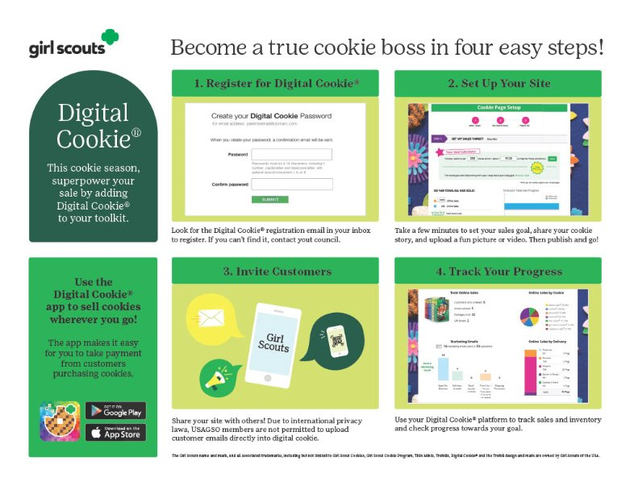
Notes:
Script:
Caregivers can help Girl Scout set up Digital Cookie in just four easy steps! We will cover these steps in more detail in this training.

Slide 10
Step 1: Register
Receive Email
Click "Register Now" In Email
No Registration Email
January 29
Create Password and Login
View the “No Registration Email” Tip Sheet
Sender: “Girl Scout Cookies” email@email.girlscouts.org
Subject: It’s time to register your Girl Scout for Digital Cookie!
All users must register through their Digital Cookie registration email every year.
Check promotions, junk, and spam folders for email.
Make sure myGS account is updated with the correct email.
Add the sender’s email to your contacts list.
Notes:
Note to councils: Customize the date for when registration emails are sent.
Script:
Watch for your registration email* from “Girl Scout Cookies” (email@email.girlscouts.org) with the subject “: It’s time to register your Girl Scout for Digital Cookie!” on ::ENTER COUNCIL DATE:: If you don’t see it, make sure to search your “Promotions/Clutter/Spam” folders.
The email will be sent to the primary email on file in your myGS account, please make sure that is up to date prior to your access date. If you don’t receive the registration email, use the tip sheets for additional steps to resend or look up to see what email is on file for your Girl Scout.
Once you find the email, open it and click on the Register Now button. You will be taken to Digital Cookie to create a password for this year and then log in to Digital Cookie with that password and email.

Slide 11
Step 1: Register
Activate Girl Scout(s)
Watch Safety Video with Girl Scout
After clicking the Activate button you will be able to update your Girl Scout’s preferred name. This name will be on the storefront and in the customer’s emails.
At the end of the video, you will need to click the green continue button.
Approve Terms and Conditions and Safety Pledge
13+ Girl Scouts
You will also have the option to add your Girl Scout’s email if 13 or older. Do not add the email address you used to log into Digital Cookie, This is optional, skip this box if you do not want to add an email.
Be sure to read the safety pledge with your Girl Scout and check the box to accept both documents.
Notes:
Note: If caregivers are both volunteer AND parent, they will only walk through this process once. If parent access is after volunteer access, they will not see the parent Terms and Conditions the parent role until parent access date starts.
Script:
When you first log in, you will need to watch a safety video, make sure your Girl Scout(s) is available to watch with you! There will be a Continue button at the end. You can’t proceed any further until the full video has been viewed.
Next you will, read and accept the Terms and Conditions agreement.
Then the “Girl Scout Safety Pledge” will appear. Be sure to read it to/with your Girl Scout(s) and check the box for “accept” and click “continue.”
Once you have accepted the terms and pledge, you will then be taken to a screen to activate your Girl Scout(s) for the Digital Cookie program and update their preferred name if desired.
If the Girl Scout you are activating is 13 or older, you have the option to enter an email address. The Girl Scout will then be able to set up the site and monitor Digital Cookie. (Note, the email address for a Girl Scout 13+ must be unique and not in use in Digital Cookie).
Girl Scouts under 13 will log in, in partnership with their caregiver and do not need a separate email address.
After activating all of your Girl Scouts (if you have multiple), you will click the “Access Site” button to be taken to the first Girl Scout’s home page. Once you have registered, watch your inbox for a registration confirmation email and save this email where you can find it during cookie season!

Slide 12
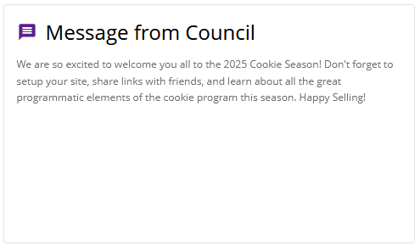
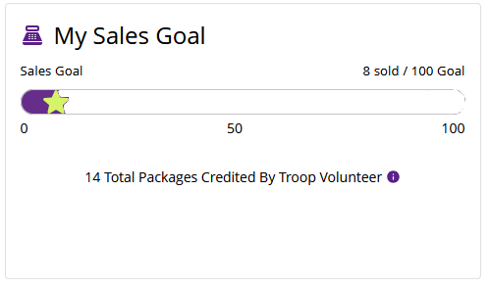
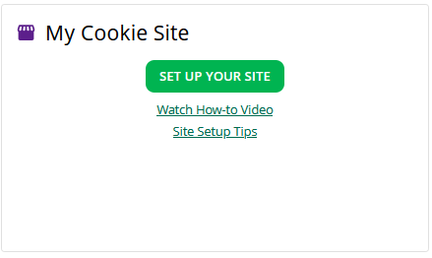
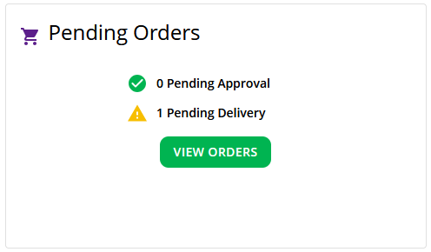
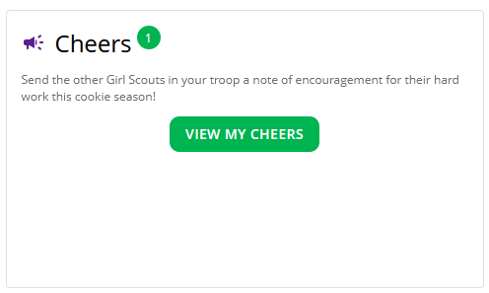
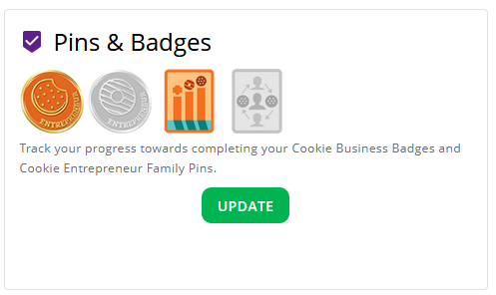
Message from Council
My Sales Goal
My Cookie Site
Note of encouragement from USAGSO
Digital sales progress bar and number of packages credited by troop volunteer.
Set up cookie site and then copy cookie site link or view QR Code.
Pending Orders
Cheers
Pins & Badges
At a glance, see if their Girl Scout has any orders that need to be approved or marked as delivered.
Quick access button to “Send a Cheer” to a Girl Scout in their troop.
Track the progress toward completing the Cookie Business Badges and Cookie Entrepreneur Family Pins.
Notes:
This slide has animation
Script:
Once they log in to Digital Cookie they will arrive on their Home page. They have 7 different sections on the Home page that help them support their Girl Scout’s Digital Cookie sales.
Message from Council: a note of encouragement from us for the sale.
My Sales Goal: See their Girl Scout’s progress toward the goal and see how many cookies the troop cookie volunteer has assigned to their Girl Scout.
Donated and In hand orders appear right away.
Shipped orders appear in the graph when the order ships. This can take a few days, orders don’t ship on weekends and holidays.
In-person delivery orders appear when the order is approved
Girl Scouts can add offline sales under the site setup page so customers can see a true representation of sales.
My Cookie Site: First they will see a button to set up the Girl Scout cookie site, once it is set up they will have easy access to the link and a QR Code to share with customers.
Pending Orders: In this section they will be notified if there are orders that need to be approved and reminded of orders that need to be marked as delivered.
Cheers: Here they will find a quick access button that will take them to the Cheers page where their Girl Scout can send a Cheer to a Girl Scout in the troop and see what Cheers have been sent from Girl Scouts, volunteers, and customers.
Pins & Badges: This section will let them know when their Girl Scout has completed a cookie pin or badge. Once completed the steps on the Badges page, the completed pin or badge will show in color.

Slide 13
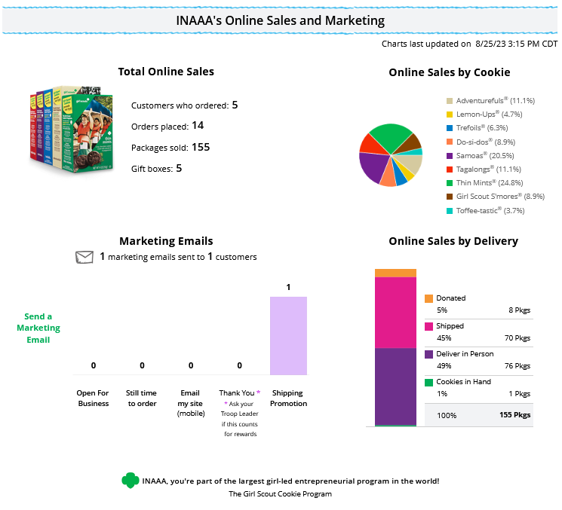
Online Sales and Marketing
Notes:
Script:
The seventh section, at the bottom of the Home page, is the Online Sales and Marketing section, this is where you can monitor your Girl Scout’s cookie business by viewing the total sales as well as a breakdown of sales by cookies and delivery options. You can also see how many marketing emails have been sent to customers.

Slide 14
Setting up the Girl Scout Cookie Site

Slide 15
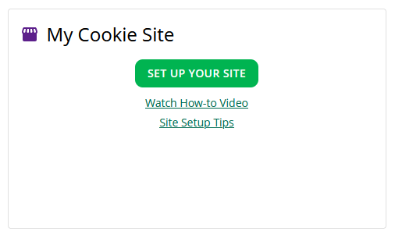
Step 2: Set up Girl Scout’s Site
Have multiple Girl Scouts? Easily switch between each site here.
To set up the Girl Scout’s cookie site:
Click the “Site Setup” link on the menu bar.
Or click the “Set Up Your Site” button from the home page.
Notes:
Script:
To setup the Girl Scout’s cookie site, click on the “Site Setup” link in the Menu bar at the top. There will also be a Set Up Your Site button on the Home page in the My Cookie Site section.

Slide 16
Four sections to set up the site
Girl Scout Site Set Up
Goal Setting: Set My Sales Target
My Cookie Story
Photo/Video Upload
Preview and Publish Your Site
Notes:
Script:
There are four sections on the site set up page. The next few slides will cover them in more detail.
1. Goal Setting: “Set My Sales Target”
2. “My Cookie Story”
3. Photo/Video Upload
4. Preview and Publish Your Site

Slide 17
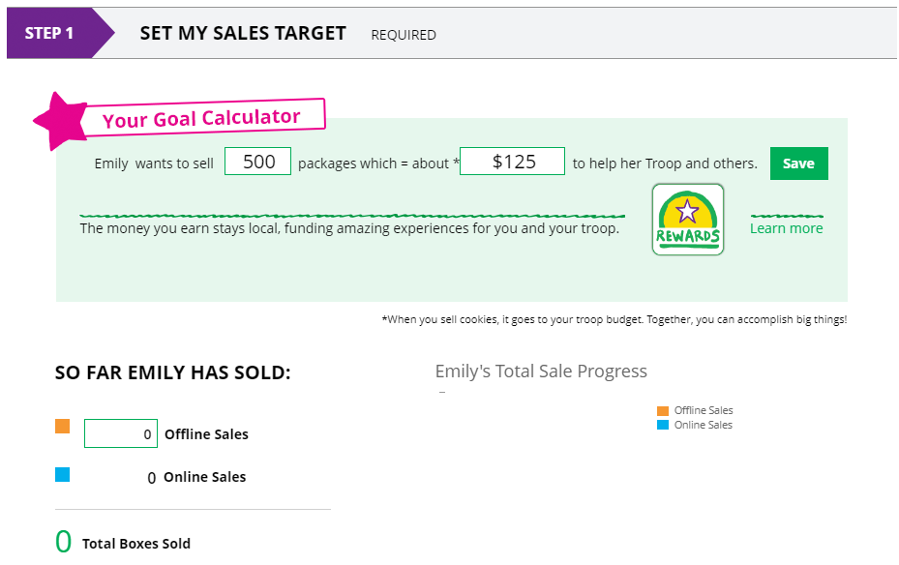
Goal Setting: Set My Sales Target
Step 2-Setup Your Site
2
1
3
4
Notes:
Script:
In the Goal Setting: Set My Sales Target section
Girl Scouts will enter how many packages of cookies they are working to sell this year through online and offline sales.
When the information is entered, the calculator will show how much money the troop will get from the hard work.
Clicking on “Rewards” will take the Girl Scout to the rewards page to see what rewards the Girl Scout might want to work towards.
Girl Scouts can enter any offline packages they have sold so their customers will see their total sales, not just their digital sales.

Slide 18
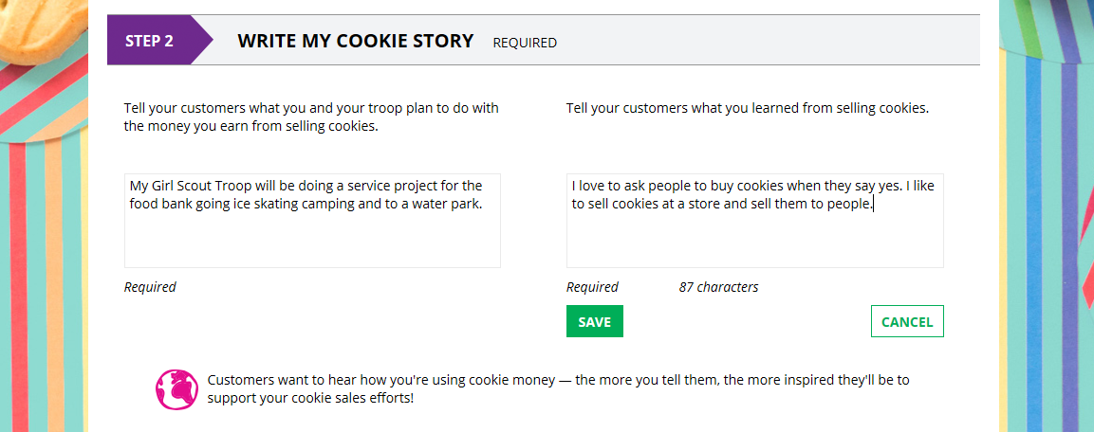
My Cookie Story
1
2
3
Notes:
Script:
My Cookie Story section.
Girl Scouts tell their customers about a troop goal and why it’s important.
Girl Scouts share what they’ve learned from the cookie program.
Save their story. They can make edits to it at any time.

Slide 19
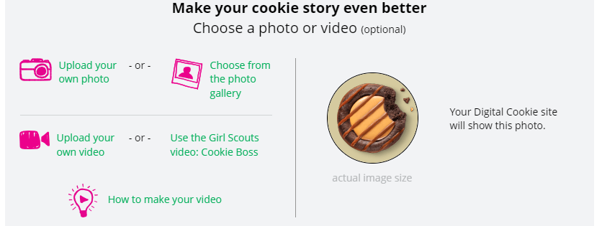
Photo/Video Upload
Girl Scouts who uploaded a photo or video of themselves sold more than double the boxes on average than those who did not.
1
2
3
Notes:
Script:
Photo/Video Upload section
1. Girl Scouts can choose to upload a photo or use a picture from the gallery.
2. Or, Girl Scouts can upload a video or use a GSUSA video (note the “Cookie Boss” video is changing, once Girl Scouts are in the site they will have a new video to select)
3. Bonus! Girl Scouts can get tips on how to make a great video.

Slide 20
Approve and Publish
Step 2-Setup Your Site
If your button only says “see your site” you may be missing some required fields or didn’t make any changes. Go back and check that everything has been completed.
Click to edit
Click to review and publish
Notes:
Script:
Once the Girl Scout has entered all the site details, they will click the See your Site and Publish button. They will see what the customer will see.
There are a few things you should check prior to publishing the site:
Is the spelling and grammar correct and does it tell a story?
Make sure the photo or video are displaying correctly.
Are the goals accurate?
If you need to change anything, click Edit and make changes
If it looks good, approve and publish the site.
Girl Scout’s 13+ will have a button that says, “see your site and submit for approval”. They can see the preview and edit. Parent is sent an email to approve the site.

Slide 21
Digital Cookie Pages

Slide 22
Badges

Slide 23
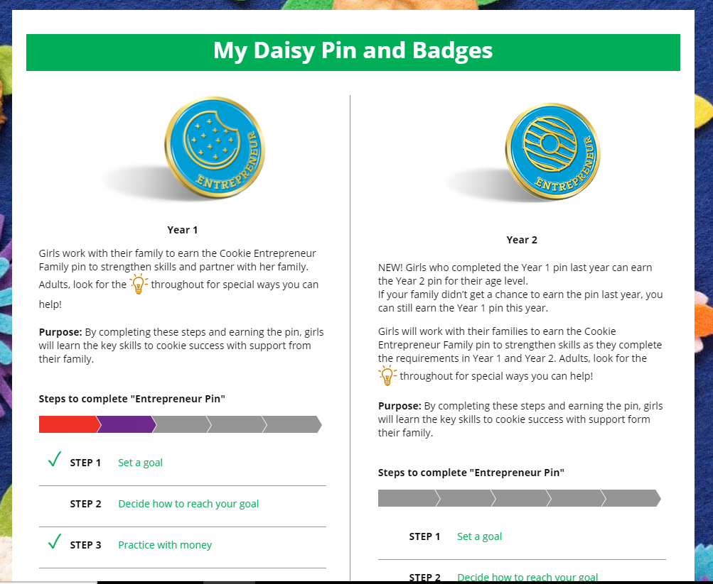
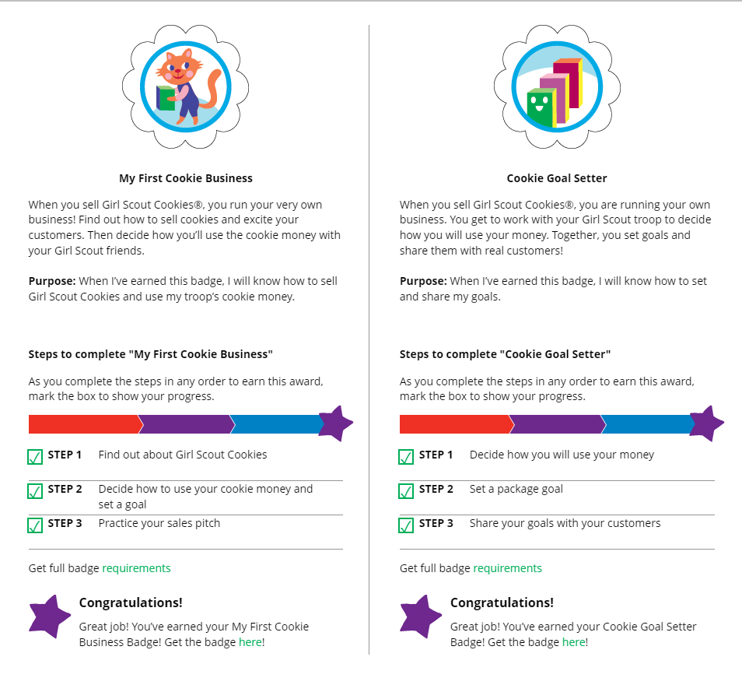
Badges
Notes:
Script
The Badges page displays the Cookie Entrepreneur Family Pins, and the Cookie Business badges appropriate to your Girl Scout’s level.
For the badges, Girl Scouts can read an overview of the steps. For full details, check with the troop volunteer or purchase the online requirements using the shop link or from your local council store.
For the Cookie Entrepreneur Family Pins, Girl Scouts can click on the instructions for each step.
The instructions for each step of the pin will pop up. Girl Scout can click on the link to complete any activities in Digital Cookie, and once completed the Girl Scout will click the box next to each step to mark as complete.
When the box for the last step in earning that pin is checked, a pop-up will appear asking to confirm the Girl Scout completed the last step.
Girl Scouts can mark the steps as completed even if they finished the badge earlier.
If they wants to do the steps again, Girl Scouts can—they are all great tools for their cookie sale. When all steps are completed, a star will appear at the end of the progress bar, and Girl Scouts will get a message of congratulations!
Once the Girl Scout has completed the badge or pin, it will display in color on the home page.

Slide 24
Learning

Slide 25
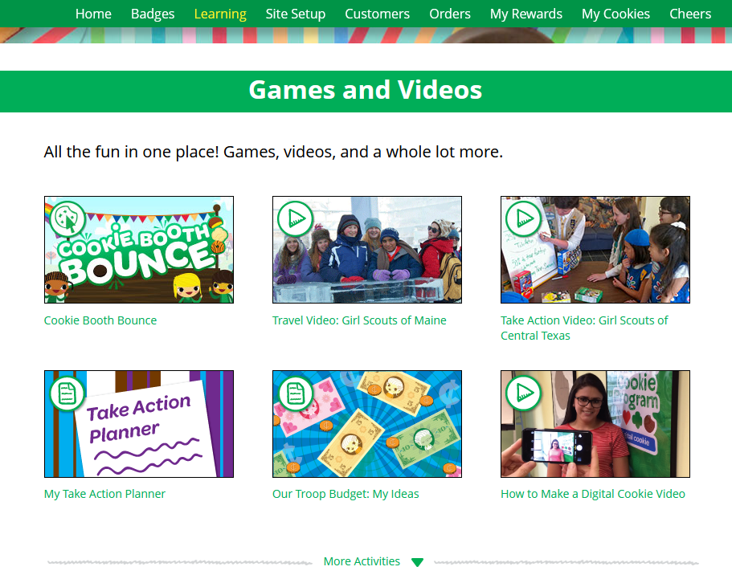
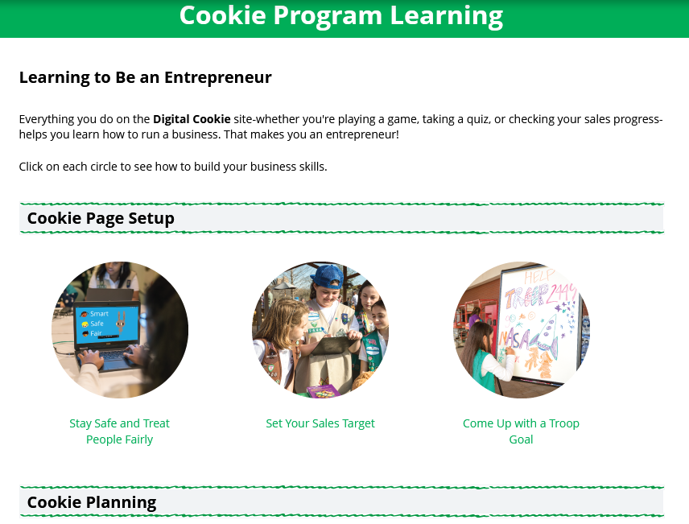
Learning
Notes:
Script
The Learning page has different activities, videos, and printables. The offerings vary by age.

Slide 26
Customers

Slide 27
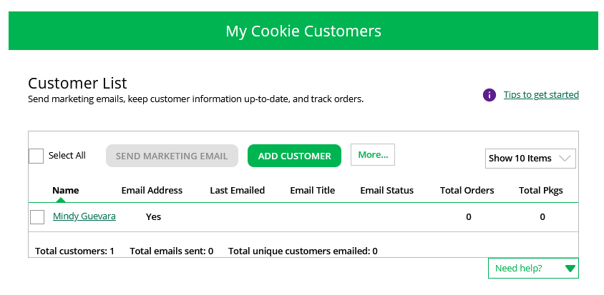
Customers
Due to international privacy laws, USAGSO members are not authorized to input customer contact data.
Notes:
Script:
The customer’s page is where Girl Scouts can add customer information to their list and send emails.
Due to international data privacy laws, USAGSO members are not authorized to input or upload customer contact data into digital cookie.

Slide 28
Orders

Slide 29
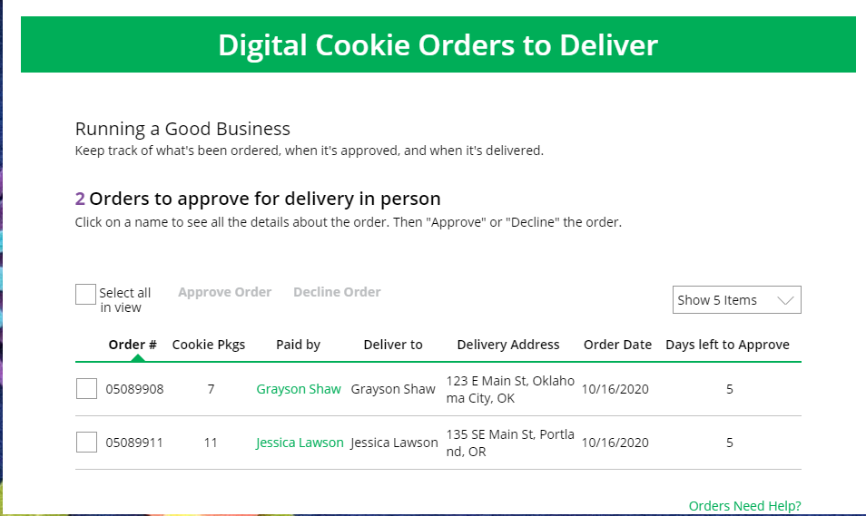
Orders to Deliver
Click on the “Paid by” name to review customer and order details
When determining whether to approve or decline the order, consider:
Is the customer a known and trusted individual?
Are you willing and able to get the cookies to the customer’s location before the end of the sale.
AND
Do you have or will you have the inventory available?
If so, “Approve Order.”
Notes:
Script:
The top of the orders page is a list of any In-person delivery orders that need to be approved. This will only be used by communities and troops offering girl delivery for inperson sales.
In this section you will see a brief overview of the order.
Orders must be approved or declined with in 5 days, or the order will be automatically declined and revert to the customer’s second option of cancel or donate. The order cannot be changed, and the customer will have to place another order.
::Read slide on determining whether to approve order::
If you are unable or unwilling to fulfill the customer’s order, click “Decline Order” and the order will default to whatever second option the customer has selected: “Cancel” or “Donate”.
If an order has not been approved by midnight, you will receive an email from email@email.girlscouts.org with the subject “Action required: you have an in-person delivery request!”.

Slide 30
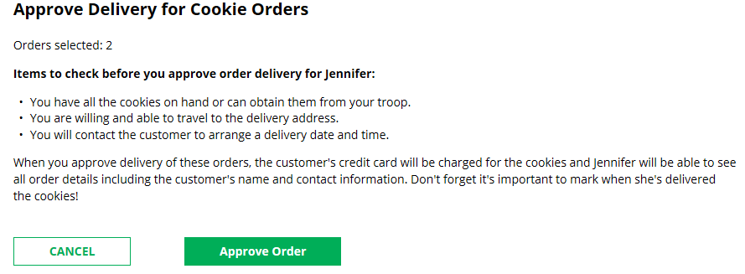
Orders
Approving/Declining Orders in Bulk
Check box
Once you approve or decline you can’t change the action and an email is deployed to the customer.
Notes:
Script:
There are multiple ways to approve and decline orders for delivery. The first way is to approve orders in bulk. You can do that by checking the boxes in front of the orders you want to approve or decline and then click “Approve Order” or “Decline Order”
A pop-up message will appear asking you to confirm the action you have selected.

Slide 31
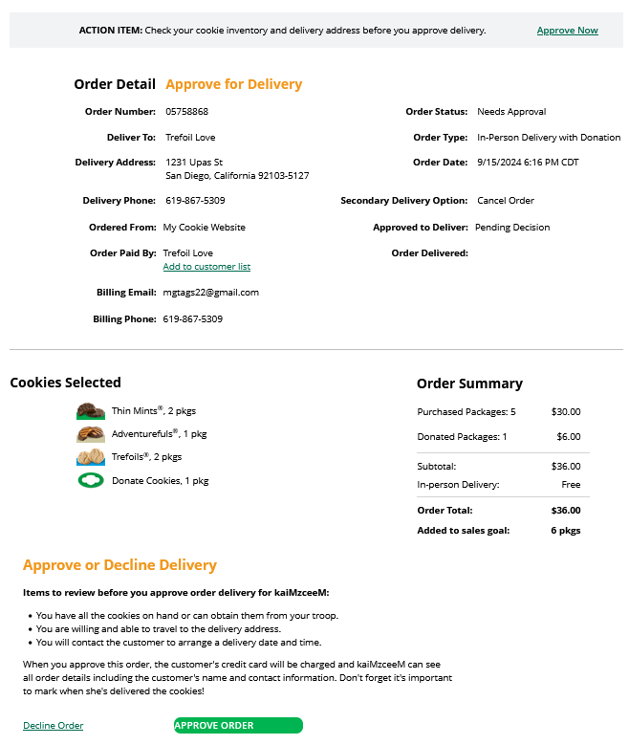
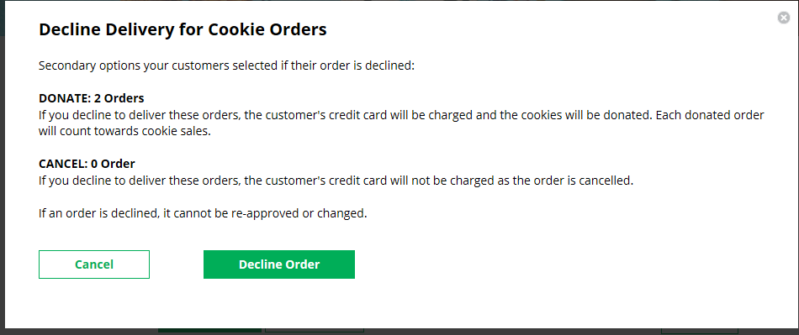
Orders
Once approved: customers receive an email to expect their cookies within two weeks of when you have them.
Approving/Declining Orders Individually
Notes:
Script:
The second way to approve orders is individually:
Click on the customer's name to bring up the order details and click “Decline Order” or “Approve Order” at the bottom.
If you decline the order, you will get a pop-up message confirming you want to decline the order and understand if the order is being cancelled or donated.

Slide 32
Orders
Orders to Deliver
Orders must be marked as delivered to update cookie inventory correctly.
Select all
OR
Select a customer
Notes:
Script:
After approving an order, the order will pop down to the next section “Orders to Deliver”. Once the order has been delivered, log back into Digital Cookie and mark those orders delivered.
There are two ways to indicate you have delivered your order:
Check the “Select All” box to select all of the orders on the page; they will all be marked “Order Delivered”.
Check the box in front of any orders you have delivered, and then click “Order Delivered.”
When they are marked as delivered, they will move down into the third section on the page as a completed order.

Slide 33
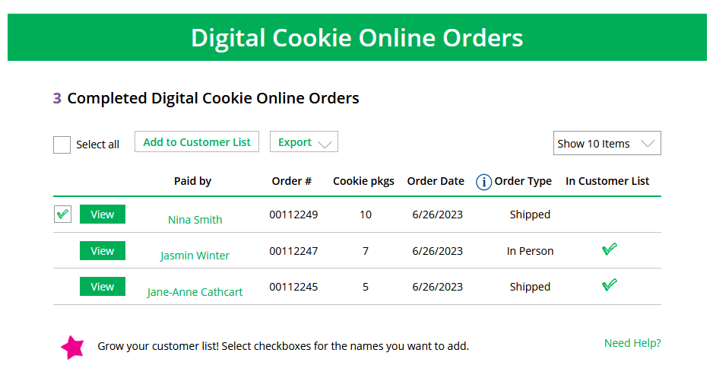
Completed Orders
Orders
.
Notes:
Script:
In the completed orders section, Girl Scouts can see all orders including shipped and donated orders.
If the customer is not in the Digital Cookie contact list, your Girl Scout can check the box in front of the customer’s name and click “Add to Customers tab.” Then, the customer will be in the records for sending thank-you emails this year and marketing emails next year for repeat business.

Slide 34
My Rewards

Slide 35
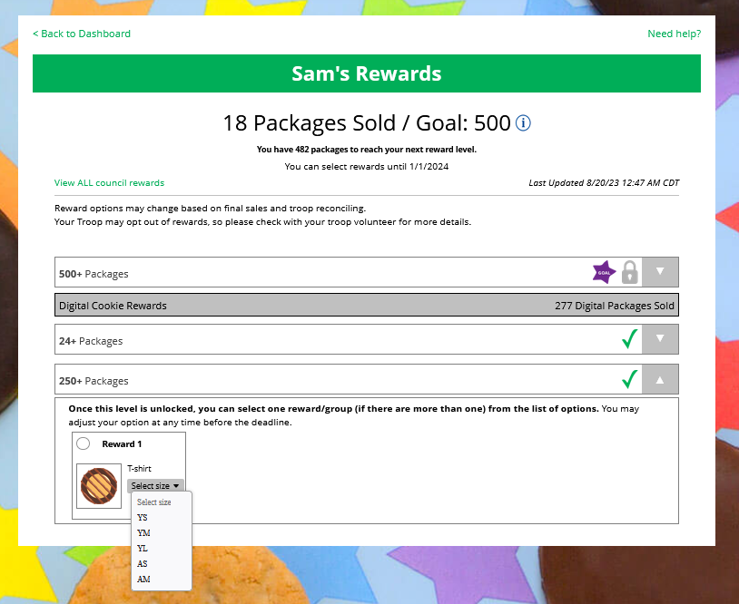
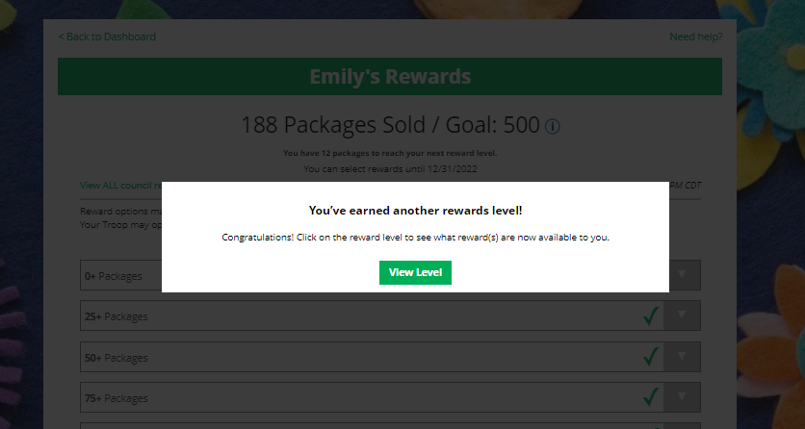
My Rewards
Purple star =Goal
Earned Reward
As Girl Scouts earns a reward, they will see a message on their “My Rewards” tab letting them know they earned another reward.
NOTE: Girl Rewards are not available in troops that opted out of rewards for additional proceeds. Please check with your troop leader to find out if you are eligible to earn Girl Rewards this season.
Select Size
Notes:
Script:
Girl Scouts can see the rewards they can earn for selling cookie packages, they can get more details about each reward.
Girl Scouts can also see where their cookie goal is in relation to the rewards!
Girl Scouts can see all the rewards they can earn by clicking on the down arrow on the right side. It may still be locked, which means the Girl Scout hasn’t yet sold enough packages to earn the reward, but they can still see the reward(s) and get more details by clicking on them.
The data for what rewards the Girl Scout has earned comes from the number of cookies the troop cookie volunteer has in their records for the Girl Scout. Check with the troop cookie volunteer if you believe the information is incorrect.
Not all rewards are represented here. System can’t accommodate Gift of Caring rewards, Per Girl Average (PGA) rewards, etc.
Girl Scout selections do not feed directly to the baker system. Troop cookie volunteer will need to pull the report from Digital Cookie but having Girl Scouts select choices and sizes in Digital Cookie cuts down on the amount of work the volunteer does at the end of the sale.

Slide 36
My Cookies

Slide 37
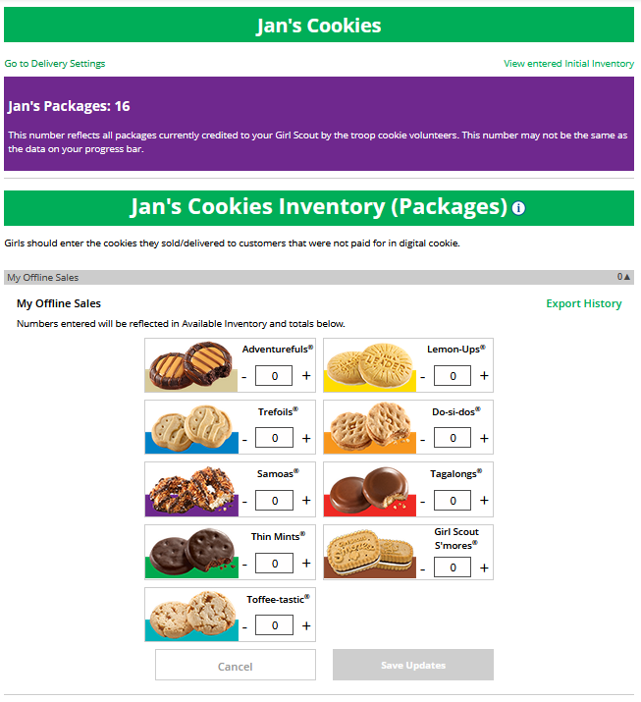
My Cookies-Inventory: Offline Sales Entry
The total number of packages that have been allocated to your Girl Scout from the troop cookie volunteer.
Offline sales need to be updated by the Girl Scout/caregiver when the Girl Scout delivers cookies not ordered/paid for through Digital Cookie.
1
2
Notes:
Script:
If your daughter is participating in inperson sales and participating in girl delivery, the MY COOKIES tab will let you track and manage cookies and available flavors.
Digital Cookie can help you make sure that you have enough cookies for your orders, track your progress on delivering/selling offline orders AND/OR make sure that your records of cookies received agrees with what your troop cookie volunteer has given your Girl Scout.
The top part of your My Cookies page shows the total number of packages that have been allocated to your Girl Scout from the troop cookie volunteer. It could include booth sales or troop sales. It is not the same as the number of cookies you are personally responsible for.
The inventory section gives you a quick view of how many cookies you should still have undelivered and how many you may need to fill your in-person orders.
“My Offline Sales” This is something that needs to be updated by the Girl Scout/caregiver when the order is delivered and receives a cash or check payment for them. If they are not entered in this section, they will not be removed from the inventory and this section will not be correct.
To enter offline sales, click the down arrow by the number of packages on the left side and open a screen to enter those sales. When those are entered, click “Save Updates”
Once you click Save Updates, you will be asked to confirm you want to update the inventory.

Slide 38
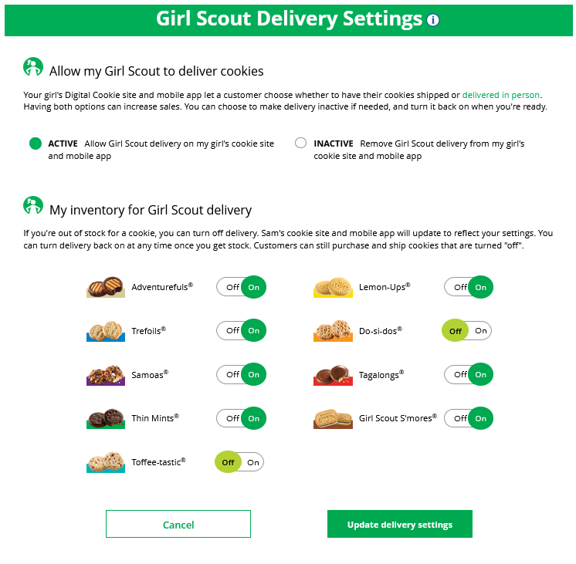
My Cookies Tab-Delivery Settings
Notes:
Script:
The Delivery Settings function gives you the opportunity to turn off Girl Scout delivery and off varieties of cookies. This might be useful if you run out of a cookie variety and can’t get any more to fill customer orders or you are entirely out of cookies for delivering to customers or otherwise are unable to deliver cookies to customers.
If you are worried about your inventory, always check with your troop cookie volunteer first to see if you can get more cookies before turning off a variety. Turning it off means a customer doesn’t have the option to purchase it for delivery so you don’t have to decline their order and disappoint them if they can’t get the variety they ordered.
When you know you need to turn off delivery or a variety(ies), go to the bottom of your “My Cookies” tab and find the Girl Scout Delivery Settings section.
When you select “inactive” to turn off the Girl Scout delivery option for your customer, you will get a warning message. If you want to turn delivery off, click “Update delivery settings”. Once you have turned it to inactive, the varieties section will be removed and is superseded by a message. You can turn the site back on at anytime during your council sale dates.
If you wish to offer delivery but are out of a cookie variety and can’t get more inventory, you can turn off just that variety of cookie for delivery and customers can only purchase those for shipping and not delivery. To do that, simply click the “off” button then click the Update delivery settings button, and it will remove that variety from the Girl Scout delivery option. If you are able to offer that to customers again, return to this section and click the “on” slider to turn that variety back on.

Slide 39
Cheers

Slide 40
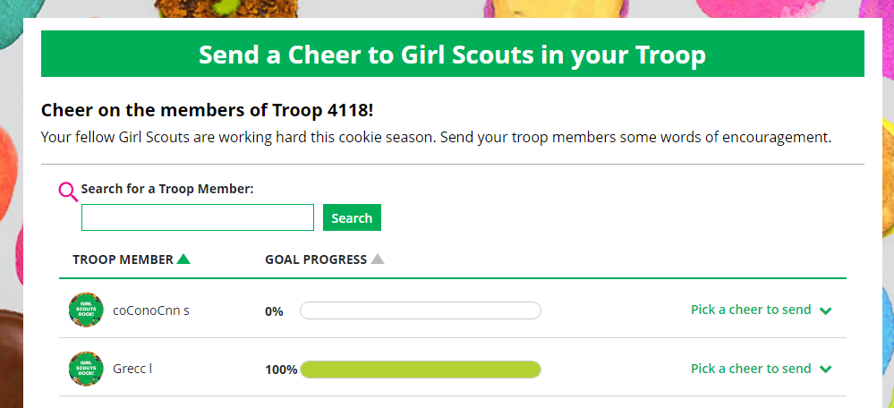
Girl Scouts can only send to other girls in their troop but can receive Cheers from customers and leaders, and other girls in their troop.
Cheers
To send a Cheer, Girl Scouts can click Pick a cheer to send next to the Girl Scout they want to cheer.
Notes:
Script:
Girl Scouts can be even more excited about their Digital Cookie experience when they give a Cheer to another Girl Scout in their troop or receive one from a troop member, troop volunteer, or even a customer.
In the Cheers module, Girl Scouts can see the other members of their troop and the percentage of sales towards them reaching their goal.
They can select the “Pick a cheer to send” drop down next to the name of the Girl Scout they wish to cheer.
Girl Scouts will see a choice of .gif images and short messages they can send. As they select the message and image they will see a preview of the cheer and then can click “Send this Cheer”
When Girl Scouts have cheers that have been sent to them, they can see how many cheers on their dashboard and from there, they can click to view their cheers.
If the cheer is from another Girl Scout in their troop they can “Cheer Back”, which will take them to a quick screen to return the cheer.
If they do not see “Cheer Back” as an option, the cheer is from a troop volunteer or customer, and they can’t send a cheer back to those supporters.
Note: some of the Cheers pictures will be different once Girl Scouts are in the system.

Slide 41
Mobile App
Girl Scouts & Caregivers
Notes:
Script:
The next slides will cover using the Mobile App for Girl Scouts and Caregivers

Slide 42
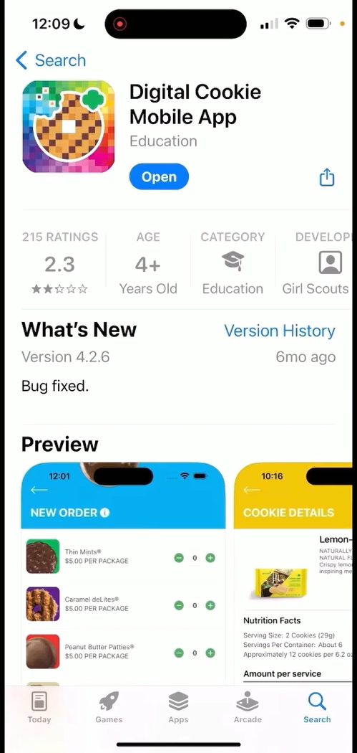
Digital Cookie Mobile App
Download a new version of the mobile app each year.
Mobile app found in iTunes or Google Play store.
Notes:
Script
Girl Scouts can use the Digital Cookie Mobile App to process and review orders placed through the Girl Scout’s individual site. Make sure to download a new version of the mobile app each year.

Slide 43
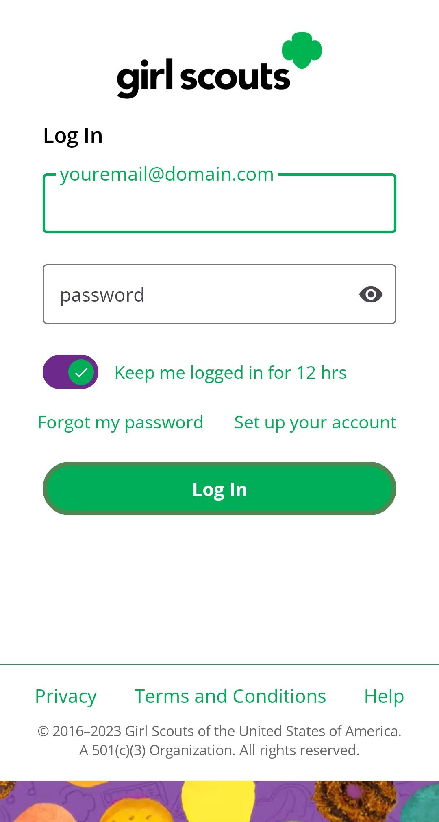
Logging In
Use the same email and password use for Digital Cookie
Girl Scout Cookie site must be published
Notes:
Script
To log into mobile app, you will use the same email and password used to log into the Digital Cookie browser site. The Girl Scout Cookie site must be published prior to accessing the mobile app.

Slide 44
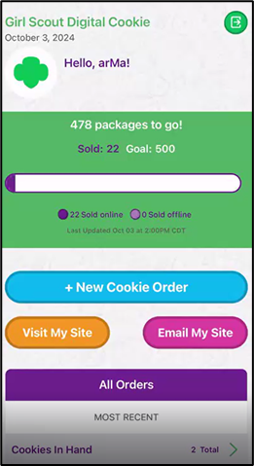
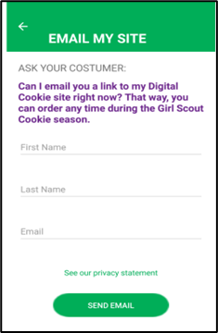
Digital Cookie Home Screen
Visit My Site
Customers can scan the QR code to visit the Troop’s Cookie Site.
Email My Site
Select Girl Scout’s Name
Girl Scout’s can send a marketing email to a customer.
Notes:
Script
When you first log into Digital Cookie, you might see multiple roles, this section of the training will cover your Girl Scout’s role. Select the role to be taken to her home screen. From here you can place a new cookie order, share the site with customers, or view all orders.
The “Visit My Site” button will take the Girl Scout to a QR code, the Girl Scout can then turn the phone around allow the customer to scan the QR code to make a purchase from the Troop’s Cookie Site.
The “Email My Site” button is used to send a marketing email to customers who can then purchase from the Troop’s Cookie Site at a later time.
To take an order using the mobile app, Girl Scouts will click the “New Cookie Order” button.

Slide 45
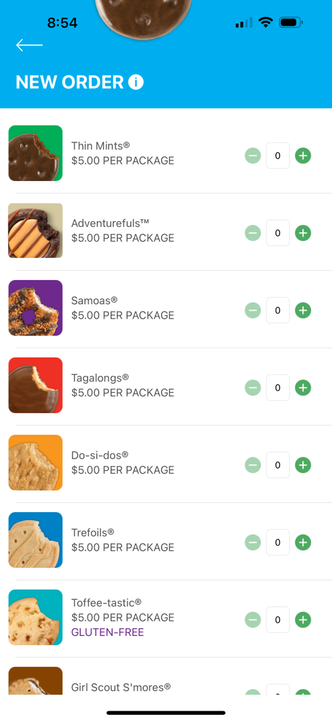
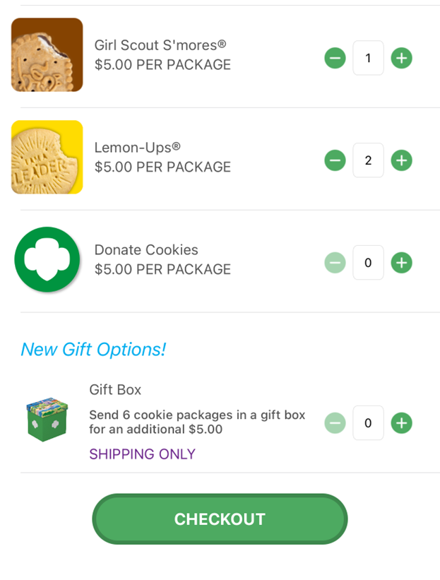
New Cookie Order
Notes:
Script:
To place a cookie order using the mobile app, the Girl Scout will select New Cookie Order, then enter the varieties the customer would like to purchase by using the plus and minus signs next to each cookie variety and click Checkout.

Slide 46
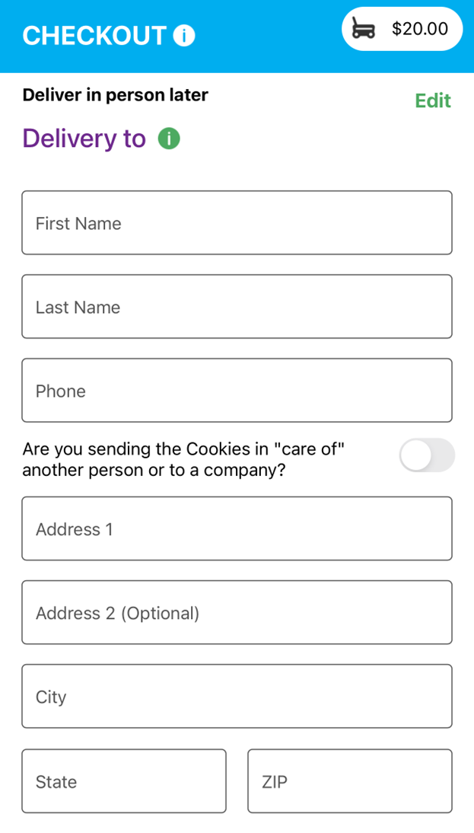
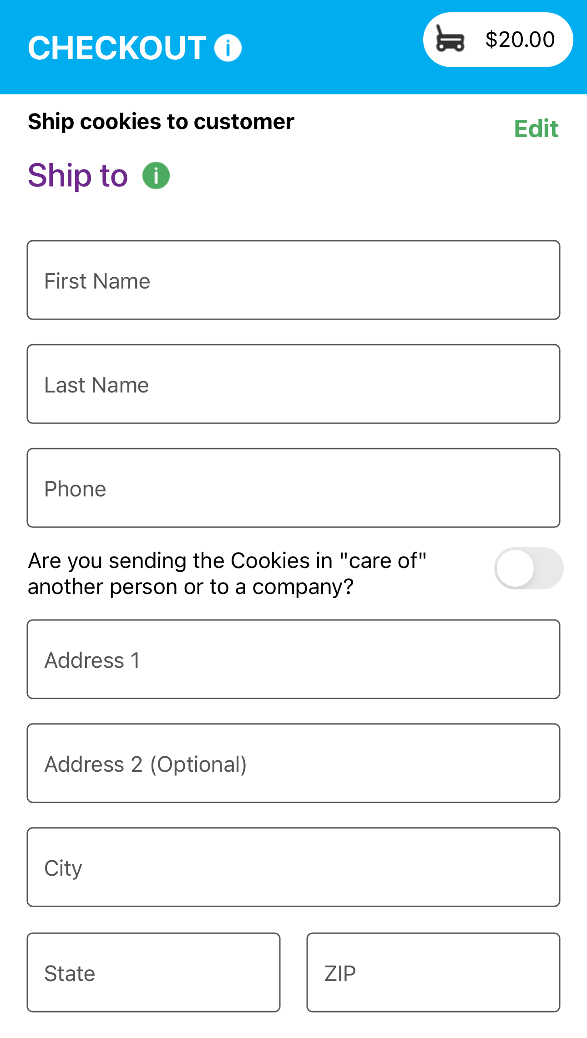
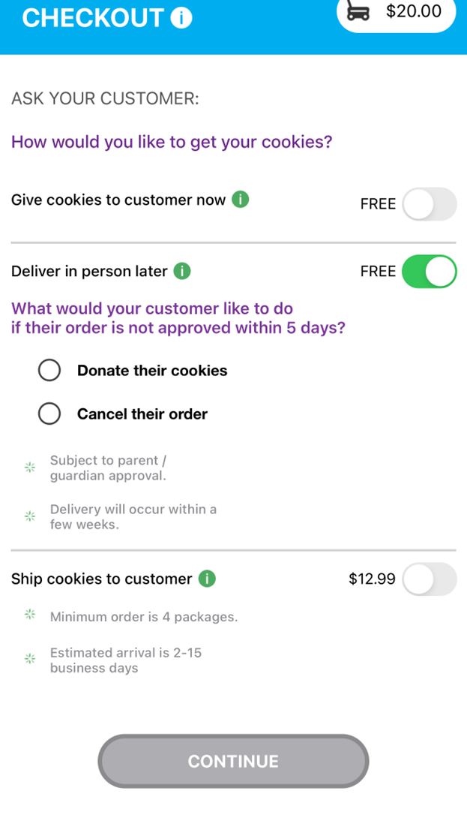
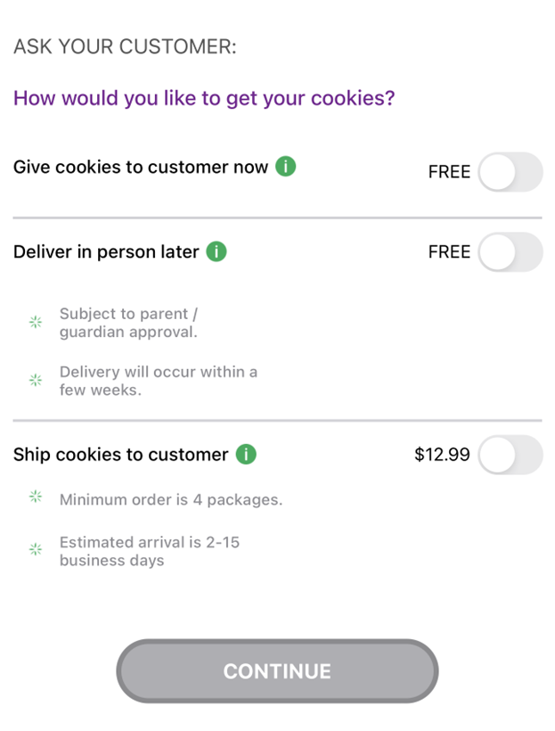
New Cookie Order
Step 2: Select how the customer would like to receive their cookies.
IMPORTANT: If you do not have cookies to hand the customer at the time of purchase, DO NOT select “Give cookies to customer now”.
Deliver in person later
Ship cookies to customer
Notes:
Note to council: there is animation on this slide.
Script:
Next the Girl Scout will select how the customer would like to get their cookies. We will cover the “Give cookies to customer’s now” option later in the training when we cover using the app at a cookie booth. If the Girl Scout, does not have the cookie varieties the customer would like or is taking pre-orders, she can select Deliver in person later, or if the customer would like to order cookies to ship to someone, she can select that option as well. It is recommended to use the QR code or “Email My Site” feature on the last screen for these to orders since it will require additional steps through the mobile app for the Girl Scout. If the Girl Scout selected “deliver in person later”, She will need to ask the customer if their order is not approved with in 5 days what would they like to do with their order. Then the Girl Scout will need to enter the customers delivery or shipped details. All before entering the customer’s payment information (which will be shown a little later).

Slide 47
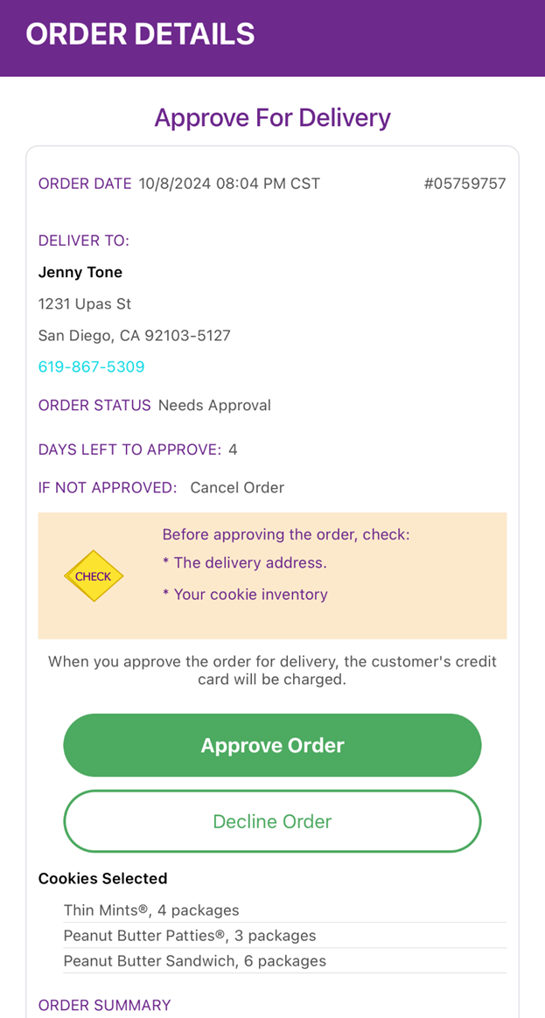
All orders for in-person delivery must be approved, even if placed through the mobile app
All Orders
Notes:
Note to council: there is animation on this slide.
Script:
Once an order has been placed, the Girl Scout can view all orders (placed through the app and the Digital Cookie site) under the All Orders section from the home screen. To view the orders in a specific category, click on the green arrow to the right to bring up all the orders. Then click on the order you want to view. If the order is an in-person deliver order users can approve or decline the order from the app. If the Girl Scout has selected to Deliver in person later (as shown in the previous slide), she will still need to work with her caregiver to approve or decline the order.

Slide 48
Mobile App
Booths
Notes:
Script:
The next slides will cover the using the Mobile App when at a Cookie Booth

Slide 49
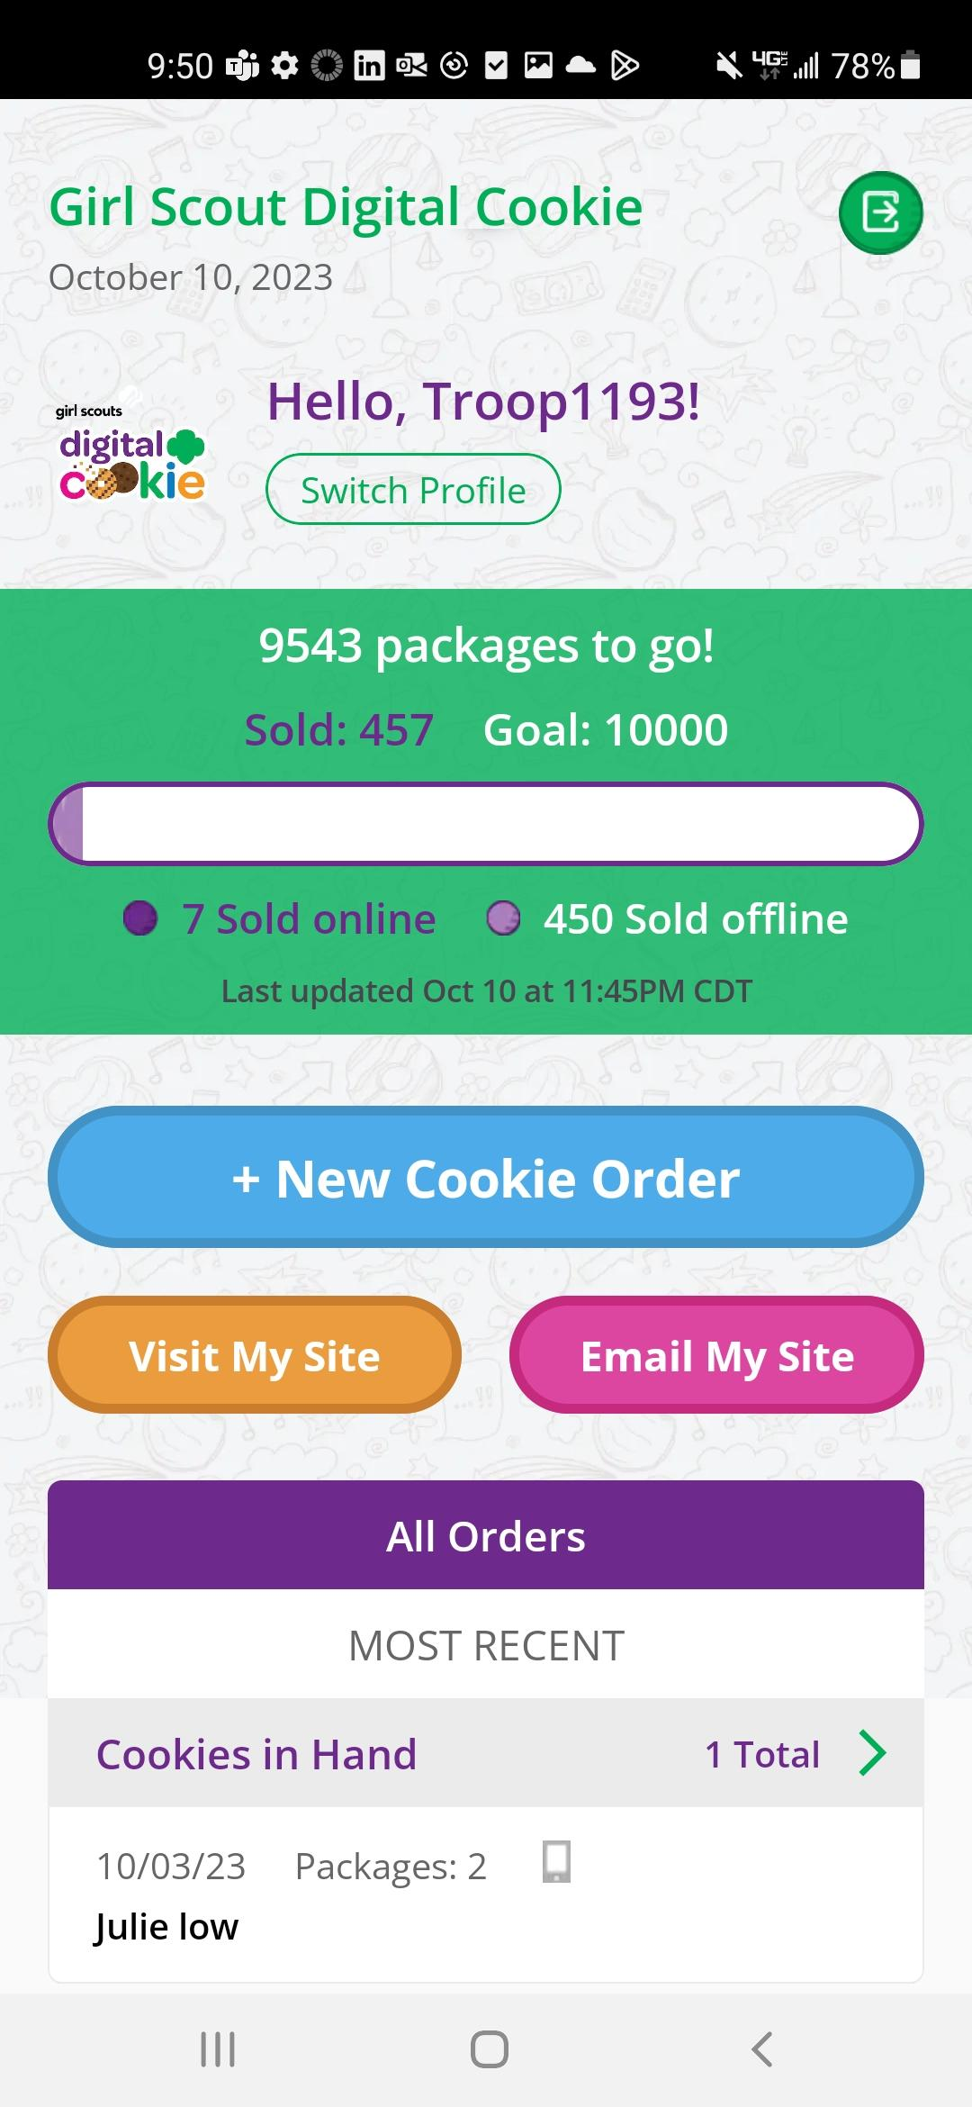
New Cookie Order
Placing an order at a cookie booth
Select the troop role
Notes:
Note to council: there is animation on this slide.
Script
To take an order using the mobile app at a cookie booth, you will want to use the Troop Role, you can do this by selecting the troop role when you first log in or if you are already logged in under your Girl Scout’s account. You can select Switch Profile. To place an order, Girl Scouts will click the “New Cookie Order” button.

Slide 50
New Cookie Order
Step 1: Select Cookie Varieties
Notes:
Note to council: remove the cookie varieties that your council is not selling.
Script:
First the Girl Scout will enter the varieties the customer would like to purchase by using the plus and minus signs next to each cookie variety. Then select Checkout.

Slide 51
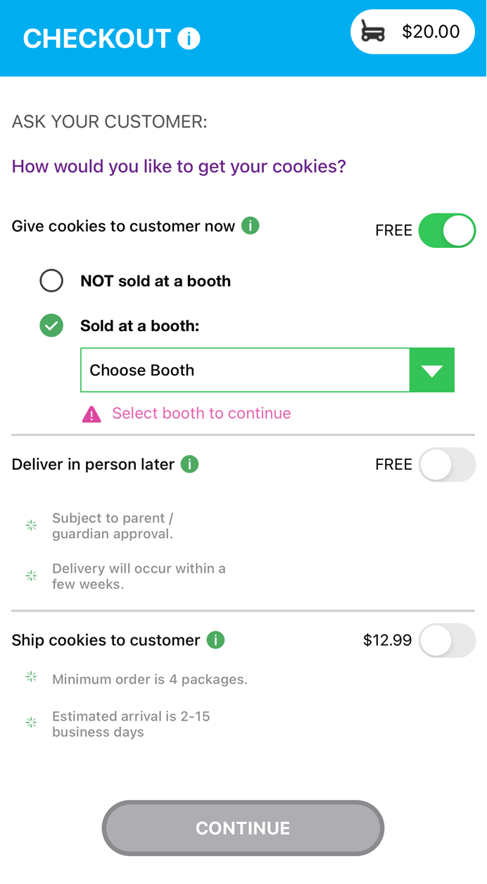
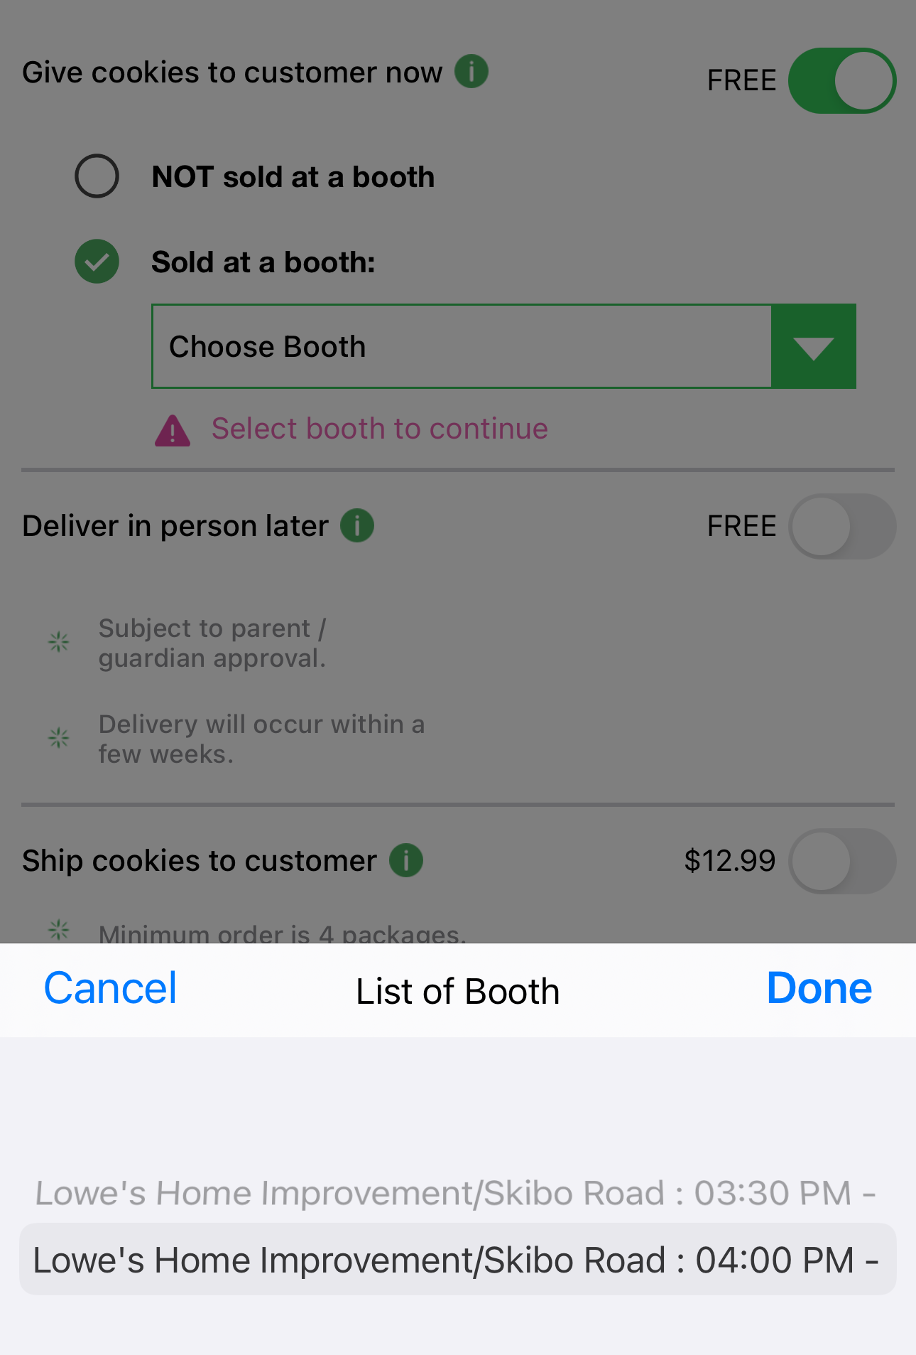
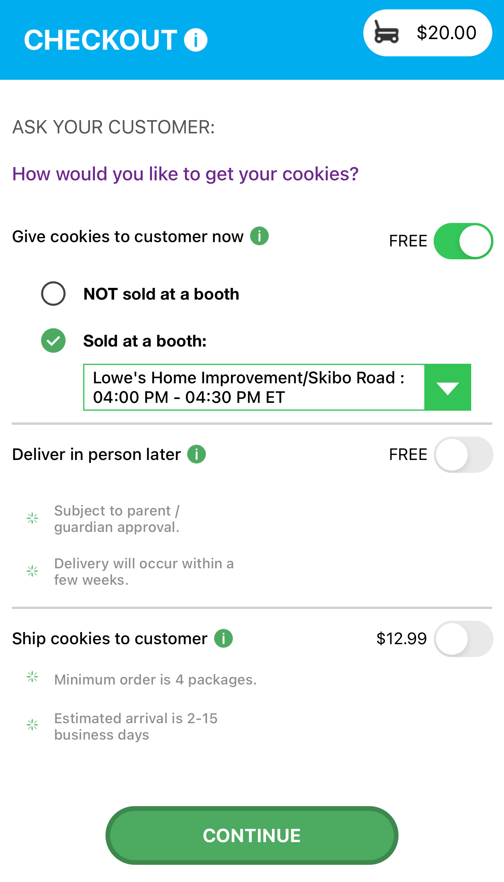
New Cookie Order
Step 2: Select how the customer would like to receive their cookies.
Notes:
Note to council: there is animation on this slide.
Script:
Next the Girl Scout will select “Give cookies to customer’s now”, since she is at a cookie booth. Once the “Give cookies to customer now” option is select, the Girl Scout can now choose if she is at a booth or not. When the at a booth is selected, the Girl Scout will be able to select which booth the troop is at. Then click continue.

Slide 52
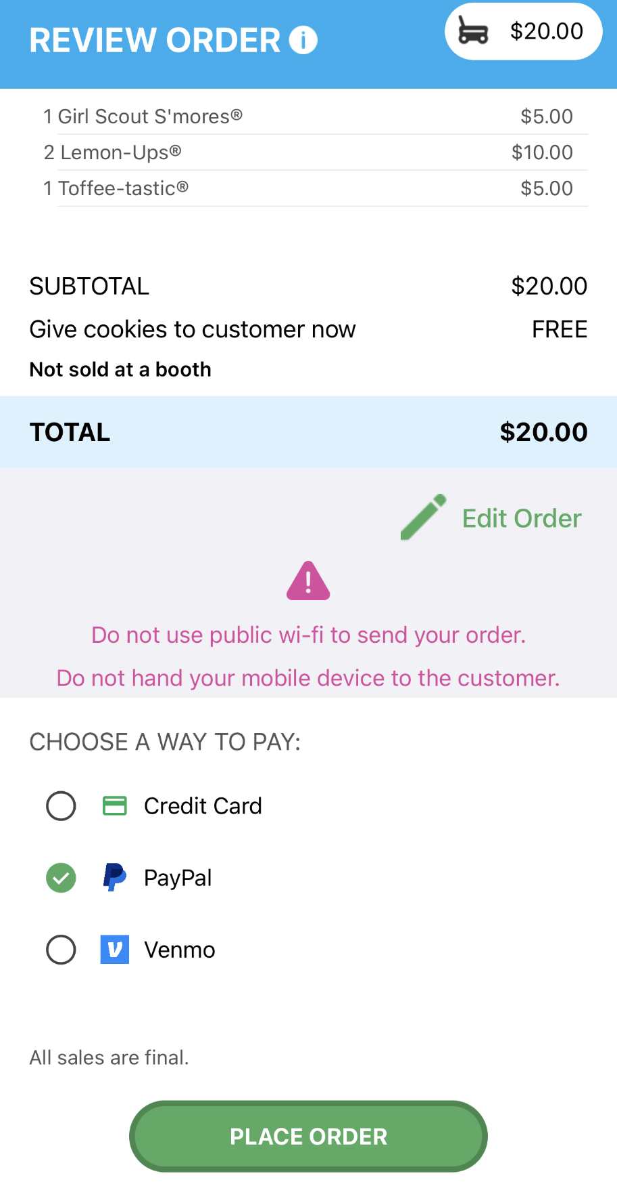
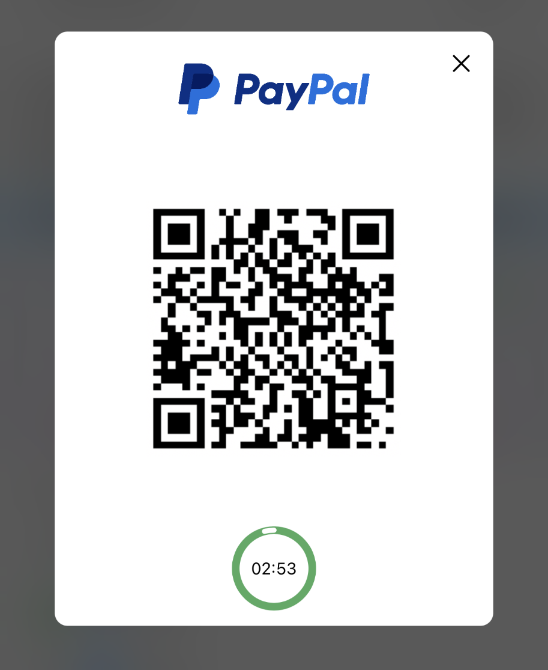
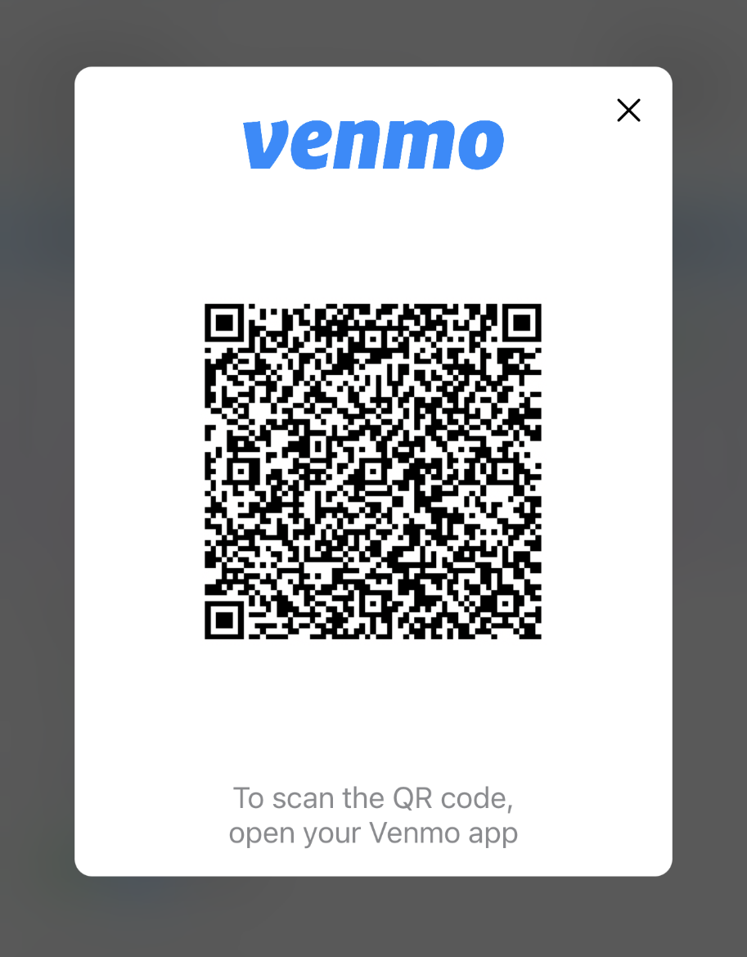
New Cookie Order
Only available for “Give cookies to customer now” orders
Step 3: Select how the customer would like to pay
Demo
Demo
Notes:
Note to council: there is animation on this slide.
Script:
Next the Girl Scout will ask the customer how they would like to pay for their order. The customer can choose Credit Card, PayPal or Venmo. The PayPal/Venmo options are only available through the mobile app when the Give Cookies to Customer Now option has been selected. If the customer choose PayPal or Venmo and the Girl Scout has selected that option and clicked Place Order. A QR Code will appear, the Girl Scout can turn the phone around and the customer can scan the QR code with their phone to pay with their PayPal/Venmo account. (To the customer side volunteers can view the mobile app video)

Slide 53
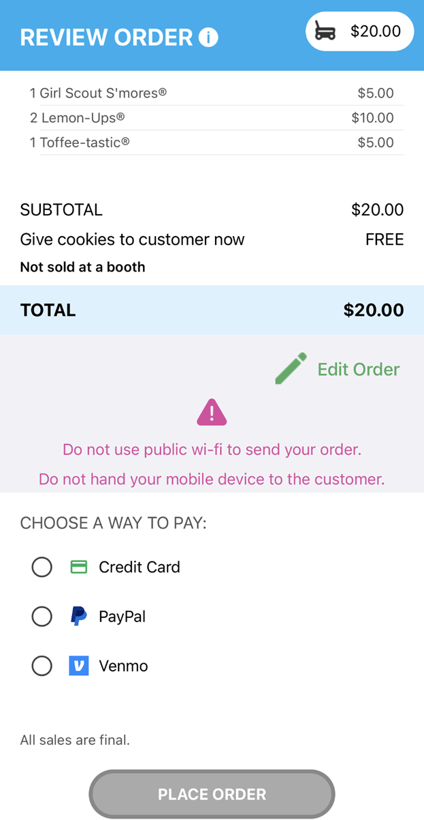
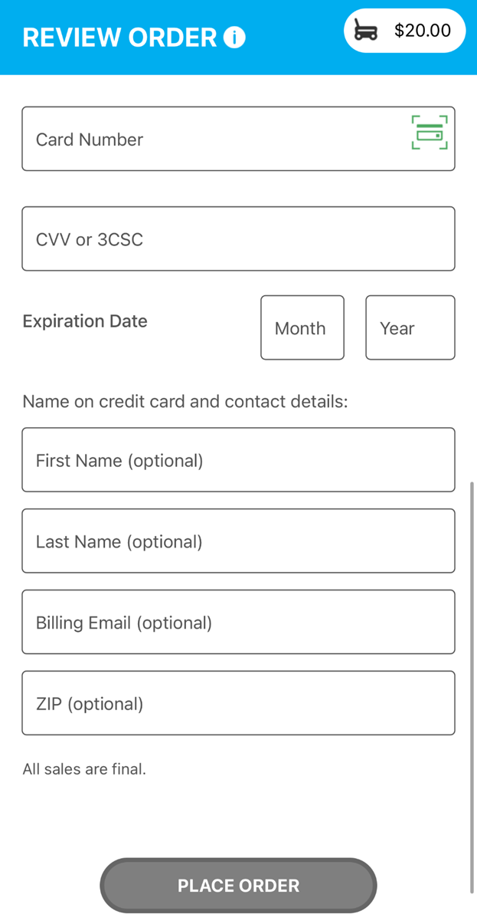
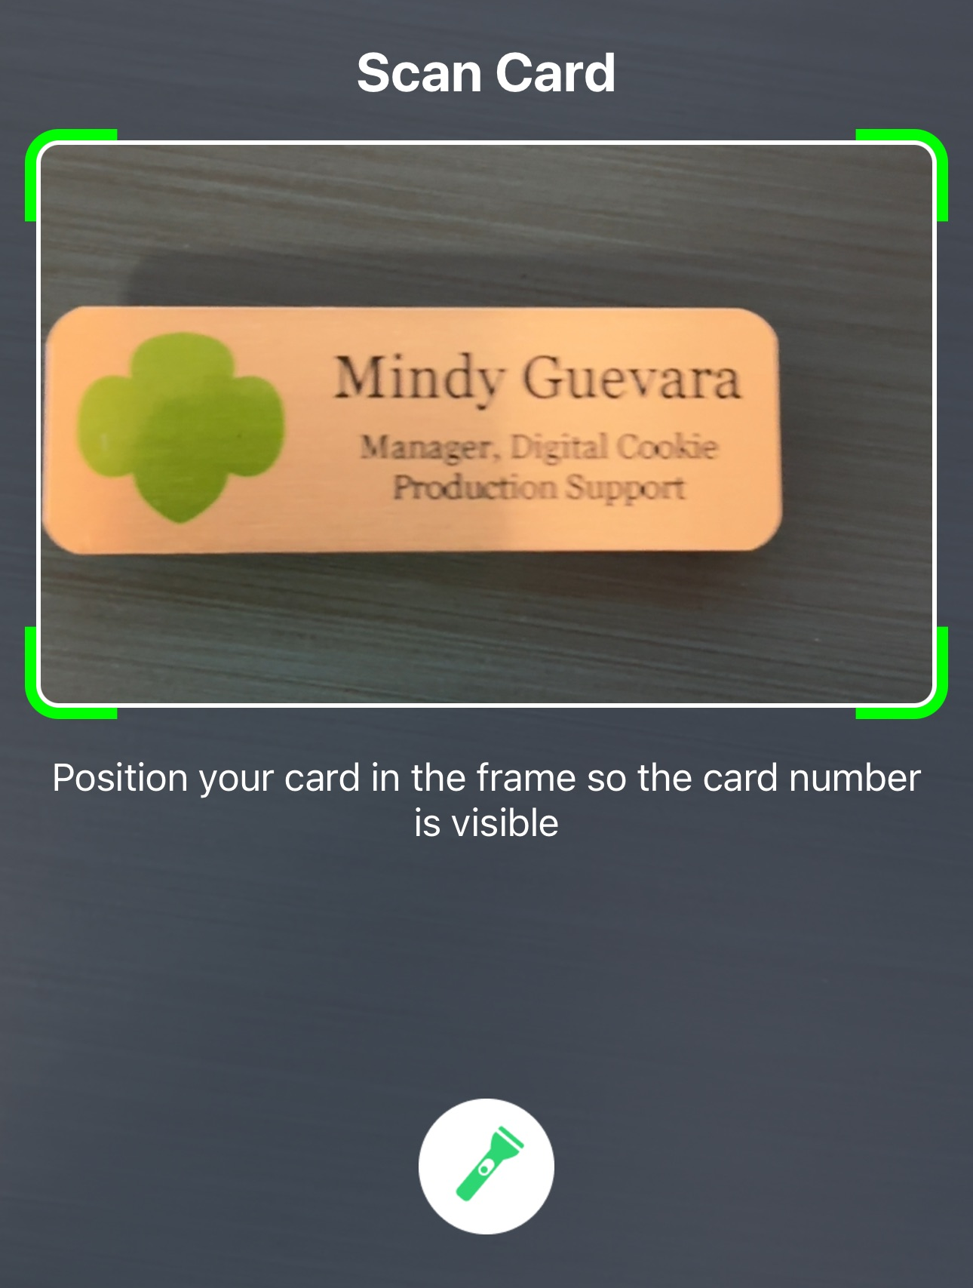
New Cookie Order
Contact details are now optional. Girl Scouts should still ask if the customer would like an email confirmation.
Step 3: Select how the customer would like to pay
Use the Scan Card feature instead of typing all the numbers.
Tip: Have good lighting and double-check the numbers before placing the order.
Notes:
Note to council: there is animation on this slide.
Script:
If the customer choose to pay by Credit Card, the Girl Scout will scroll down on the phone to enter the payment details. Use the Scan Card feature instead of typing all the numbers. Make sure to have good lighting when using this feature. One the payment details have been entered, the Girl Scout can ask the customer if they would like to receive an email confirmation. While the customer details are optional now it is always good to ask and handy to have in case of any issues with the order.

Slide 54
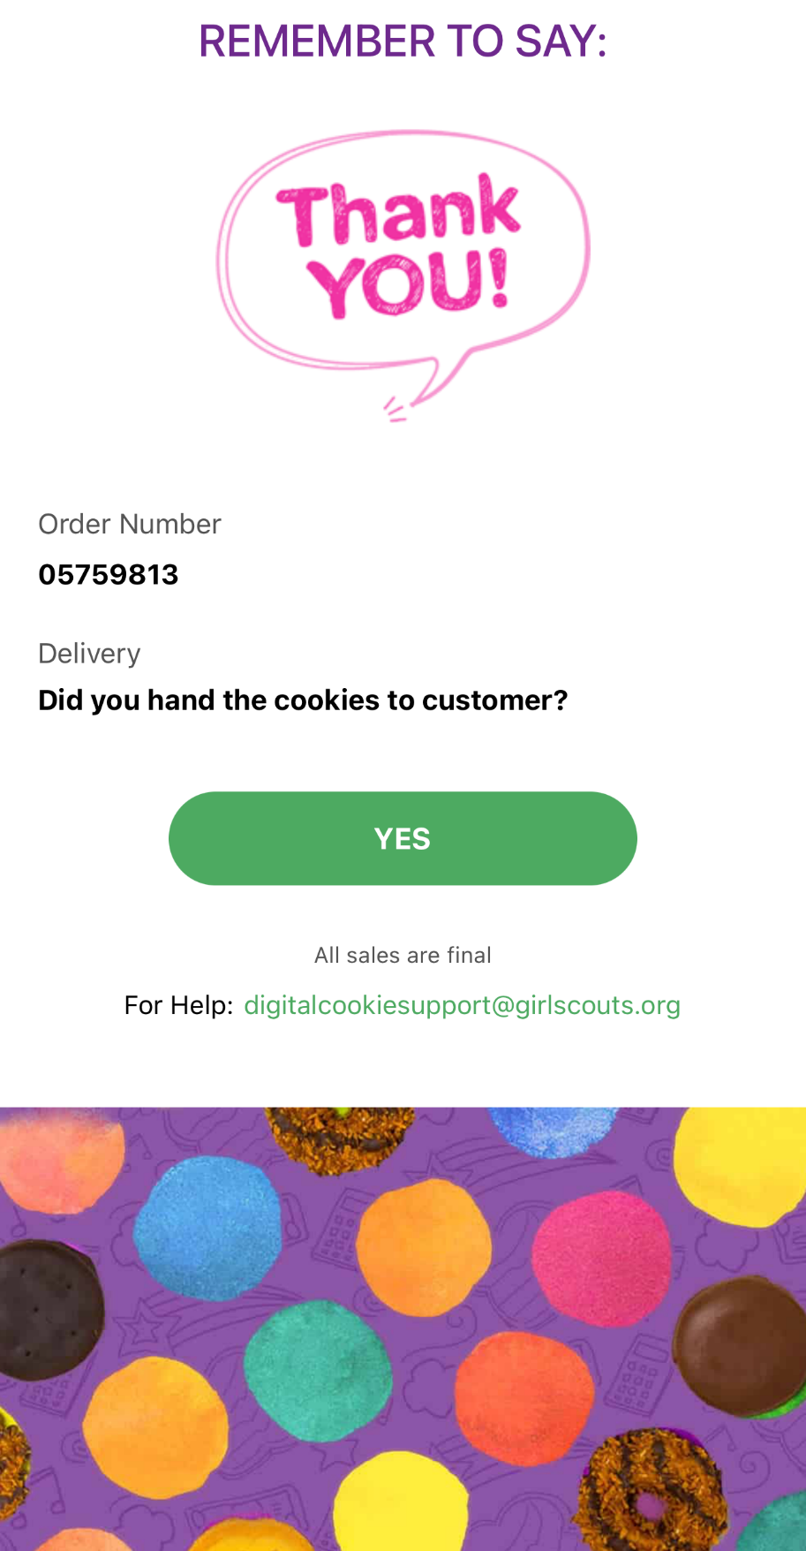
Once customers order has been successfully placed
Notes:
Note to council: there is animation on this slide.
Script:
Once the order was successfully place, a screen will pop up on the Girl Scout’s phone to remind them to hand the cookies to the customer, and then select done with a reminder to say Thank You to the customer.

Slide 55
Digital Cookie Customer Experience

Slide 56
Customer View-Placing Order
Customer enters package quantity
Select Delivery Method
Checkout
Notes:
Script:
When a customer lands on the Girl Scout’s cookie site, they can see the cookie varieties, read the Girl Scout’s cookie story and see the progress to the Girl Scout’s goal.
As customers order packages, the total amount updates.
After selecting the cookies, customers will select the delivery method
Once customers are satisfied with their order, they will simply click the “Checkout” button.

Slide 57
Customer View-Checkout
Additional Information from Customers
Notes:
Script:
Customers are then taken to a checkout screen to complete basic delivery and billing information.
The next screens (Order Preferences, Connect with Girl Scouts, and Payment Details) ask customers to:
Choose a second option if Girl Scout delivery is not approved.
Indicate if they want membership or volunteer information (optional).
Share if they were Girl Scouts (optional).
Complete credit card information.

Slide 58
Customer View-Confirmation
Send Girl Scout a Cheer
Place another order
Notes:
Script:
Once customers have completed the information and clicked continue at each step, they will click the “Place Order” button
Customers then see an order confirmation screen that includes the option of placing a new order in case they want to send some to a friend!
Customers will then receive a series of emails depending on their order delivery method.
See Customer Experience tip-sheets for more details on the emails customers receive

Slide 59
Digital Cookie Shipping Fees
Package Bracket | Digital Cookie 2023-2024 Consumer Charged Flat Fee
4-8 | $12.99 (tier A)
9-12 | $14.99 (tier B)
Digital Cookie Shipping Fees
For orders of 13 packages or more shipping is calculated as follows:
13 packages of cookies: tier B (12 packages) + tier A (1 more package) = $27.98
25 packages of cookies: tier B x 2 (24 packages) + tier A (1 more package) = $42.97
$5.00 surcharge to orders shipping to Hawaii, Alaska, Puerto Rico, APO/FPO/DPO, Guam and US Virgin Islands
Don’t make the decision for your customers, the answer is always no unless you ask.
Customers want the cookies and are willing to pay shipping
They have the option to not purchase shipped and still donate-that is more sales than not asking
Notes:
Script:
There are a lot of people who don’t know a Girl Scout and want the cookies and are willing to pay shipping to both get the delicious cookies and support your Girl Scout.
Customers can decide if they want to purchase shipped, or donate a box or two, or nothing at all.

Slide 60
Digital Cookie Registration Self-help Steps

Slide 61
Digital Cookie Registration Self-help Steps
Need Help to Log In
Notes:
Script:
If you did not receive your Digital Cookie registration email, there are a few steps you can try before reaching out to customer support for help.
Click on the “Need Help to Log In” link on the Digital Cookie home page. Digitalcookie.girlscouts.org
The Help With Log In page will appear. From here you can:
Request a registration email.
Check the email address that’s on file for you.
Reset your password.
Contact Customer Support.

Slide 62
Digital Cookie Help Center

Slide 63
Digital Cookie Help Center
Your go-to place if you need support!
Notes:
Script:
There are many places in Digital Cookie to receive support. There are FAQs, Tip Sheets, Videos, and links to contact customer support.
Click Need help to log in:
If you didn’t receive your registration email and you want to check which email address is on file.
Forgot your password
Click Help at the bottom of the page to go to the Help Center for FAQs, Tip Sheets, and more.
There are also help sections built into the site.

Slide 64
Digital Cookie Help Center
Select which role and category you need support on.
Inside, each category will have detailed instructions, links to tip sheets, or even video tutorials to help you.
Notes:
Script:
In the Digital Cookie Help page you can select the role you need support on and then select the category
Inside each category there are detailed instructions, links to tip sheets, or video tutorials to help the user.

Slide 65
Digital Cookie Help Center
After looking, still can’t find what you need? Contact customer support.
Click the topic you need help with and complete the form for more assistance.
Or click the Live Chat button to chat with a Digital Cookie support agent during business hours.
Notes:
Script:
Still need help? Click on the Contact customer support link
Click the topic you need help with and complete the form for more assistance
Want to talk to a live agent? Click on the Live Chat button during business hours to chat with a Digital Cookie customer support agent.

