Slide 1
To Serve My Country: Girl Scouts Partnerships with the Military

Slide 2
To Serve My Country: Girl Scouts Partnerships with the Military.
Kelly Bullard
Business Services Director, USAGSO
Girl Scouts of the USA
Abigail Trafford
Regional Director, USAGSO – West Pacific
Girl Scouts of the USA
Notes:
In the chat – introduce yourself, what is your name and what council are you from?
Talk a bit about our background

Slide 3
1. USAGSO Overview
2. Military Lingo 101
3. Case Study
4. Engaging Families & Building Partnerships
5. Council Action Planning
6. Question and Answer
7. Upcoming Collaboration Calls
Notes:
Kelly

Slide 4
USA Girl Scouts Overseas Overview Our history, members and purpose.
USAGSO Overview
Notes:
Abigail 5 - 11
Learn about USAGSO, how we started, who we serve and why it is important to serve girls and families living overseas.

Slide 5
USA Girl Scouts Overseas (USAGSO)
USAGSO Overview
USA Girl Scouts Overseas exists to bring Girl Scouts to the daughters of military, foreign service workers and American expats around the world and to all girls in American and International schools.
Notes:
Abigail
USA Girl Scouts Overseas exists to bring Girl Scouts to the daughters of military, foreign service workers and American expatriates around the world. We also serve girls in American and International schools, even non-Americans enrolled there. We ensure that no matter where American families move, they’ll have access to the Girl Scout Leadership Experience.
Originally known as Lone Troops on Foreign Soil, Girl Scouts’ overseas program began in 1925 with a single troop of 18 girls in Shanghai, China. Today, USAGSO supports members in 90 countries around the world.

Slide 6
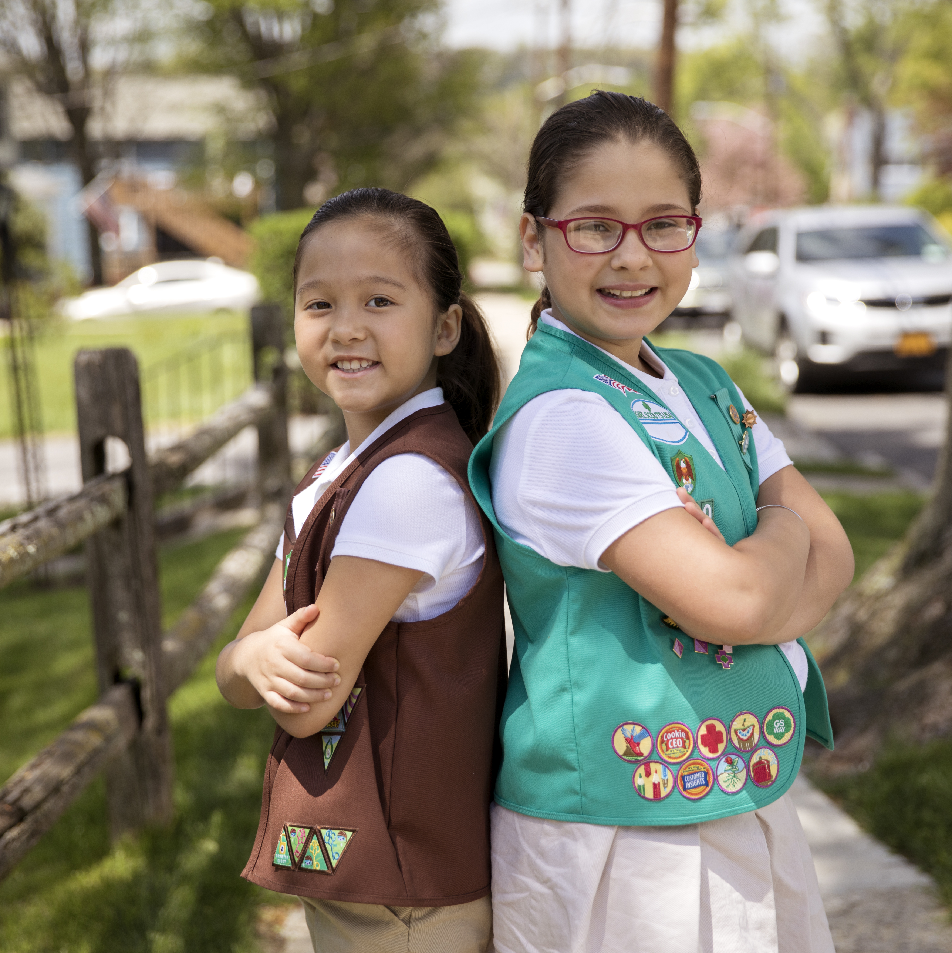
USAGSO Overview
1925: 1st troop – Shanghai, China
1940s: US Department of Defense partnership
Serving military families overseas
1980s: expanded to include non-military
2016: Council of Advisors established
Providing support and guidance
Today:
3 Regional Offices
GSUSA - NYC HQ
North Atlantic - Vicenza, Italy
West Pacific - Sagamihara-shi, Japan
6 Continents
90+ Countries
164 International Communities
9,000+ Worldwide Members
40% military & 60% civilian members
Notes:
Brief overview of our history
Originally known as Lone Troops on Foreign Soil, Girl Scouts’ overseas program began in 1925 with a single troop of 18 girls in Shanghai, China. Today, USAGSO supports members in 90 countries around the world.

Slide 7
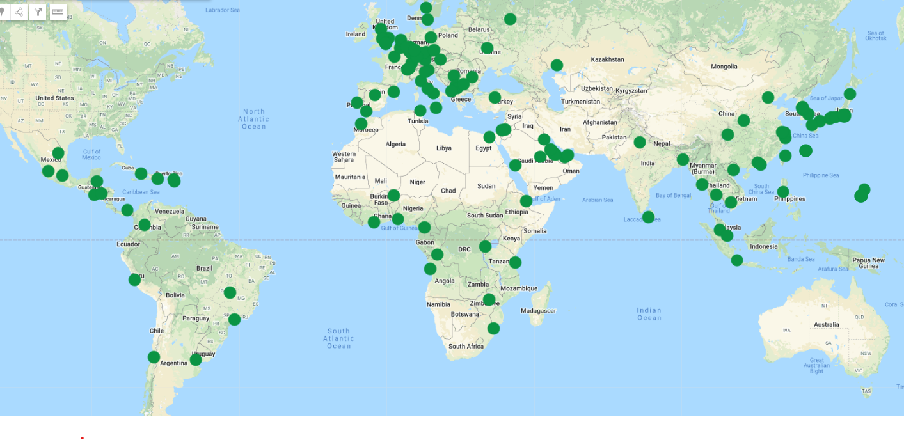
USAGSO Overview
Notes:
And this is a screenshot of an interactive map from our website that points prospective members to USAGSO communities.
We served over 12,000 before the pandemic. We’ve been slowly rebuilding and restarting communities that disappeared during the pandemic. This year we are 85% towards our 10,530 membership goal for MY22.

Slide 8
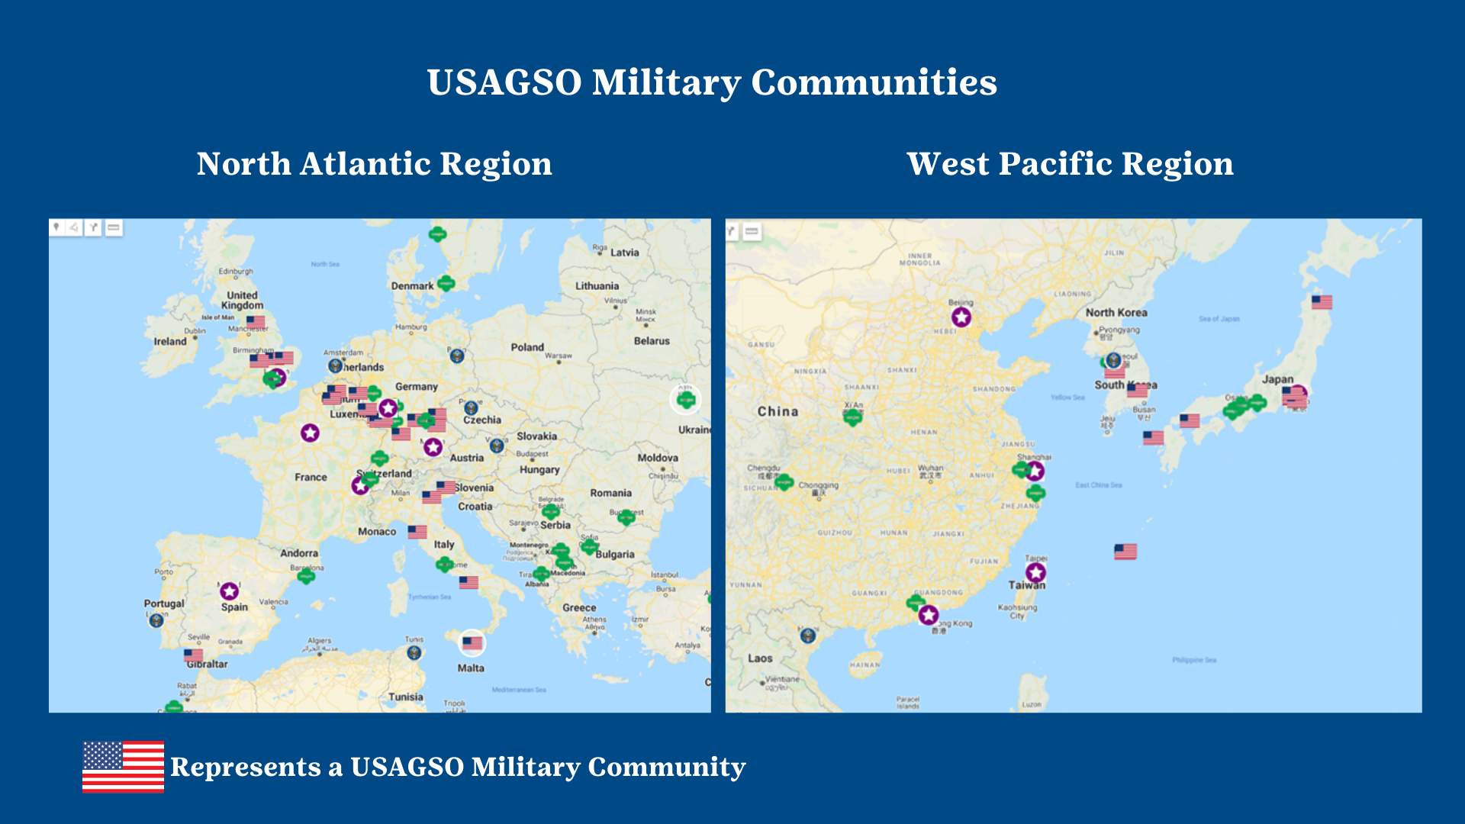
Notes:
Snapshot of the military communities that we serve (on bases) -
Majority of military comms are in Germany, Italy, Japan and South Korea
Span four branches (Marines, Army, Navy, Air Force)
Military girls typically attended DODEA schools on bases.

Slide 9
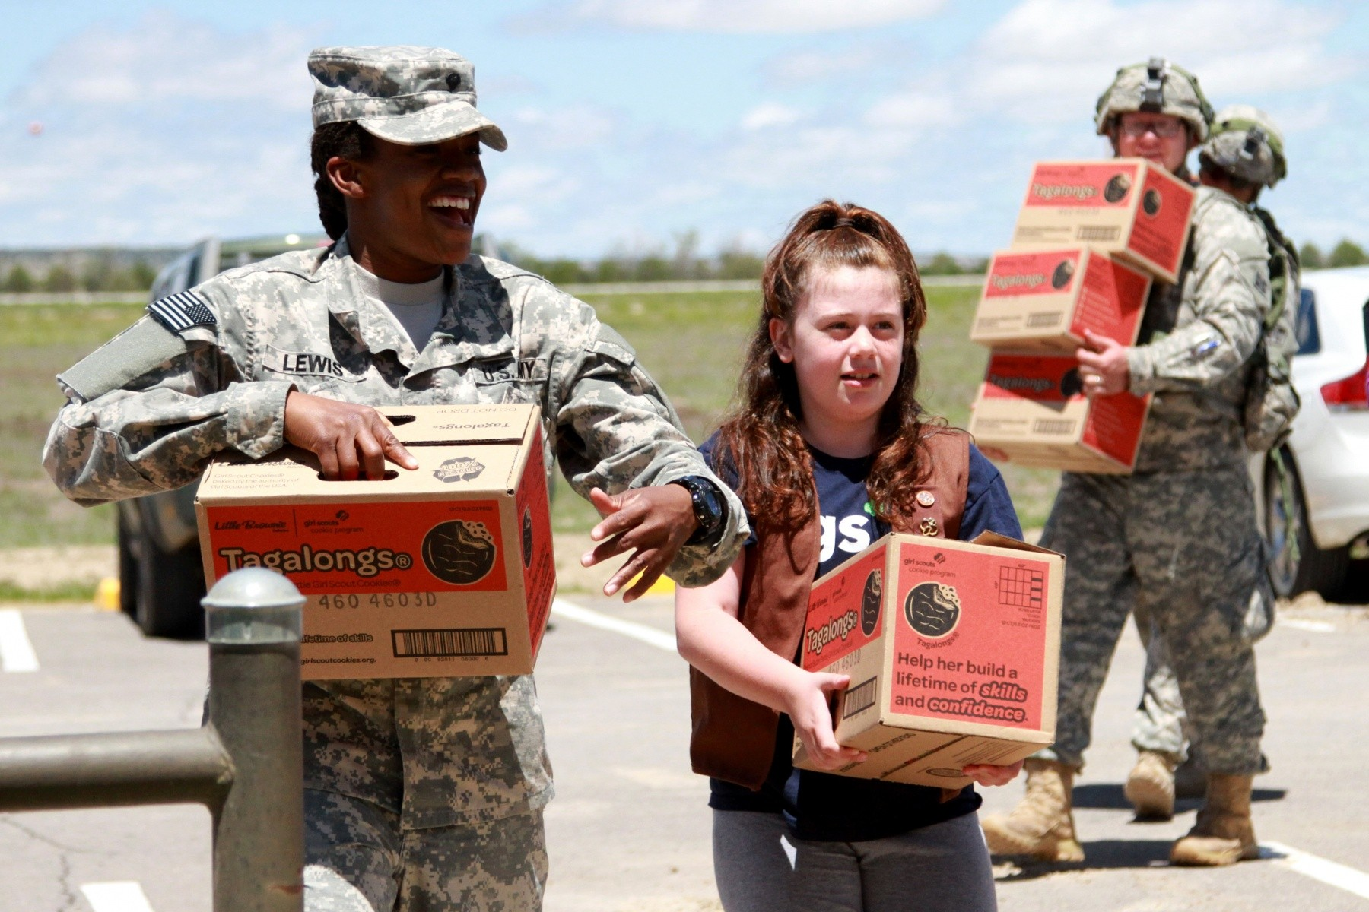
USAGSO & US Military Community in Europe & Asia
USAGSO Overview
Last year, USAGSO served 2,225 daughters of active-duty military and DOD-sponsored families stationed around the globe with the support of over 1000 local volunteers.
38 military communities, making up 35% of membership
Over 50 girls earned a Girl Scout Bronze or Silver Award
8 girls earned their Gold Award
Countless community service and take-action projects completed!
Notes:
Originally created to support military families abroad, today a little over 36% of our members are military.
Currently, we receive funding from the military for each military girl we serve.

Slide 10
USAGSO means different things to girls in different parts of the world. It is…
USAGSO Overview
A connection to our American culture and values.
Consistency during times of transition.
A support network and friendship group.
And in areas in turmoil, a glimmer of hope.
Notes:
We mean different things to girls in different parts of the world. Some of our girl members hold a U.S. passport but have never lived in the U.S. Others haven’t lived in the U.S. for many years. Nearly all of the families we serve move every 2-4 years-- some to new locations overseas while others repatriate back to the U.S. Girl Scouts may be their only consistent link to the U.S. We want them to know that no matter where they move, they’ll be able to find Girl Scouts.
In the last year USAGSO has taken the lead on new initiative within our Movement to provide better support to military families in transition, ensuring their Girl Scout experience can continue regardless of where they are stationed– whether they are moving overseas or returning stateside. We'll talk more about this during the case study.
We also have programs in countries that devalue girls, where civil and political unrest is common, and where natural disasters have devastating effects. In those locations, it’s Girl Scouts and our troop leaders who are telling girls they can achieve whatever they set their minds to. We, Girl Scouts, are their glimmer of hope.

Slide 11
My family has been a part of the military for 16 years and has traveled all over the world. Being a military child can sometimes be hard with having to move every couple of years. Changing schools and having to leave friends and make new friends is never easy but this year I joined a group of some awesome girls. Girl Scouts has been a place I can come to be myself and to experience things I never thought I could. From the start, we accomplished so much and being military only makes it better because we all experience the same life together. -Chloe, 9 years old, Germany
Notes:
Kelly
Before we move on, let’s hear from Chloe in Germany about her experience as a Girl Scout in a military community and the impact its had on her.
12 minutes in

Slide 12
Military Lingo 101 Common vocabulary and important acronyms to know when working with the Military.
Military Lingo 101
Notes:
Kelly 13 - 16

Slide 13
Who and Where Vocabulary
Military Lingo 101
DOD – Department of Defense
DHS – Department of Homeland Security
Active Duty – A full time job as a member of the armed forces.
Civilian – Someone who is not active duty but works for DOD as a private citizen.
Military Branches - Army, Navy, Marines, Air Force and Coast Guard
Deployment – The movement of troops to a place for military action, typically unaccompanied.
Garrison Commander – Commander of the base or post
Sponsor – The service member or the DOD employee
CO – Commanding Officer
MP – Military Police
Visitor Office – Where a visitor can be signed on base/post by someone with base access.
Notes:
In the military title and rank matter, its important to understand what role people have and who is in charge. This would be the same as learning about the school district in your council, who your key point of contact or partners will be.

Slide 14
Partner Organizations
Military Lingo 101
PX – Post Exchange
AAFES – Army and Air Force Exchange Service
MWR – Morale, Welfare and Recreation
ACS – Army Community Service
Private Org (Office) – Self sustaining private organizations set up by individuals.
Spouse Association – Association for spouses of active duty or civilian employees
Single Soldier Organization – Organization made up of soldiers who are unmarried or unaccompanied by their family
DODEA – Department of Defense Education Association
NAF- Non-Appropriated Funding
Stars and Stripes – Military newspaper paid and free
Notes:
There are also religious services on base/post (PWOC, CCD)
These could organizations can differ by branch and also by the size of the base and the type of units on the base.
Possibility is out there you need to do your own research – here are some ways to figure it out.

Slide 15
Moving Around the World
Military Lingo 101
PCS – Permanent Change of Station
TDS – Temporary Duty Station
CONUS - Continental United States
OCONUS - Outside of the Continental United States
Notes:
To adequately support military girls and their families is helpful to understand what PSC is and the impact on the family.

Slide 16
What’s a PCS like for a girl and her family?
Military Lingo 101
A lot of unknowns
Months without personal belongings
Leave behind family, friends, pets
High highs and low lows
Expensive
Parent Deployment
Notes:
ABigail 17 – 18
To support girls in military families its important to understand their perspective. A PCS is a big deal and its not always a smooth process. Here is a little window into what these girls and their families face every 2 – 3 years.
Unknowns – one month you could be moving to Kentucky and the next month it could be Japan. Nothing is final until you are on a plane to that location.
Moving personal belongs takes months – families live out of suitcases for weeks and in temporary lodging.
Say goodbye to friends, family members, pets and your community support systems (church, neighbors, daycare, babysitters, nanny)
Expensive – the military pays for your PCS, moving is still expensive. You may need to buy a new car, pay for your pet’s flight, you now how to pay for airfare home to see family, you need to pay enrollment fees for school, restock your kitchen, buy new clothes for a new climate.
High Highs and Low Lows – One day you are enjoying your best life – exploring a new community (or country) trying new foods with new friends and feeling lucky for this experience but the next day you are missing home and the conveniences of living in your home community. You feel frustrated that you haven’t connected with a new group of friends or don’t know how to do things that were so simple at home like buy your favorite snacks or pay your cell phone bill,
Parent Deployment – Parents deploy when they are serving in the states or overseas. This is especially hard for kids and spouses, after moving to a new community (or country) to find out that your parent will be gone for months or a year is heartbreaking for kids and spouses.
This is why Girl Scouts is SO important for our girls and families. It provides instant community, new friends who share some of the same challenges and helps girls have one consistent activity from post to post.

Slide 17
Being in Girl Scouts overseas in a military community, is kind of different from being in a troop in the states. There's always people moving in and out throughout the year. As a military kid, GS has helped me make more friends (although with every friend made there can be another one lost). I wish people knew how hard being a military kid can be-like you lose your friends all the time, so you don't get super close. I wish they knew how much travel we can do. I wish they knew how different the experience is and how we have big dreams too. -Tori, Junior GS, Germany
Notes:
Let’s listen to Tori, a junior from Germany, tell us about her PCS experiencing and moving to a new overseas community.

Slide 18
USAGSO Case Study Come along with our team as we expand our support in overseas military communities.
USAGSO Case Study
Notes:
Abigail 19

Slide 19
Why (re) prioritize military girls and communities? 1. It was the right thing to do. 2. The data showed there was an opportunity for growth. 3. Increased funding potential. 4. Volunteer support was (for the most part) there. 5. Consistency during COVID.
USAGSO Case Study
Notes:
2019 - Focused on the lack of growth in military communities. Membership was continuing to decline year over year and we hadn’t proactively developed a strategy to specifically support military girls and families. We were treating all communities (SU) the same.
We started by digging into the data, it showed we had significant potential for growth , there were girls and families who could (and wanted) to join Girl Scouts if we found the best ways to reach them. We also knew the volunteer support was there – we had strong SU volunteers (OCMTs) and the right USAGSO staff to champion this effort. We all also agreed it was the right thing to do, our organization is supported by the military, these were the girls we were brought overseas to support.
We also knew that increasing membership meant increased funding from the military. In Asia we get 200+ dollars per year for each military girl we serve. Additionally these are the only communities that can sell physical cookies for us, so financially this makes a lot of sense.
Luckily we made this commitment at the right time, while other communities were shutting down (or moving back to the states because of COVID), military communities had the consistency we didn’t have elsewhere. Clear COVID guidelines, limited community spread, minimal lockdowns. It was still tough but not as difficult as many of our civilian communities.
Picture: Paris troop

Slide 20
Our Next Steps: 1. Set ambitious and measurable goals for our military communities. 2. Made a tactical year-long recruitment plan. 3. Increased our support to military SU volunteers. 4. Lived out our commitment to our priority customer.
USAGSO Case Study
What could this look like in your council?
Notes:
AT – Green, Kelly - White
What would I feel comfortable sharing with the commander at the next briefing? What would I be proud to share we accomplished? What is possible in this first priority year (using data and considering resources).
2. Tactical recruitment plan – shifting the recruitment focus to both the staff member (and the OCMT/SU). How could USAGSO help support recruitment efforts on military communities? This required staff time, effort and $$
3. We held special training for them, offer more onboarding resources, held/faciliated their year long planning sessions, visited each military community (when possible with COVID).
4 – we had to make uncomfortable decisions and still to our priority customer. We devoted time and effort to this community over others
Look like as a council?
Do you have the staff capacity and resources to support this prioritized growth?
Do you have the appetite for it? Do you have leadership buy in?
Do you want to build thoughtful and strategic relationships with the military?

Slide 21
We saw results almost immediately but quickly learned we needed to engage other stakeholders. This was bigger than just our membership team.
USAGSO Case Study
Notes:
Our success snowballed and other teams wanted to get involved. We needed them to help us be successful…
Our European regional office wanted in on our tactical recruitment efforts and enhanced volunteer support
We needed increased marketing efforts (ads in Stars and Stripes), event/program support and needed marketing help (internal and external).
We were struggling with incoming and outgoing PSC transfers the process wasn’t working and we needed help – ie: Transition Initiative for Military Families
We needed to tap into military services and partnerships to strengthen support to girls and volunteers and get the word out (CDC, MWR, command leadership, private org office)
We leaned on our military partnerships/relationships - what support could each command provide to our growing Girl Scout communities?
Your Council:
What departments or teams in your council would you need to engage to be successful?
When/how do you engage those teams?
Does your council have strong customer care practices for PSC transfers?
What relationships would you need to build internally and externally to support your military communities?
What else would you need to consider

Slide 22
One year into our strategy, we grew our military communities for the first time in 5 years!
USAGSO Case Study
We still have miles and miles to go and more girls to serve.
We need to strengthen and expand our partnerships; we need stronger succession planning for SU volunteers and more staff members in strategic geographic locations to support military girls and families.
Notes:
This meant a bigger foot print, a larger community, thousands of dollars in funding and a path towards bigger and better in MY22. And we did this ALL DURING A PANDEMIC. We didn’t quite reach our goal but we were 150 girls from it!

Slide 23
Engaging Families and Building Partnerships
Engaging Families and Building Partnerships
Notes:
During this section we will discuss how engaging families and building partnerships with the military might look like in your council’s geographic area.
Kelly

Slide 24
Council Capacity, Collaboration & Communication.
Engaging Families and Building Partnerships
Council capacity and market share
Create a cross-functional team at your council to develop a military-specific recruitment and engagement plan.
Partner with USAGSO to ensure that all council transfers in and out of your council are processed in a timely and appropriate manner.
If military families are going to be a priority customer, make sure EVERYONE knows.
Notes:
Kelly
Do you have capacity to implement a new initiative? What is the market share for K-5 girls in military communities? Are there other local non-profits already focusing their efforts on this population and can you partner?
Cross-functional collaboration – marcomm, outreach, membership and troop support/customer care teams should operate cross-functionally with the full support of council leadership which includes time and staffing. Decide where this initiative is going to live and create buy in throughout your council. If a military partnership is a new initiative you are considering as a recruiter, know you will need to collaborate with these departments within your council and plan to have your research done before going to your leadership team to pitch. Get your data to back you up and have a plan in place- especially if you will need additional staff.
USAGSO partnership for families moving to a from overseas- between 2019-2021 approximately 780 members transferred into USAGSO from stateside councils and approximately 1660 transferred out. There is a need for a smooth council to council process, with an open line of communication with USAGSO and the stateside customer care teams. Discuss Transition Initiative for Military Families.
Dedicate space for your military families- page on your council website, social media, celebrate MoMC, cookie program. Utilize paid advertisements with your media outlets (paper/TV/radio) Stars and Stripes etc.

Slide 25
Military Partnership
Engaging Families and Building Partnerships
Where are your bases located and who are the primary points of contact?
Research the services provided on base and contact the MWR or ACS to learn more.
Can they accommodate a Girl Scout troop or should you look at the neighboring schools or libraries?
Build and continue to nurture that relationship.
Notes:
Abigail
Where are your bases and who are the points of contact to learn demographics? Are there services for families on base or nearby? Social clubs for spouses?
Will you be able to have a troop meet on base or at a local school or library?

Slide 26
School Location & Accessibility.
Engaging Families and Building Partnerships
Determine if your council is in a state with DoDEA schools
-or-
Identify the schools near to base that serve military girls, contact the principal or administration.
Notes:
Kelly
DoDEA (Dept of Defense Education Association) important for councils in Alabama, Georgia, NC, SC, Virginia, Kentucky, NY, PR
According to US Government Accountability Office (02/21 report) , Over 90% of installations have at least 1 public school option nearby.
Find out where your military bases/installations are
Go to your county school board website and find your school locator/search link. Instead of entering a home address you will enter the address of the military base and find the feeder schools.
give people a few minutes and ask them to share out their plans or put them in the chat

Slide 27
Family Engagement
Engaging Families and Building Partnerships
Find out if volunteers who are already serving your council are associated with base and meet with them to learn more about how to serve their base community.
Host a military specific event for girls in your community to learn more about their experiences and how to better serve them.
Never underestimate the wealth of knowledge and willingness to help when it comes to a military spouse.
Notes:
Abigail-
Consider launching starter troops right after peak PSC times (late summer/early fall) and January

Slide 28
Quick Exercise
What are the next steps
for your council?
Based on what we have covered during the session,
take a moment to write down three next steps your council
could take to engage and support military families in your community or strengthen your partnership with local military command.
Feel free to share in the chat.
Notes:
Kelly
5- 7 minutes
Share in the chat 3 minutes

Slide 29
Question and Answer
Unmute or put your questions in the chat box for Kelly and Abigail to answer.
Notes:
Abigail

Slide 30
The best part of being a Girl Scout in a Military community is that we get to enjoy the Girl Scout experience in so many ways and places; and we get to learn while interacting with leaders with different backgrounds, experiences and points of view that push us to think outside the box. It’s always exciting because we get to live in and visit different places. We also get to try an assortment of new things, including food, clothing, cultural norms and activities with local Girl Scouts. And for my sister and I, one of the best things about it is that our ARMY dad is also a Girl Scout Leader. My very own hero is also MY Girl Scout Leader!! -Meredith and Maddie, Ambassador and Cadette, Bogota
Notes:
Kelly
Before we close, I would like to share the best part of being a GS in a military community from Meredith and Maddie, an Ambassador and Cadette from Bogota

Slide 31
Future Council Collaboration Calls
Date | Topic | Suggested Staff
May 23, 2022 6:00 – 7:00 pm EST | Council to Council Transfers – Supporting Military Families as they move | Membership, Customer Care
July 11, 2022 6:00 – 7:00 pm EST | Building a Year-long Military Engagement and Recruitment Strategy | Membership, Program, Customer Care, Council Leadership
September 12, 2022 6:00 – 7:00 pm EST | Military Partnerships: Starter Troops and Child Youth Programs | Membership, Customer Care
November 14, 2022 5:00 – 6:00 pm EST | Adult Recruitment and Engaging Military Families | Membership and Program
January 17, 2023 5:00 – 6:00 pm EST | Celebrating Month of the Military Child | Membership and Program
March 13, 2023 5:00 – 6:00 pm EST | Preparing for Spring Campaigns | Membership, Customer Care, Program
Notes:
We hope you are able to join us for our next call May 23rd at 6pm est to discuss C2C.
Please visit our website at USAGSO.org - the military support banner at the top of our home page will guide you to the registration links.

Slide 32
Thank you!
Let’s stay in touch!
Kelly kbullard@girlscouts.org
Abigail atrafford@girlscouts.org
Notes:
Get the deck with the questions

