Slide 1
Girl Registration Flow- USAGSO
Please read the notes section of each slide for the tips & tricks

Slide 2
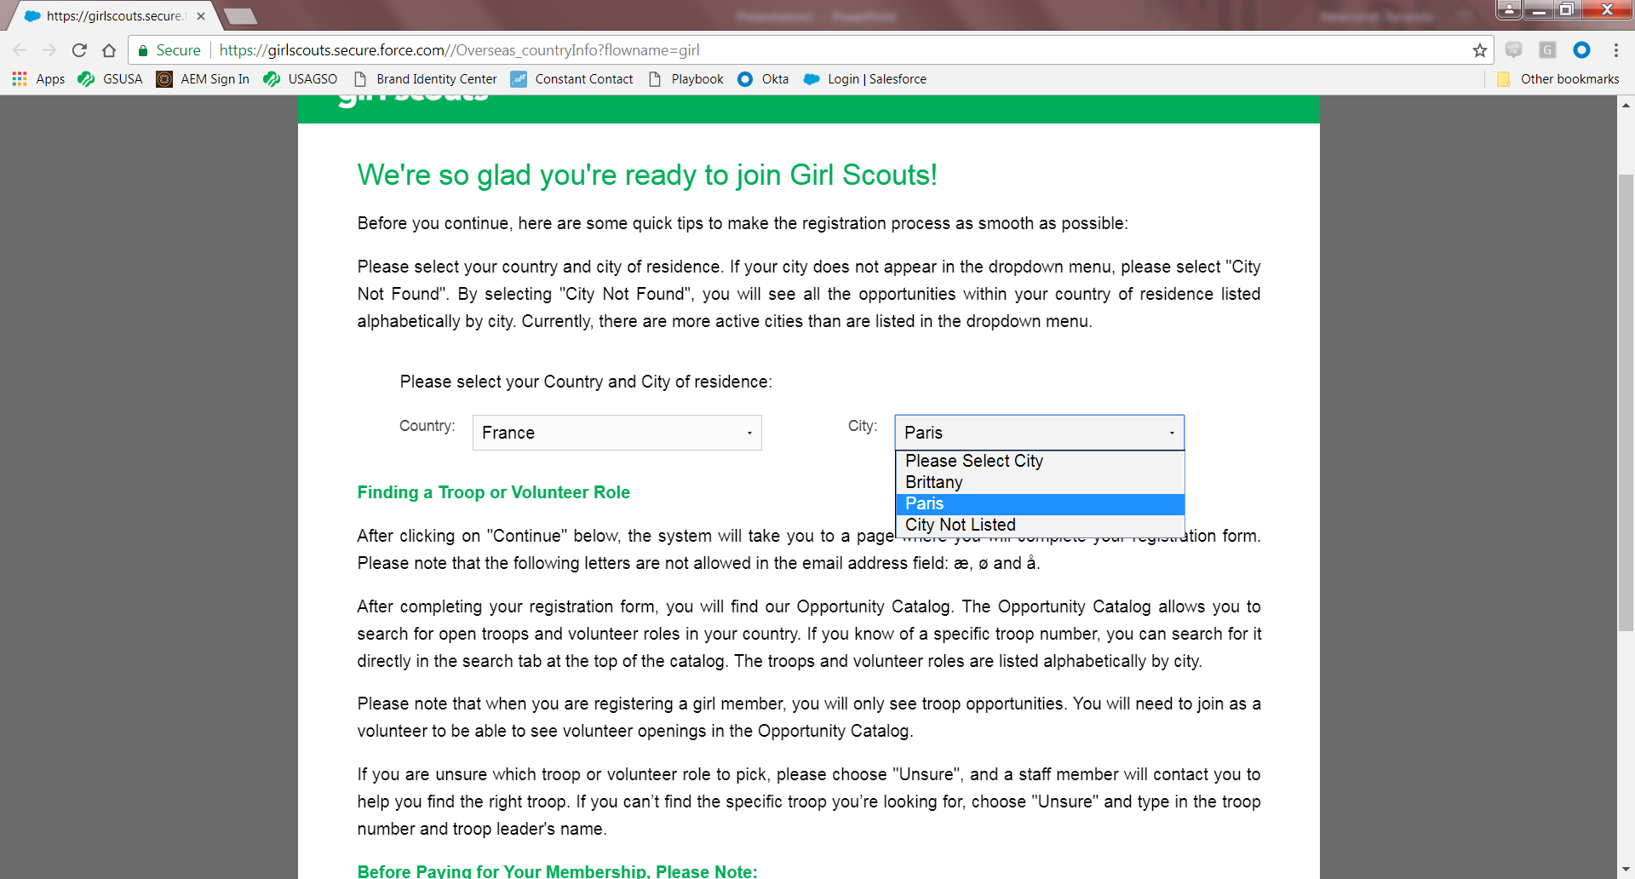
Notes:
Upon selecting “Join Now” from www.usagso.org website, you will arrive to this welcome page. This is the first page all girl and adult members will see, and where you will select your country and city. For this demonstration, we are using France as the country and Paris as the city. Countries with smaller membership communities will only have a country selection available to them. If you do not see your city listed, please make that selection in the dropdown box. Currently there are more active USAGSO cities than are listed in the dropdown menu, we will continue to add them as we grow.

Slide 3
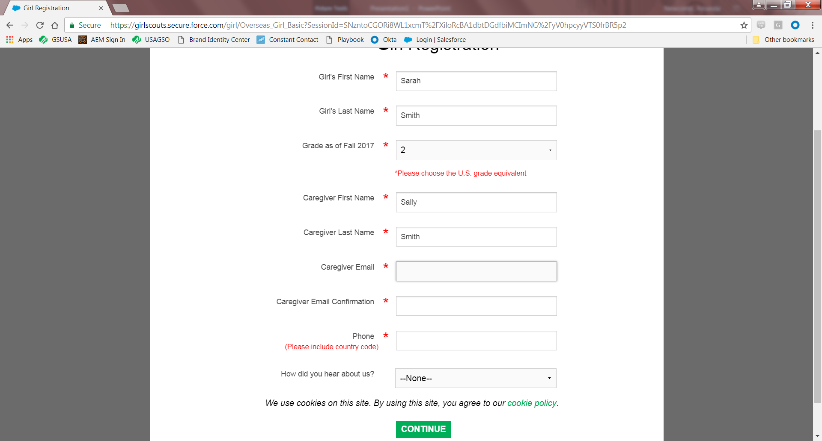
Notes:
For Girl Registration– you will need to include both the girl and parent/guardian information. Since many of our international members do not have the same grade listings as those in the United States, we request that you choose the U.S. grade equivalent. Please include the country code in the phone entry.

Slide 4
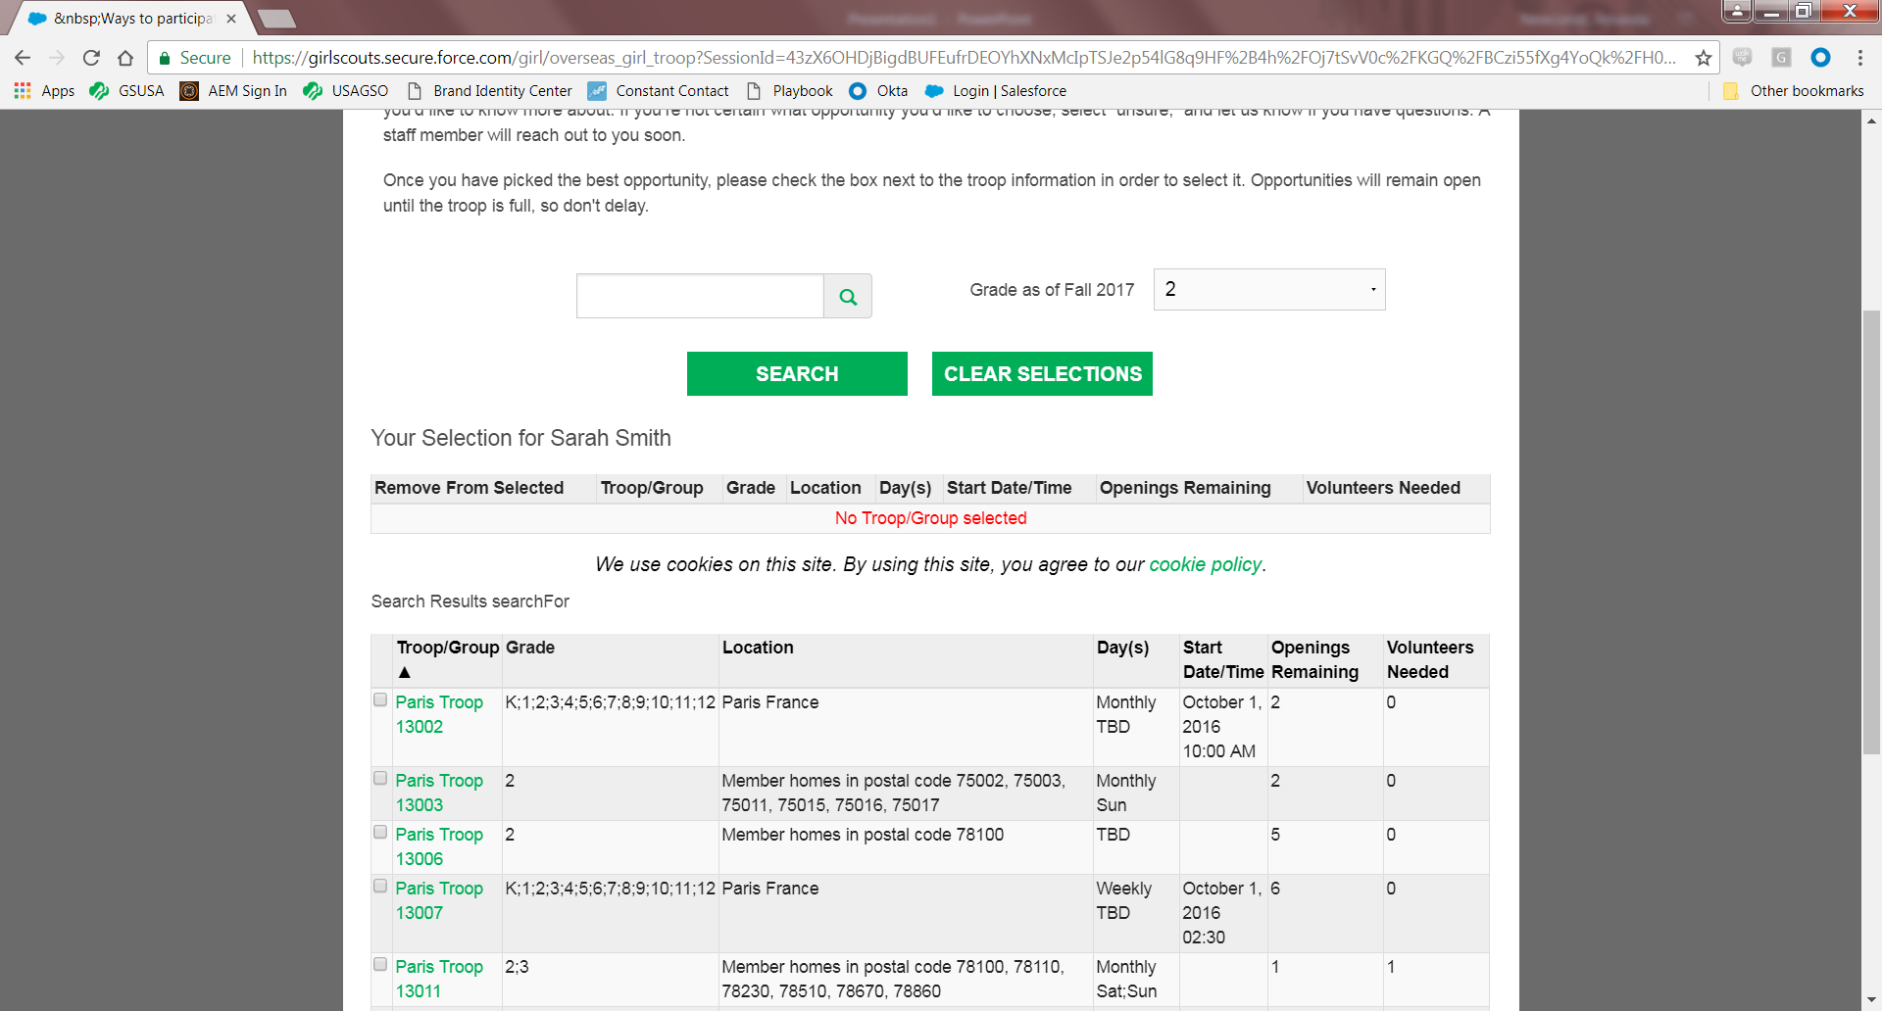
Notes:
For this demonstration, our Parisian parent/guardian will arrive to the opportunity catalog for girl members. You will select the option that works best for you by checking the box next to the troop name. Please note: parents will also be able to select unsure (and will need to provide a reason) and parents can select Individually Registered Member (aka Juliettes).
As you can see from this screenshot, parents will see that there are 2 openings available in Paris Troop 13002, but 0 volunteers (troop leaders) needed. If this troop needed troop leaders, it would display the number of troop leaders needed in order to become an active troop.

Slide 5
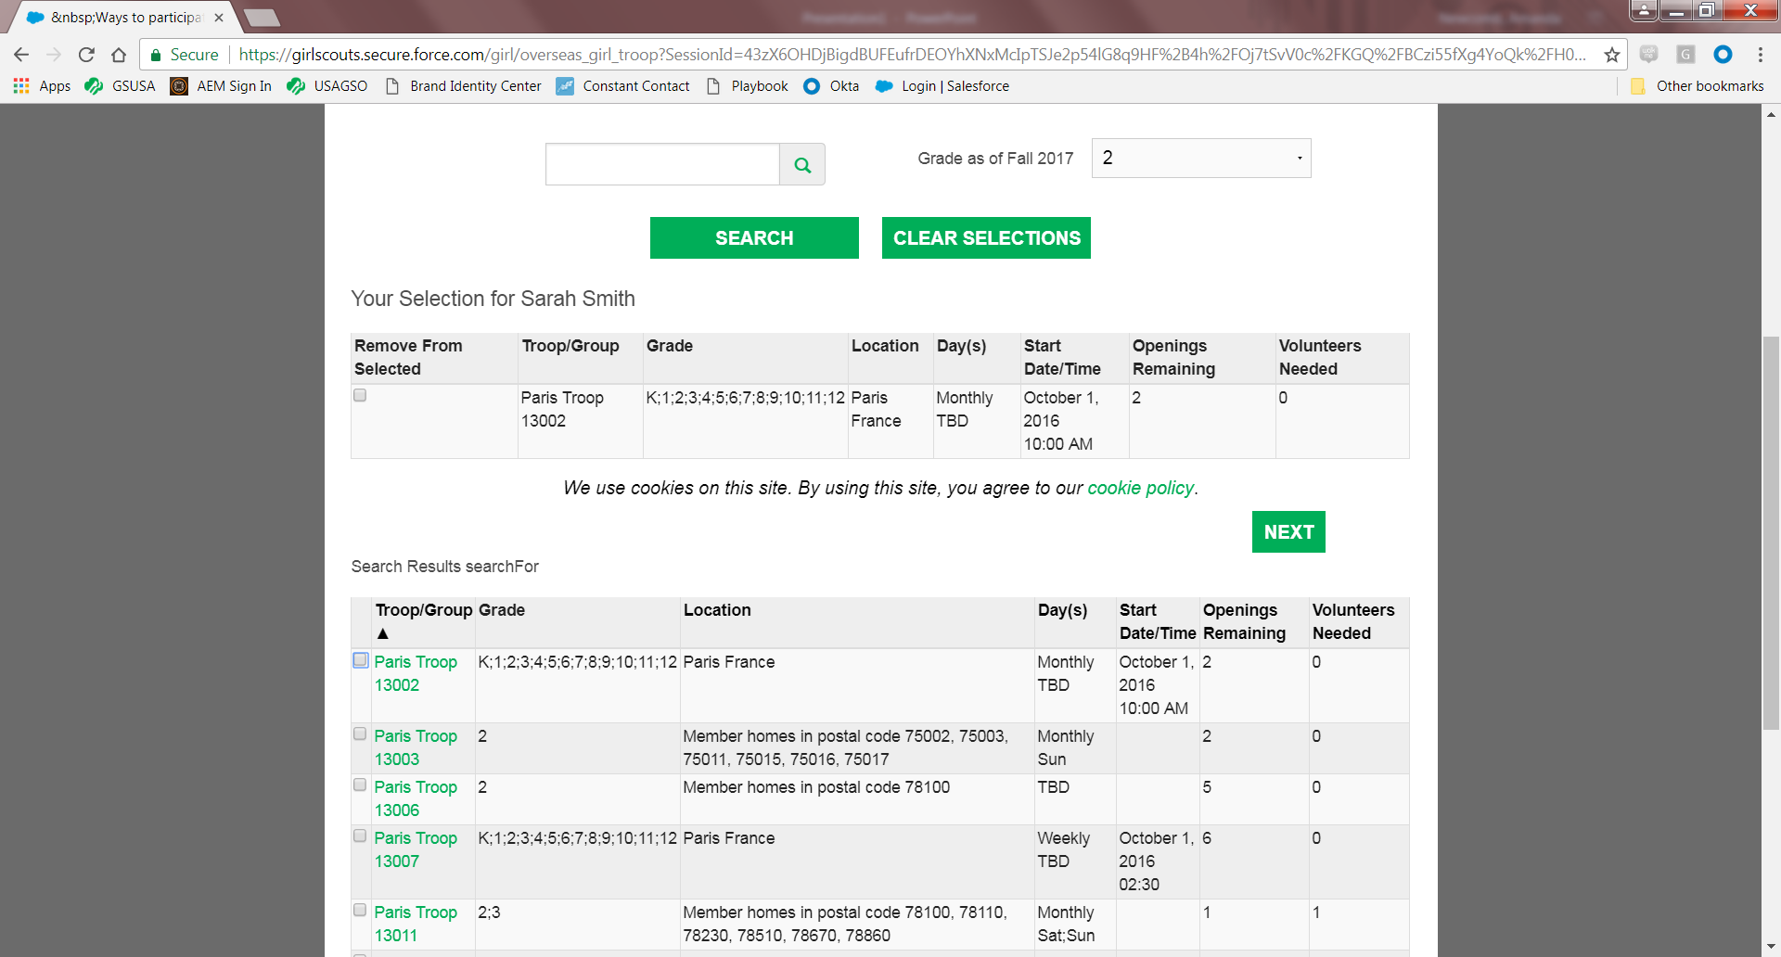
Notes:
Upon selecting Paris Troop 13002, you will then need to click the NEXT box in the middle of the page.

Slide 6
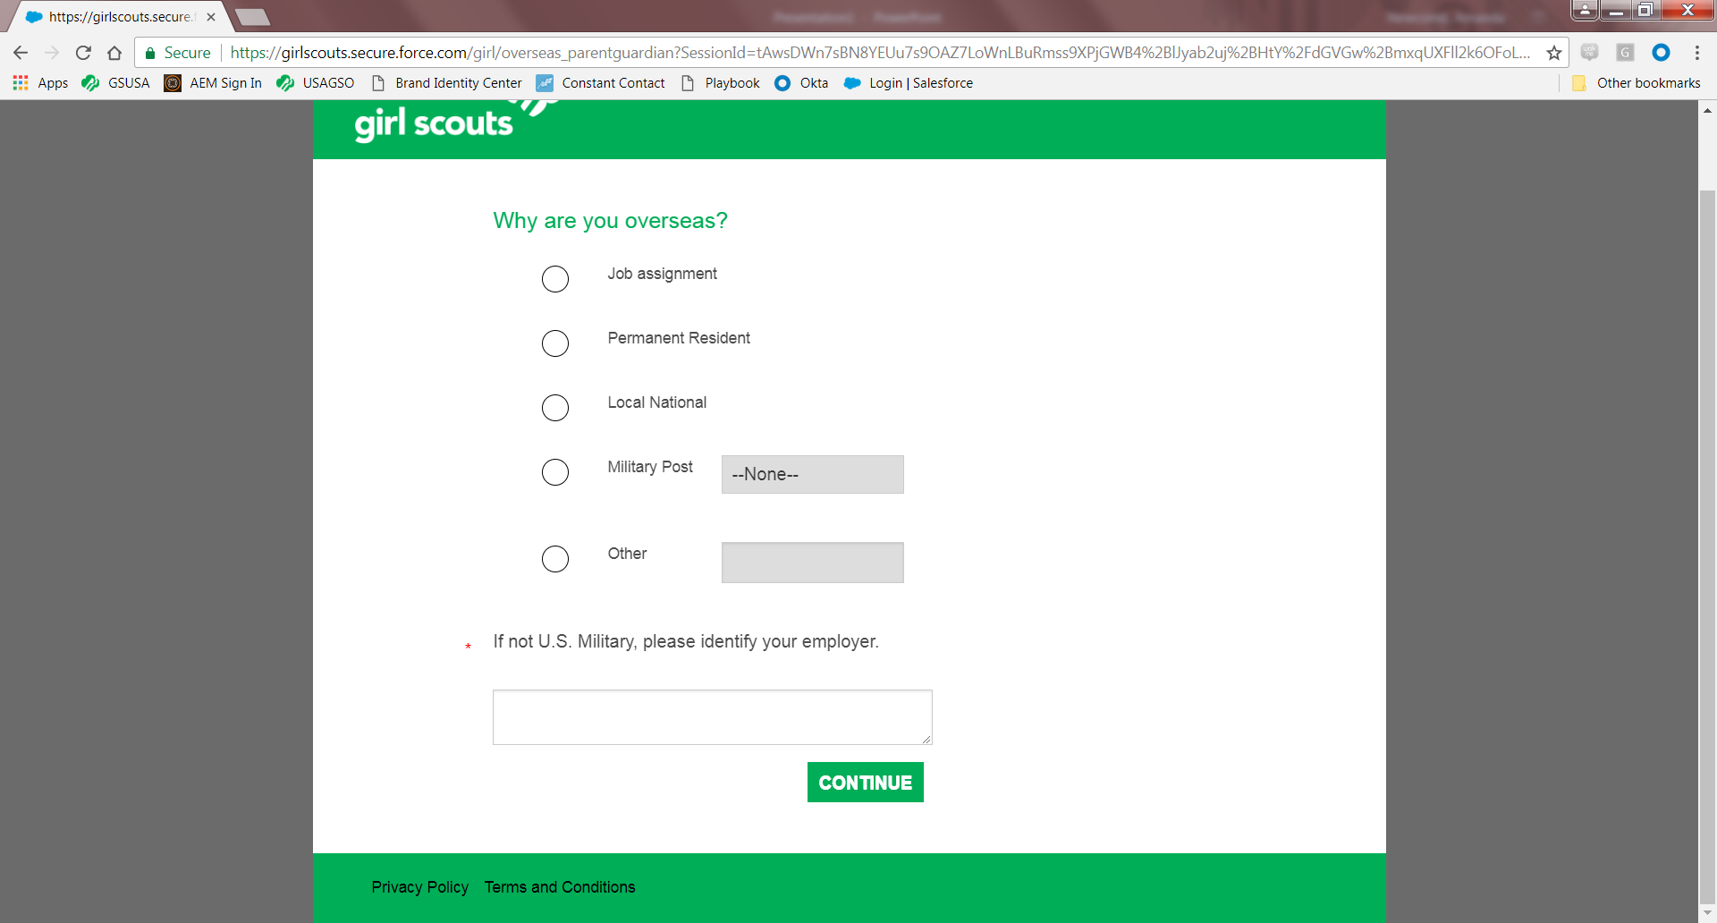
Notes:
For our overseas members, you will need to select the reason why you are overseas. We understand that if you are a local national, you are not really living “overseas”. Since USAGSO is technically an American organization, this is how we need to collect this information. We appreciate your understanding.

Slide 7
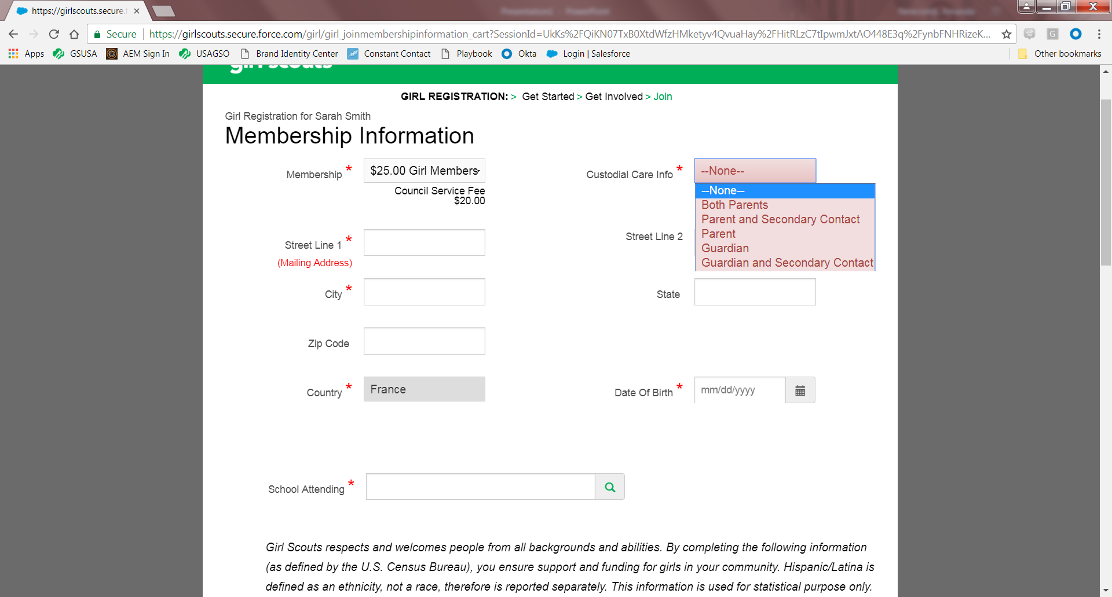
Notes:
This page the is where the parent/guardian will enter custodial and address information. If you want both parents/guardians or a secondary contact attached to the girl’s membership, please make the appropriate selection for your family.

Slide 8
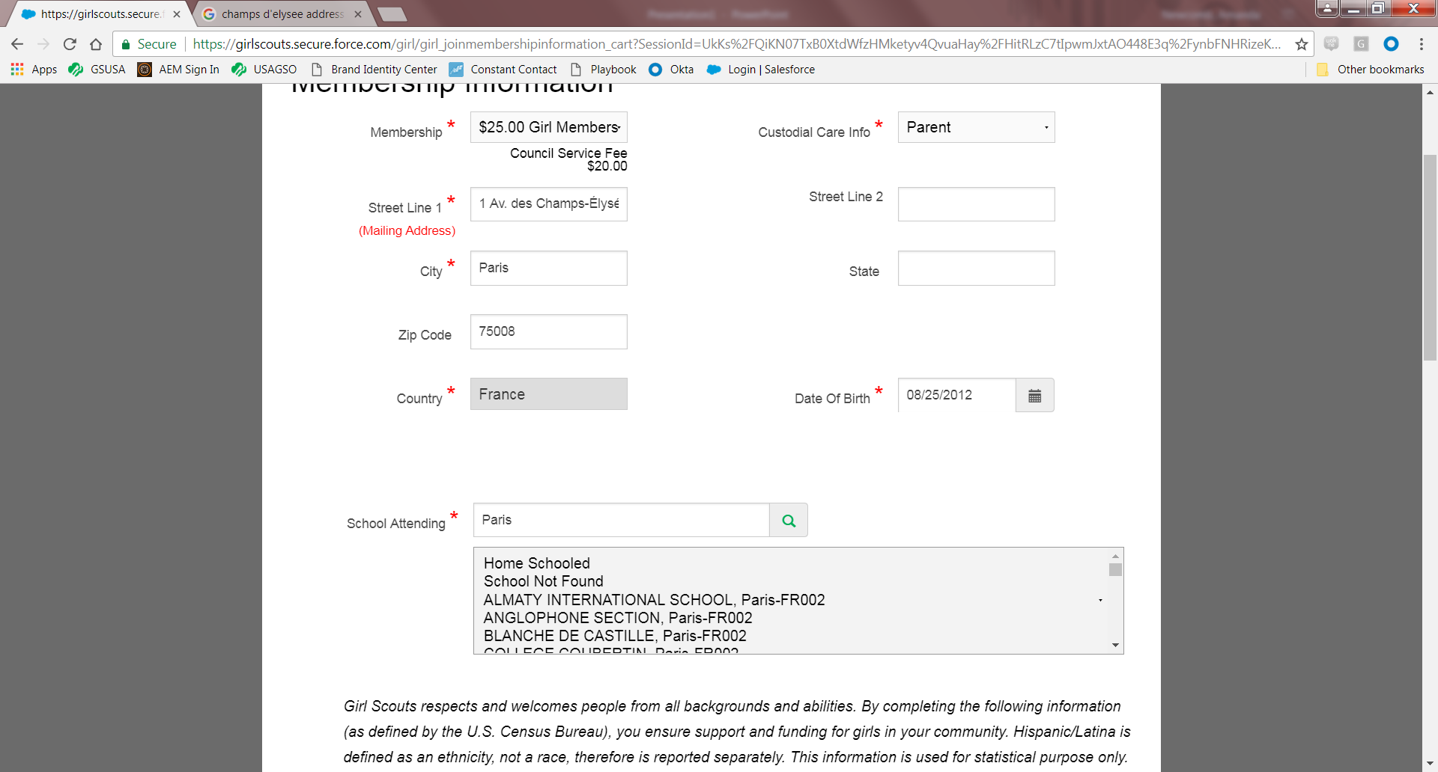
Notes:
You will also be able to bring up a number of school selections already loaded into the system. If you do not see your school listed, please select school not found. The school attending entry has a bit of a quirk: you need to enter something into this box and then press the search button to the right of it. If you do not press the search button, then it will appear as though you left the search box empty.

Slide 9
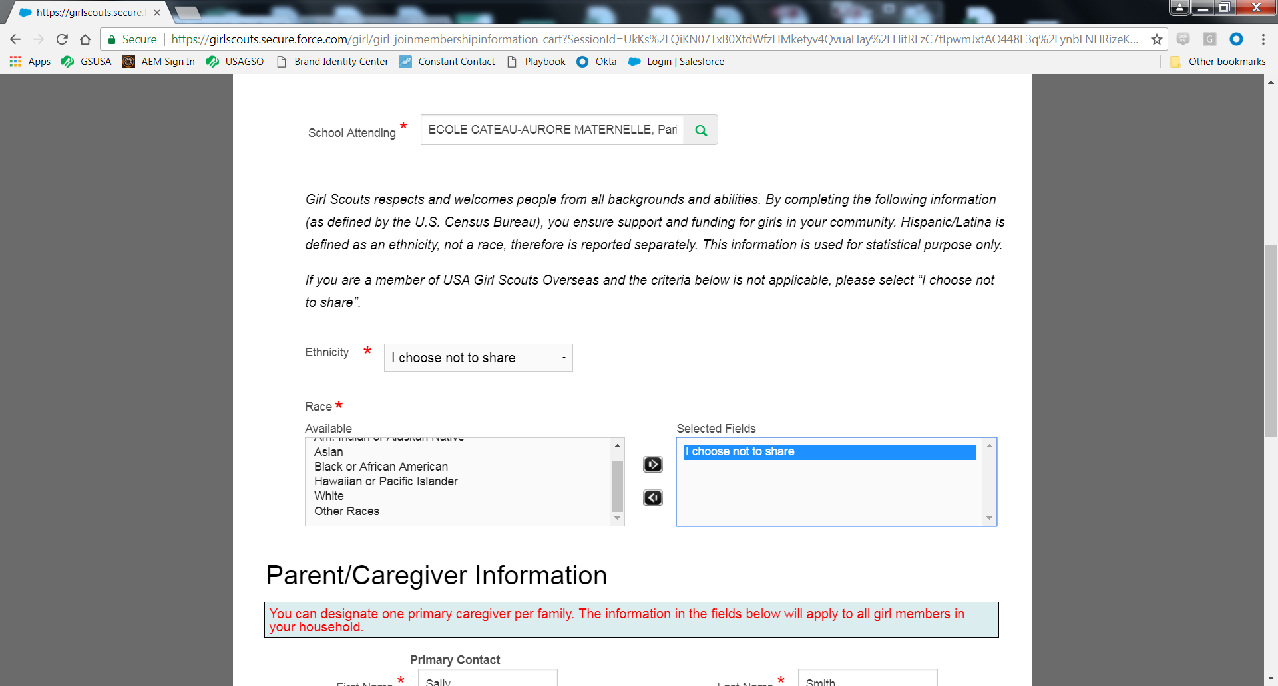
Notes:
In this selection, this survey is set per the national office requirements. If you would prefer not to enter your information for any reason, select “I choose not to share”. Under the “Race” entry, you will need to make your selection and click the right arrow in order to move it into the “Selected Fields” box.

Slide 10
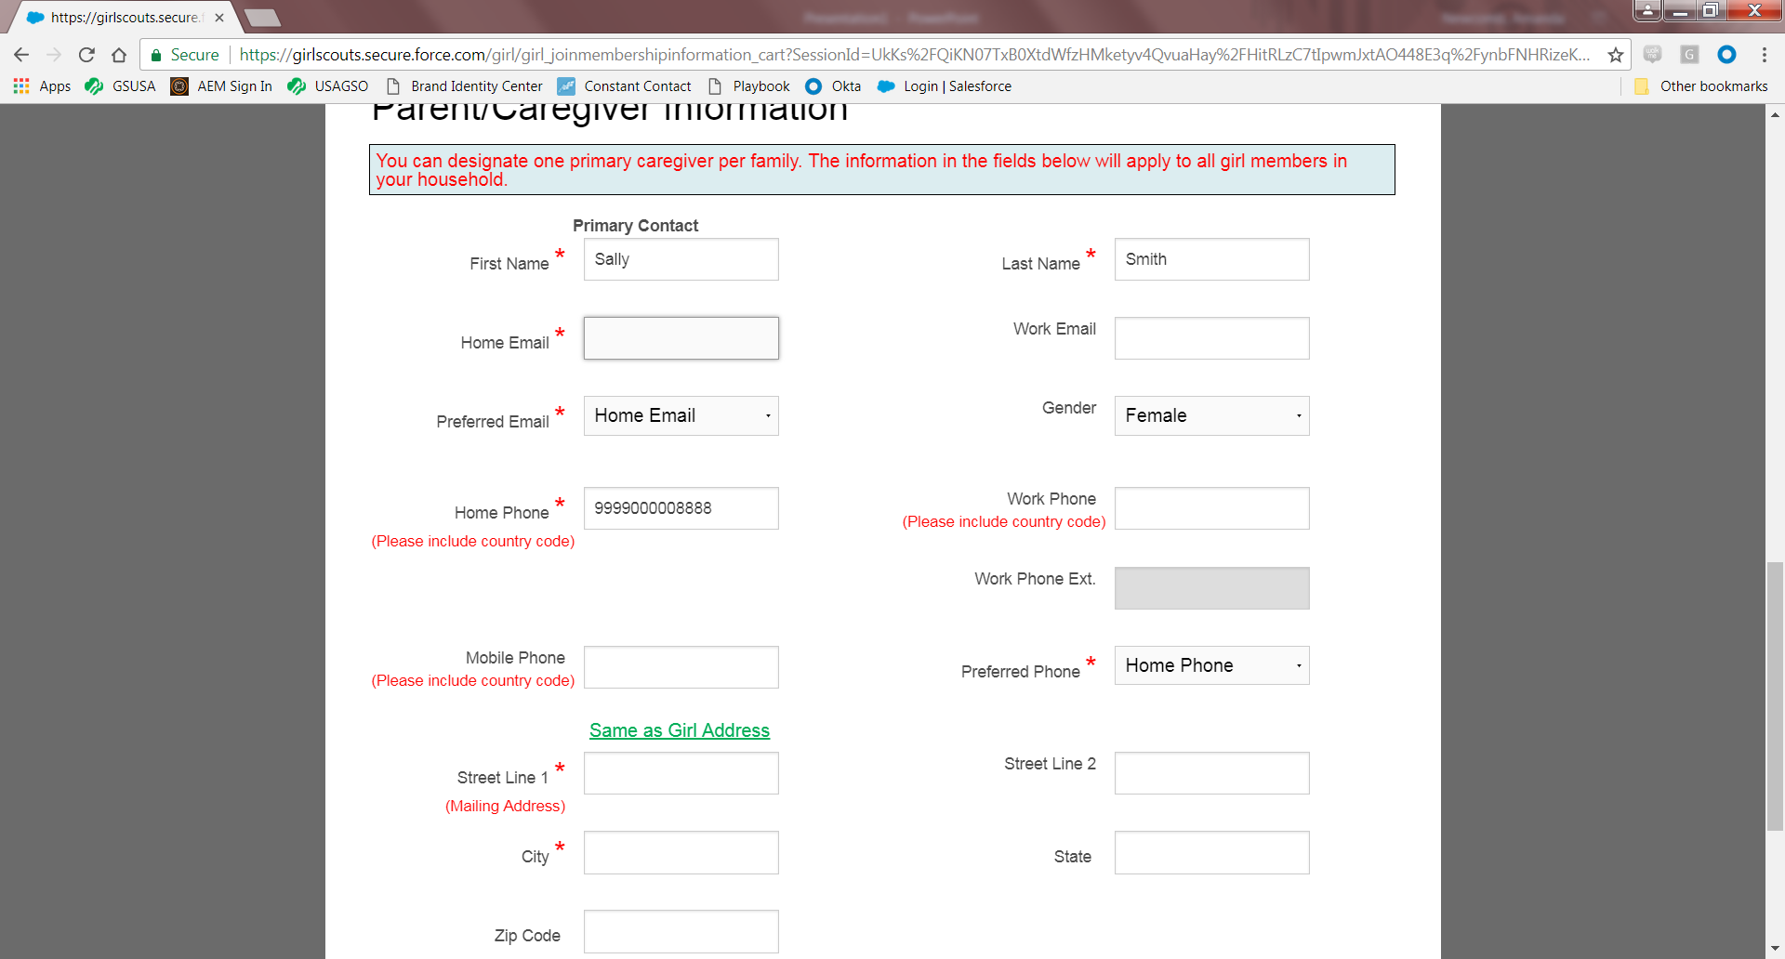
Notes:
The parents/guardians can enter the family information here– again please include the country code for your phone number.

Slide 11
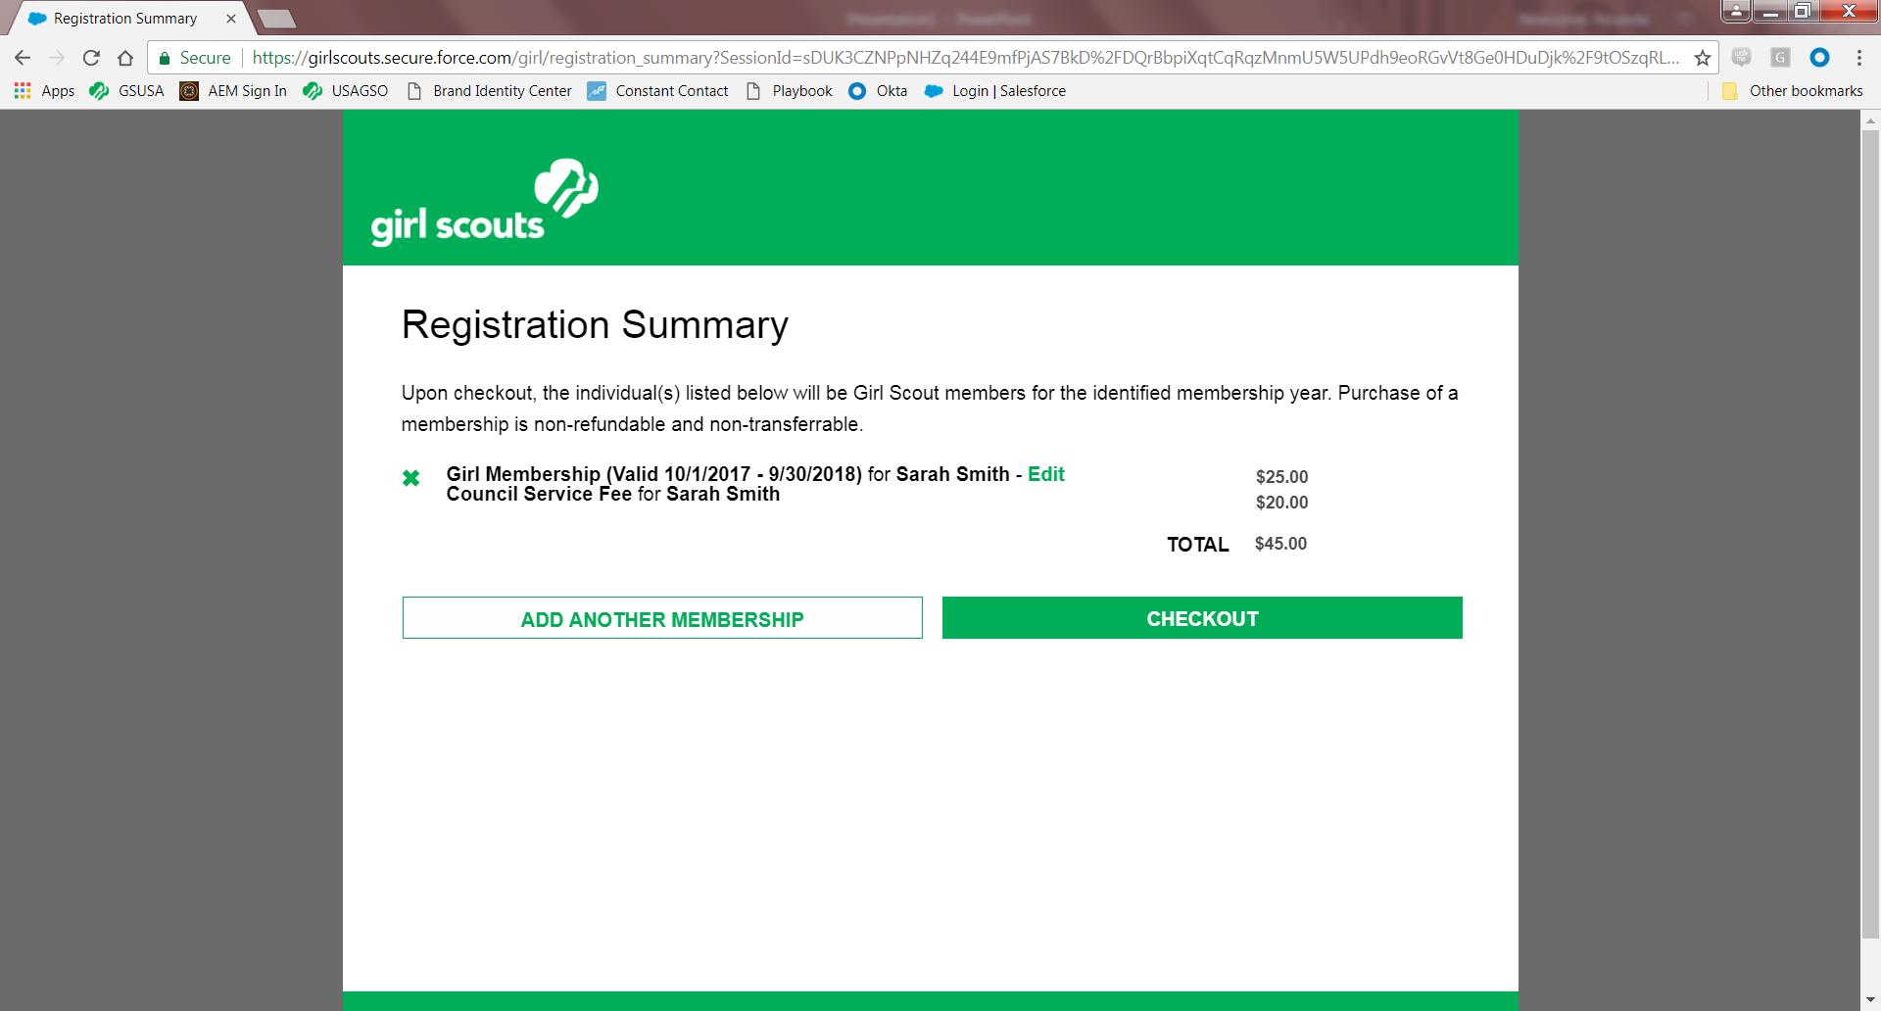
Notes:
This page will show your membership registration summary. If you want to add another member (i.e. a sibling) you can make that selection here and go through a similar (but shorter) registration process.

Slide 12
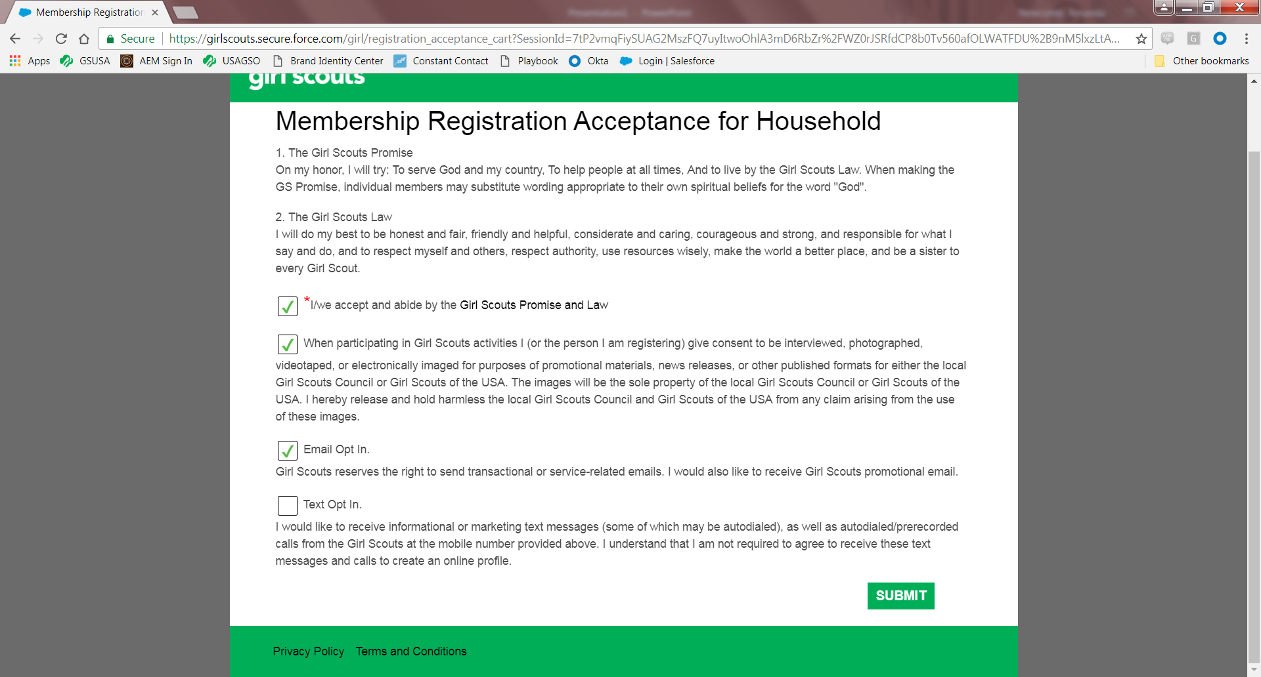
Notes:
Please keep the Email Opt In selection checked, so you don’t miss out on important updates from USAGSO.

Slide 13
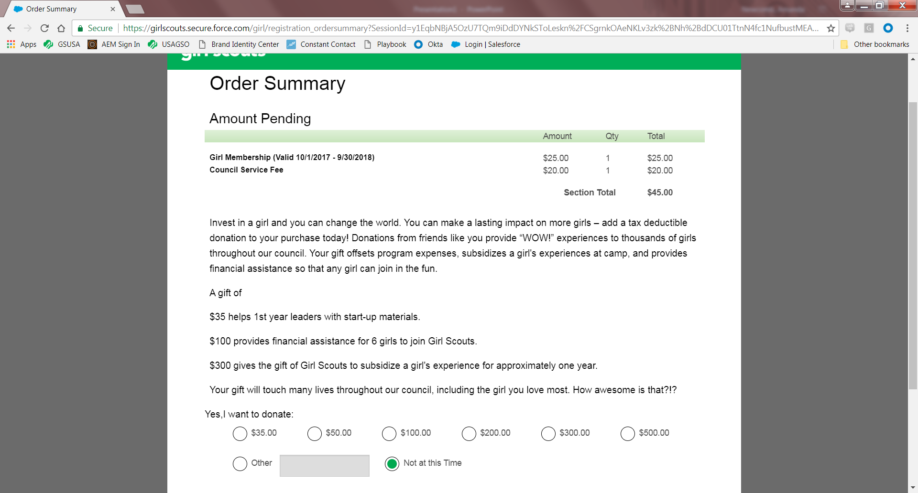
Notes:
This is the order summary where you can also donate to USAGSO and help us provide more assistance to our communities and members.

Slide 14
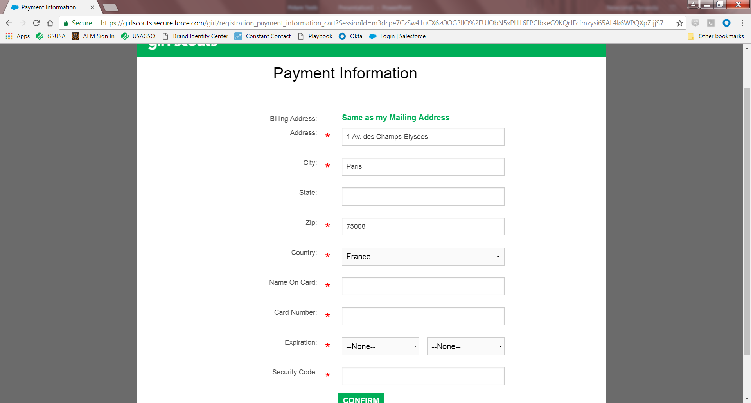
Notes:
Typical Payment Information page. The only thing to keep in mind with this page is that if your billing address is tied to an address in the United States, you will need to enter a “State”. Do to a system quirk, you may need to enter your state a second time after selecting the United States as your country. We have put in a request to stop this double entry, and hope to have it completed in the near future.

Slide 15
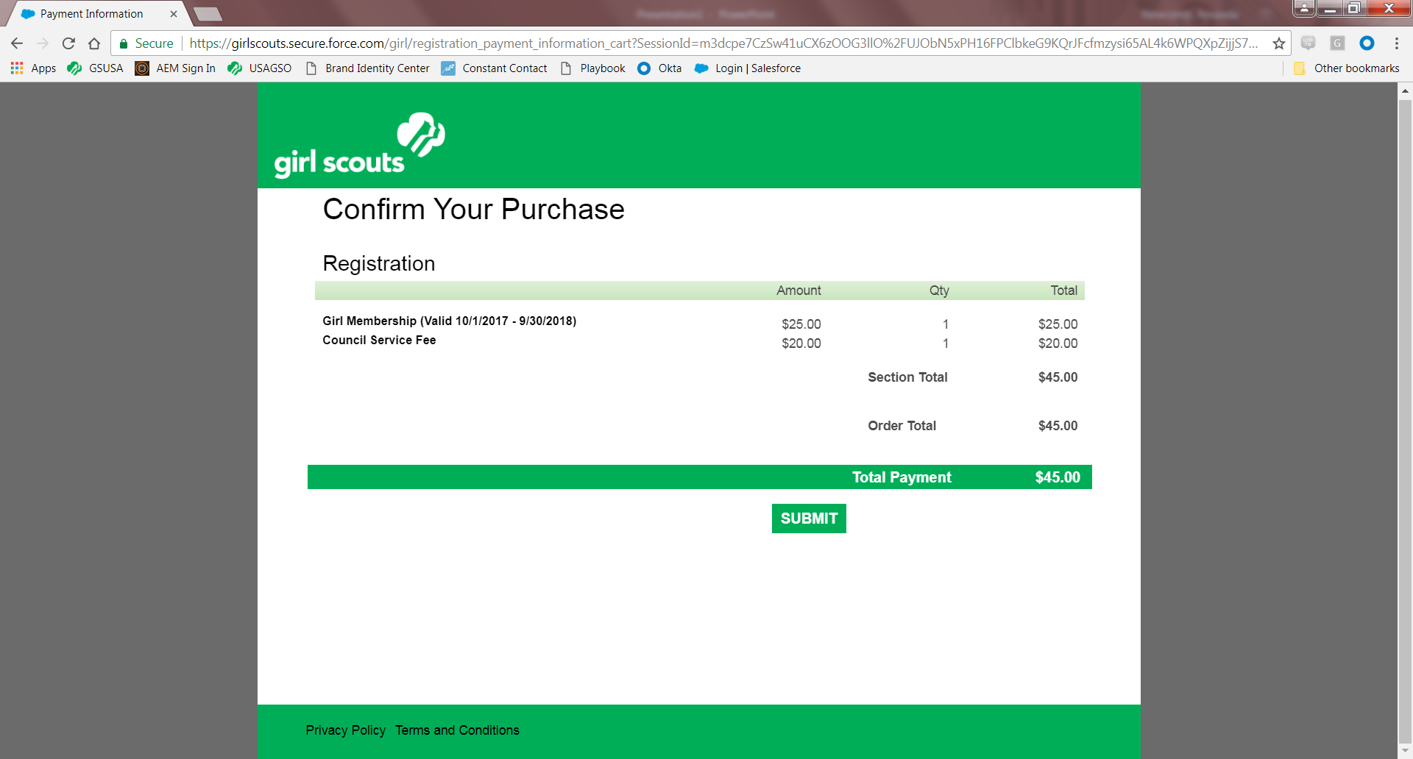

Slide 16
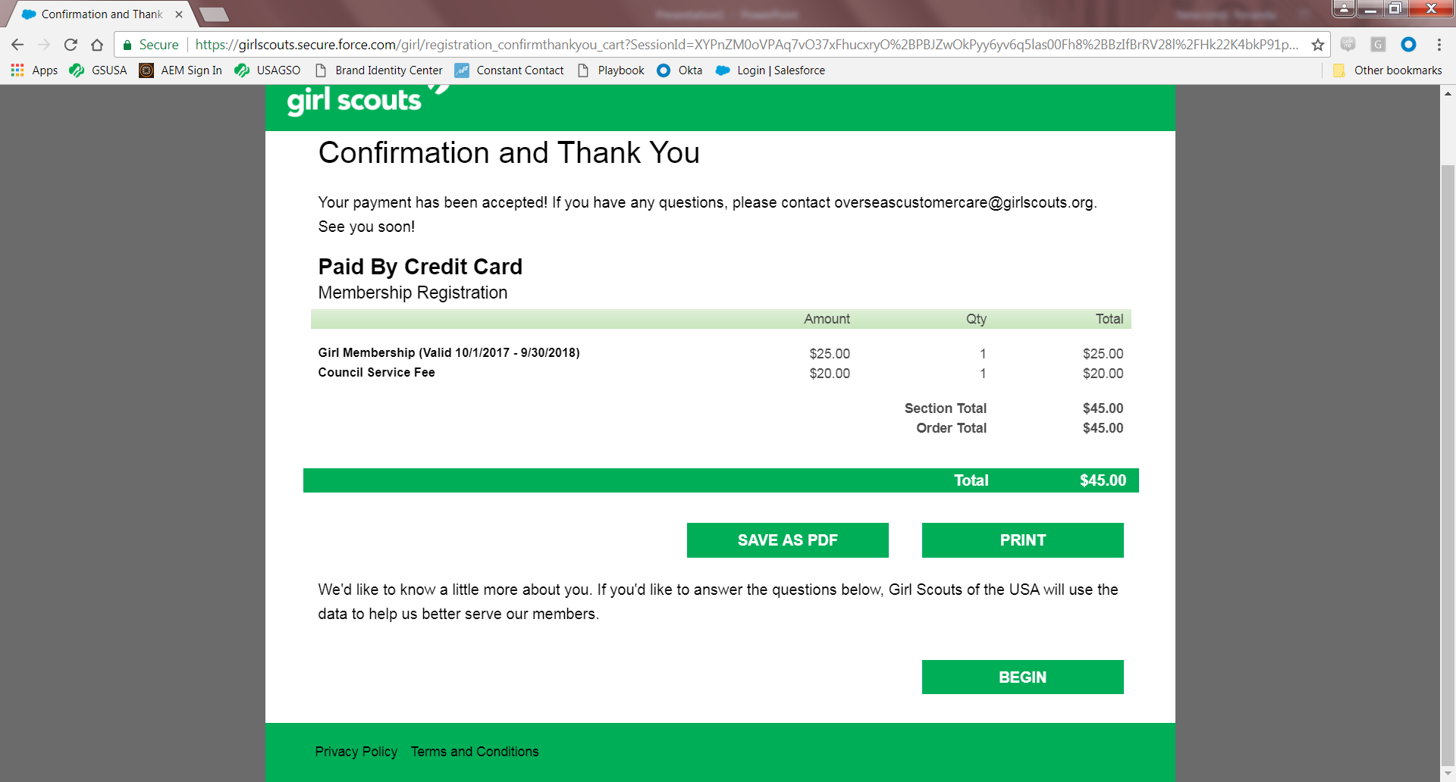
Notes:
You will receive email confirmation of your membership. If you find that you cannot select “Save As PDF”, make sure your popup blocker is turned off. The BEGIN link on this page takes you to another survey. You do not need to complete it.

Slide 17
Volunteer Registration Flow- USAGSO
Notes:
The Volunteer Flow is very similar to the Girl Registration Flow.

Slide 18

Notes:
Again, you will select your country and city.

Slide 19
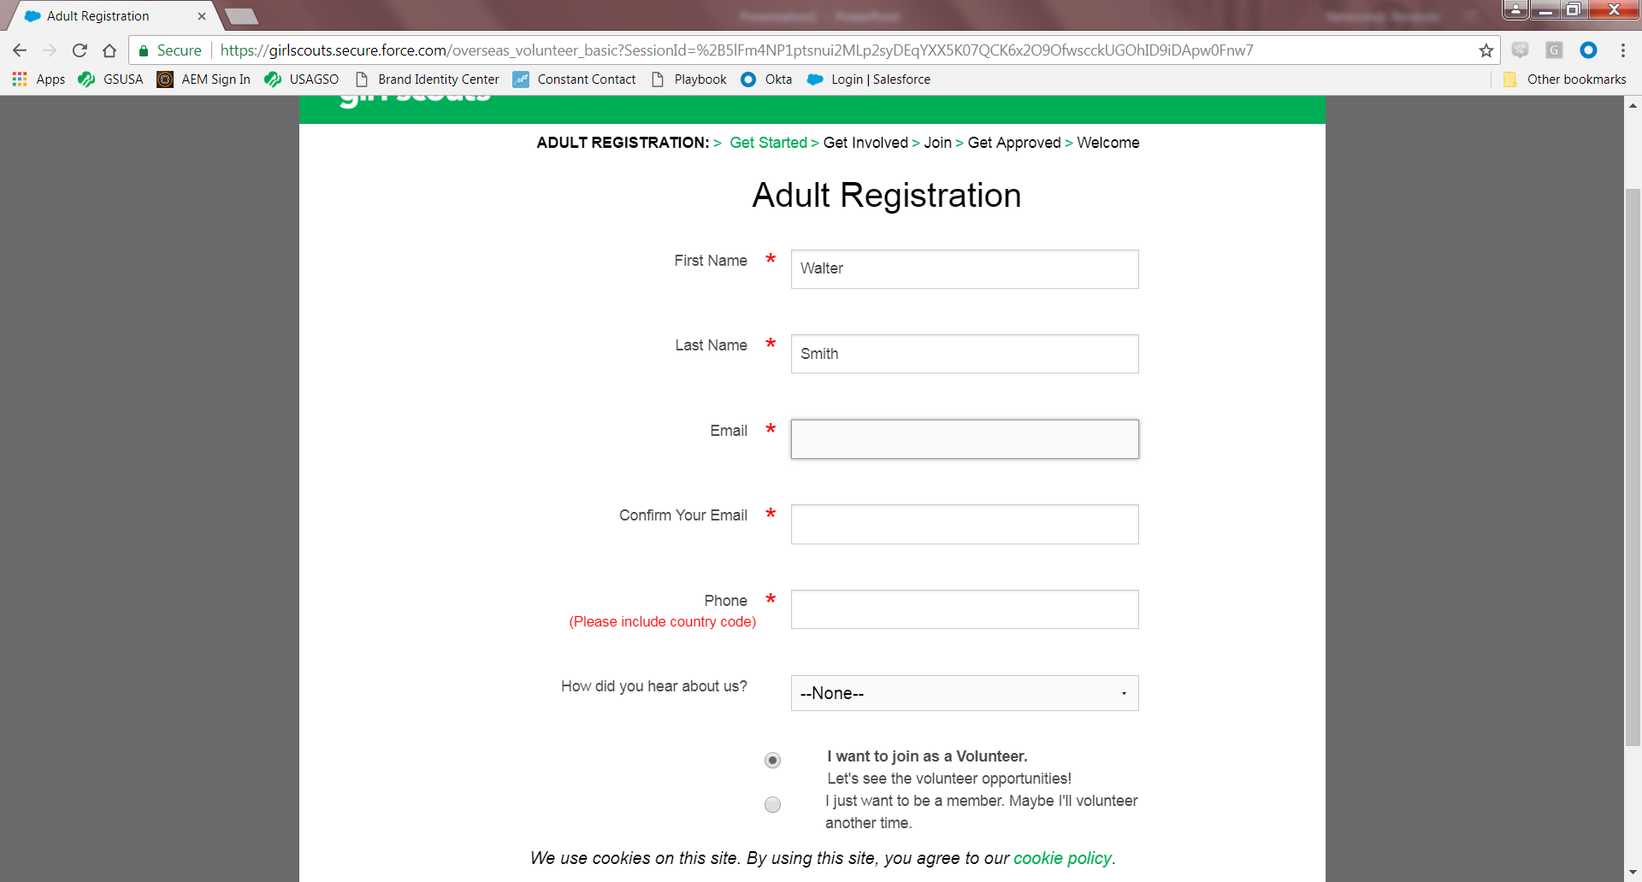
Notes:
You will need to enter your email. For adult registration, you will have the option to join as a volunteer or just join as a member. If you join as a member, you will be able to enter a troop number in order to be associated to that troop. If you do not know the troop information, you can leave it blank.
If you select, “I want to join as a Volunteer”, you will see the volunteer opportunities in the Opportunity Catalog.

Slide 20
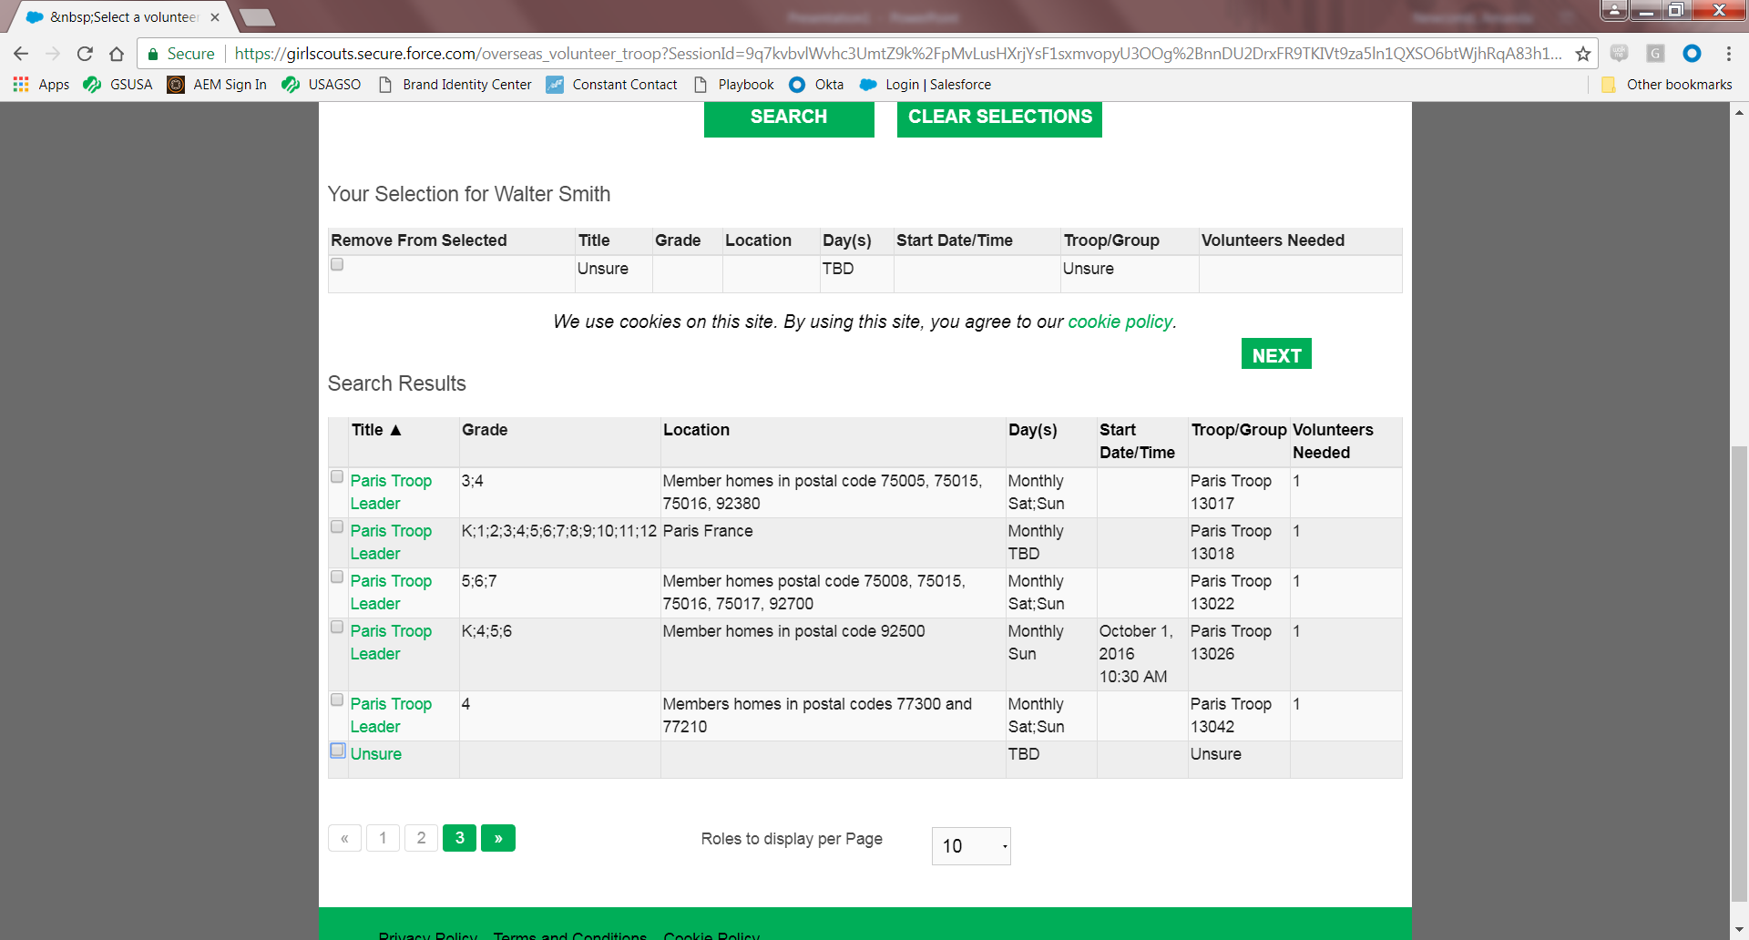
Notes:
This is the volunteer opportunity catalog for Paris. You can see how many volunteers are needed for each opportunity under the “Volunteers Needed” column.
In the volunteer opportunity catalog, you will always be able to select “Unsure” or Community Volunteer. For troop opportunities, you can select troop leader or Family & Friends Volunteer.

Slide 21
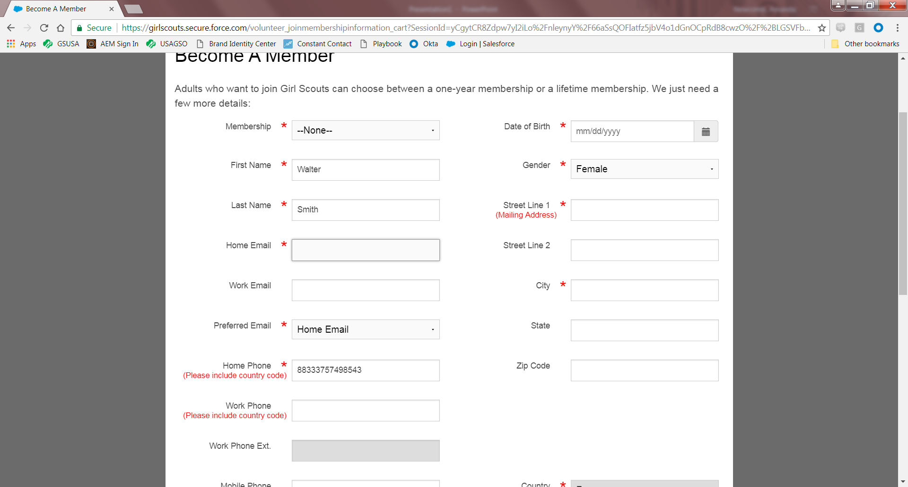
Notes:
After selecting your volunteer opportunity, you can then enter your contact information. You will then process through the same payment process as you did through the girl registration process detailed above.

