Slide 1
OCMT Year- End Financials

Slide 2
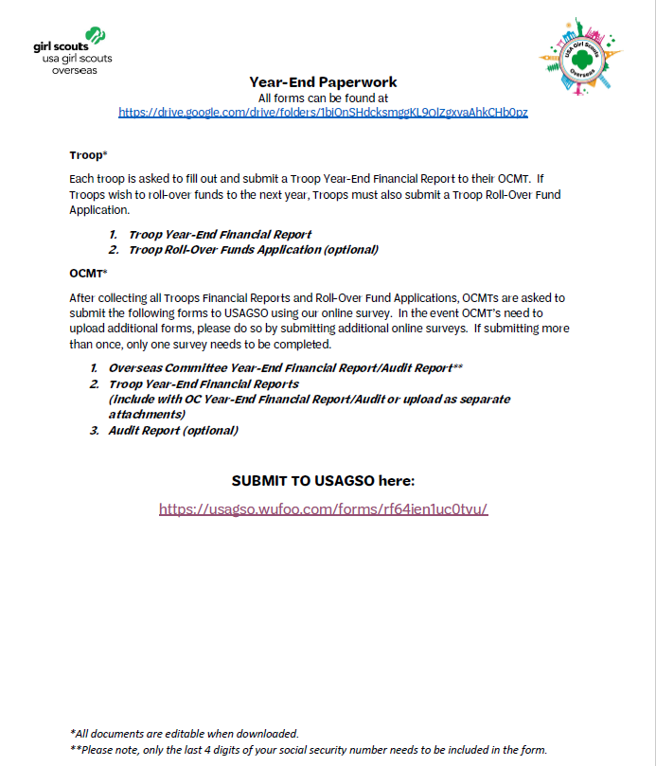
What is the Year End Report??
Each troop and OCMT are required to submit a financial report once a year that accounts for the income and expenses of the troops and OCMT.
The year end report covers the period from June 1 (of the previous Girl Scout year) through May 30 (of the current Girl Scout year) and is submitted to the Membership Managers NLT June 30th each year.
Troops submit Troop Year-End Financial Report, Rollover Application and Supporting Documents to their OCMTs.
OCMTs submit OCMT Financial Report/Audit Form, Troop Financials and rollover applications and Supporting Documents (bank statements) through Wufoo, and complete the End of Year Survey .
Notes:
The Financial Year End report is the annual financial report required of all troops and OCMTs. It accounts for all financial transactions within the troops, and ensures transparency with the troops, OCMTs, and USAGSO. You will used your bank statements, ledgers, and saved receipts to complete it.
The report covers June 1st until May 30^{th a}nd is due to your assigned Membership Managers no later than June 30th each year. If your troop (or OCMT) has funds left over greater than $500, you will need to fill out a Rollover Application (which we will discuss in this training), and submit with your Year End Financial report.

Slide 3
Who’s responsible for the Year End Report?
Troops submit Year-End Financials to their OCMT
OCMT Treasurer puts them together and submits to Membership Manager at USAGSO.
USAGSO reviews and submits the Year-End Financials to the Finance Manager.
Notes:
Let’s begin with a quick overview of the roles of everyone involved with Year End Financials.
Troop Leaders will submit their TROOP Year End Financials to the OCMT Treasurer. The OCMT Treasurer consolidates the financials, and submits them in one packet to their assigned Membership Manager. The Membership Manager reviews that all necessary components are submitted, and that there’s no need for additional reporting. It is then submitted to the USAGSO Finance Manager.

Slide 4
WHERE?
All forms can be found on usagso.org > Volunteers > Forms and Documents > Annual Financial Reporting
Google Drive

Slide 5
WHEN?
OCMT submits all documentation by June 30th 2021. To request an extension, please contact your Membership Manager.

Slide 6
OVERVIEW?
Financial reports document troop income and expenses between June 1st 2020 to May 30th 2021
Income and expenses should be tracked by the troop treasurer on a regular basis
If your troop submits a Rollover application – please specify how the funds will be used and when you plan on using them
Submit your OCMT Year-End financial forms through Wufoo and complete the EOY survey.

Slide 7
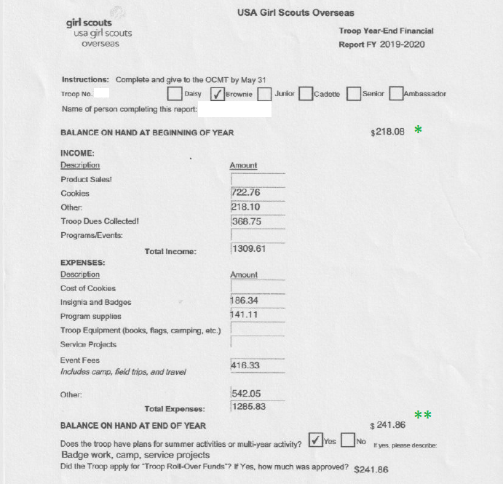
Notes:
In the troop year-end financial report, you will add your troop number, your age group and the name of the person completing the report.
The balance on hand at the beginning of year will be the amount you reported as end of year balance of last year.
Add all income and expenses for your troop. You will find the balance on hand at end of year by adding the balance on hand at beginning of year to the total income and subtracting the total expenses.
At this point you will need to select if you plan on having summer activities, and if you have applied to a troop rollover. If you do, you will need to complete the troop rollover application, which will be submitted with your Troop Year-End Financial Report.

Slide 8
Notes:
If your troop has leftover funds and you would like to use them in the summer or for future projects, please fill out the troop rollover application form.

Slide 9
Notes:
Make sure to add the name of your OC, the name of the OCC and their signature for approval.
This form will need to be included with the troop financial report for every troop requesting rollover funds.

Slide 10
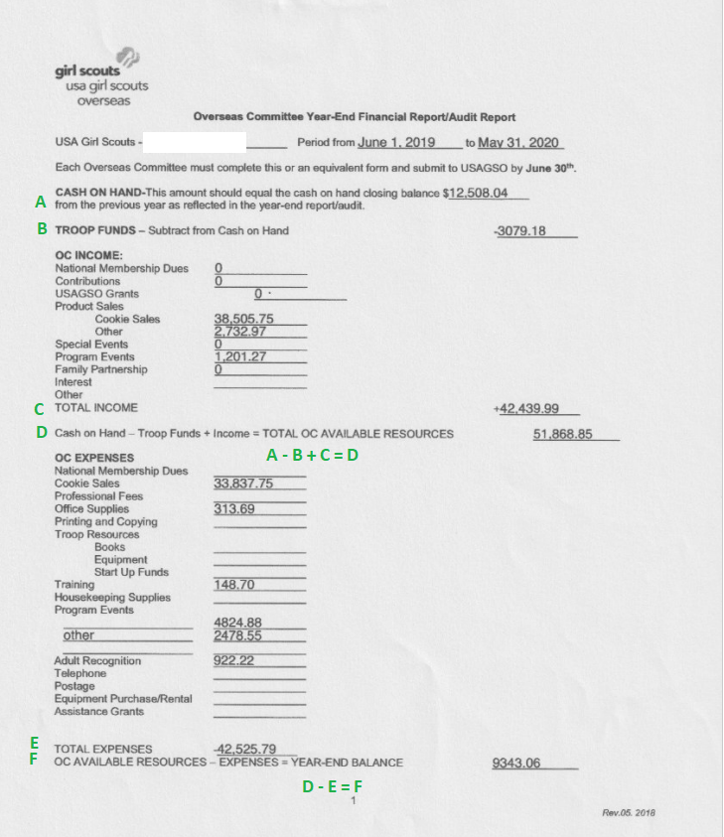
Notes:
OVERSEAS COMMITTEE YEAR-END FINANCIAL REPORT/AUDIT FORM
We will now show you how to complete the overseas committee year-end financial report and audit report. Add the name of your committee and the period which will be June 1st, 2020 to May 31st, 2021.
A -Cash on hand is the total amount you had in your bank account at the end of last year financial report.
B - troop funds is the total of funds that your troops had left last year on May 31st (from the Troop financial report, add all troop funds amount with this symbol*)
OC INCOME: add here everything that you have earned during this year
C - total income just adds up all the income reported
D - TOTAL OC AVAILABLE RESOURCES is calculated by A – B + C (cash on hand – troop funds + total income)
OC EXPENSES: enter here all expenses from June 1st to May 31st and then add them up in:
E - TOTAL EXPENSES
F - YEAR-END BALANCE is calculated by D – E (total OC available resources – total expenses)

Slide 11
Notes:
G - TROOP FUNDS is the sum of all troops’ year-end balance on May 31st, 2021 (**)
H - CASH ON HAND will be the addition of G + F (troop funds and Year-End balance)
The final CASH ON HAND (H) will be the amount that you have right now in your bank account.
On STATUS OF FUNDS STATEMENT, you will add the cash on hand amount that is your bank account, please also add the name of your financial institution and the account number.
Please add month, day, and year that this report was completed, add names of the members that prepared this report and the last four digits of your Social Security number.
Please also indicate how many signatures are required to draw a check or make a withdrawal from the account.
Sign and date.
All communities handling more than $1000 will need to have the STATEMENT OF AUDITOR signed and dated by a third party (could be a parent for example).

Slide 12
SUBMIT DOCUMENTS
Once the OCMT has collected all troops financial reports and roll-over applications, and completed the Overseas Committee Year-End Financial Report-Audit Report, please go to Wufoo form OCMT Year-End Survey 2021, add all documentation and complete the survey.

Slide 13
Q&A
My community has more supporting documents then can fit on the Wufoo form. How do I submit these?
Please fill out the Wufoo form a second time and attached the additional supporting documents. You do not need to fill out the survey questions a second time.
Do I have to put my social security number on the Overseas Committee Year End Report?
Only the last 4 digits of your social security number are required.
Do troop finances need to be submitted to USA Girl Scouts Overseas?
No, troop finances should be submitted to the Overseas Committee Management Team.
My community only handled 750.00 dollars do we need to fill out the Overseas Committee Year End Reporting form and submit to USAGSO?
Yes, all Overseas Committee Management Teams need to complete the year end reporting form and submit it to USAGSO. Only communities who handled more than $1000 dollars during the Girl Scout year need to complete the audit.

Slide 14
Q&A
How can our troop and community spend our funds?
Review our guidance here (link document).
How much money can my community roll over from year to year?
Ideally funds should be spent in the year earned. Communities should not hold more than $50.00 per girl year over year. However, we know some troops or communities have long term plans for their funds, like a summer camporee and those situations will be evaluated on a community by community basis.
Who should complete my community’s financial audit?
Ask a parent or another volunteer that is not a member of the OCMT to review the financials and sign off that they have reviewed and believe the finances to be accurate.

